Slide 1
ChatGPT & The Debate Carousel
Content & Pedagogical Strategies

Slide 2
Supplies
Debate Carousel Sheets #1 and #2
Pencils/Pens
(A possible Demo of ChatGPT for those who might not know?)

Slide 3
The Debate Carousel
Reflect on the written statement.
In a group of four, each person will start by writing a supporting argument in Box 1 – no matter what your opinion is.
Pass to the right.
Read the information on the paper you receive.
Add another supporting argument (different from the one on the paper) in Box 2.
Pass to the right.
Read the information on the paper you receive.
Add an opposing argument in Box 3 - no matter what your opinion is!
Pass to the right.
Read the information on the paper you receive.
Write your final opinion and reason!
Debrief with your group.

Slide 4
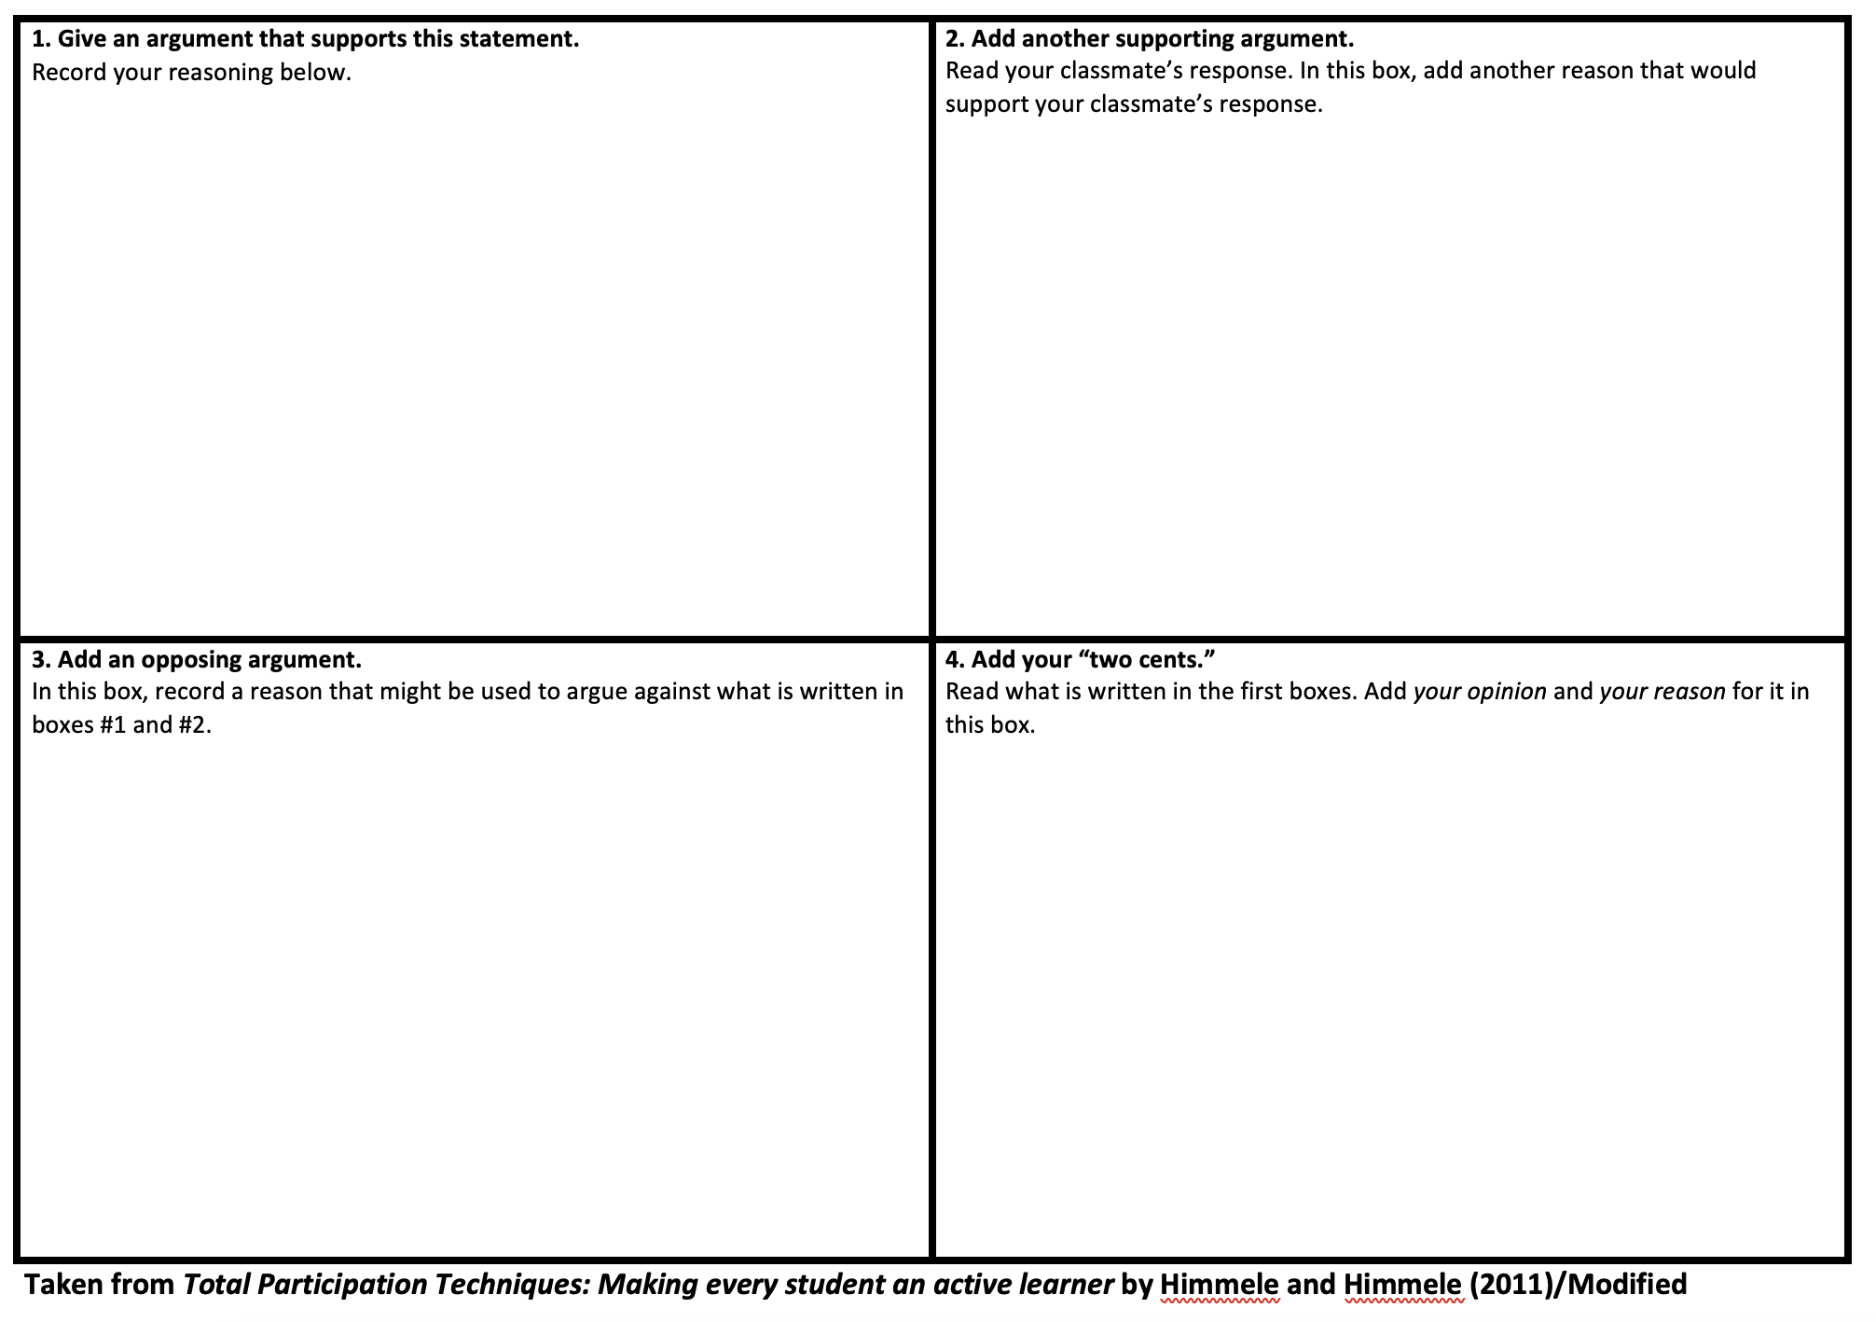

Slide 5
Carousel #1 - ChatGPT
ChatGPT is a language model developed by OpenAI, based on the GPT (Generative Pre-trained Transformer) architecture. GPT models are designed to understand and generate human-like text based on the input they receive. ChatGPT, specifically, is fine-tuned for generating conversational responses and engaging in interactive text-based conversations.
The model is trained on a vast amount of text data from the internet, which enables it to learn grammar, context, facts, and even some reasoning abilities. It doesn't just provide predefined responses but generates text based on patterns it has learned during training. This makes ChatGPT capable of answering questions, providing explanations, generating creative content, offering suggestions, and more, all in a conversational manner.

Slide 6
Carousel #2 – CS Integration

