Slide 1
Match Mine
CS Unplugged Activity – Routing & Deadlock

Slide 2
Supplies
Folder
Blank sheets
Pencil
Match Mine images
Folder as a divider

Slide 3
Getting Started
Each participant gets a folder with a blank sheet of paper, a secret image, and a pencil. Keep your secret image face down and do not discuss it with your partner or with other pairs. Stand your folder upright to keep the area in front of you private.
Designate one partner to be the “director” and the other to be the “artist.” The artist should keep their secret image face down, and the director should look (privately) at theirs.

Slide 4
Game Rules
The director gives verbal instructions to the artist to replicate the picture on their paper. The director can't see the artist’s paper, and the artist can't ask any questions. The director’s directions should only describe shapes, distances, and other geometric information. The artist may request that the director repeat their last instruction.
Allowed: “Draw a wobbly oval about halfway down the page to the left of the line you just drew. The oval should be longer than it is taller.”
Not Allowed: “Draw an arm shape coming out of the circle.”
This is about clear communication and precise instructions!

Slide 5

Debrief & Discussion – Part 1
How did you approach your role (director or artist)?
What challenges did you run into? What worked well?
What were you looking for from your partner?
How would you approach this problem if you were to do it again?

Slide 6
Debrief & Discussion – Part 1
How did you approach your role (director or artist)?
What challenges did you run into? What worked well?
What were you looking for from your partner?
How would you approach this problem if you were to do it again?
Great news – let’s do it again!
Swap roles and repeat.

Slide 7
Debrief & Discussion – Part 2
How did you approach your role (director or artist)?
What challenges did you run into? What worked well?
What were you looking for from your partner?
How would you approach this problem if you were to do it again?
Bonus: Was this computer science?

Slide 8
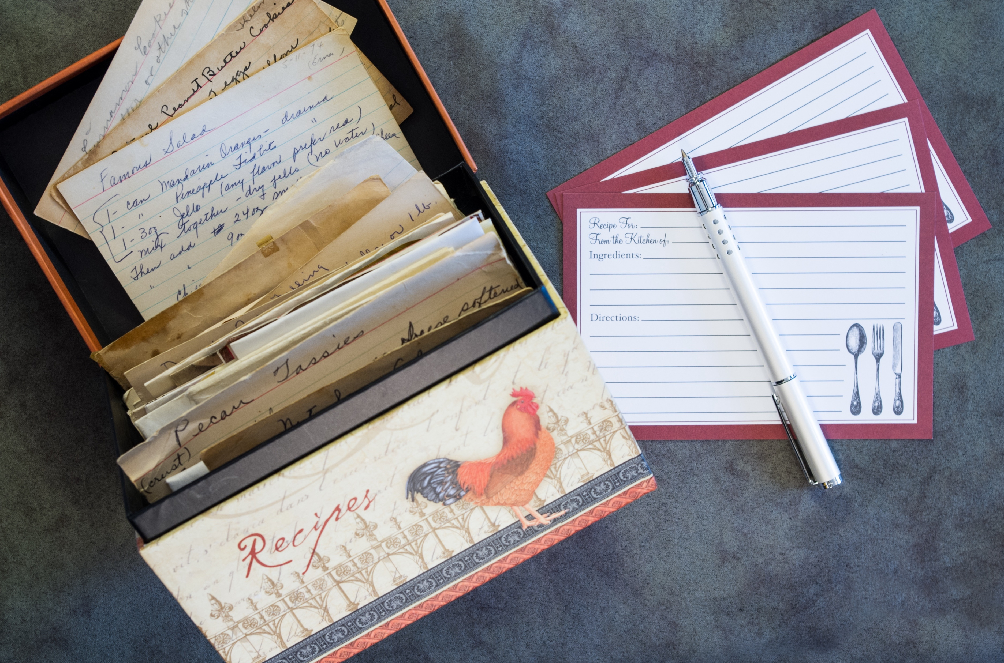
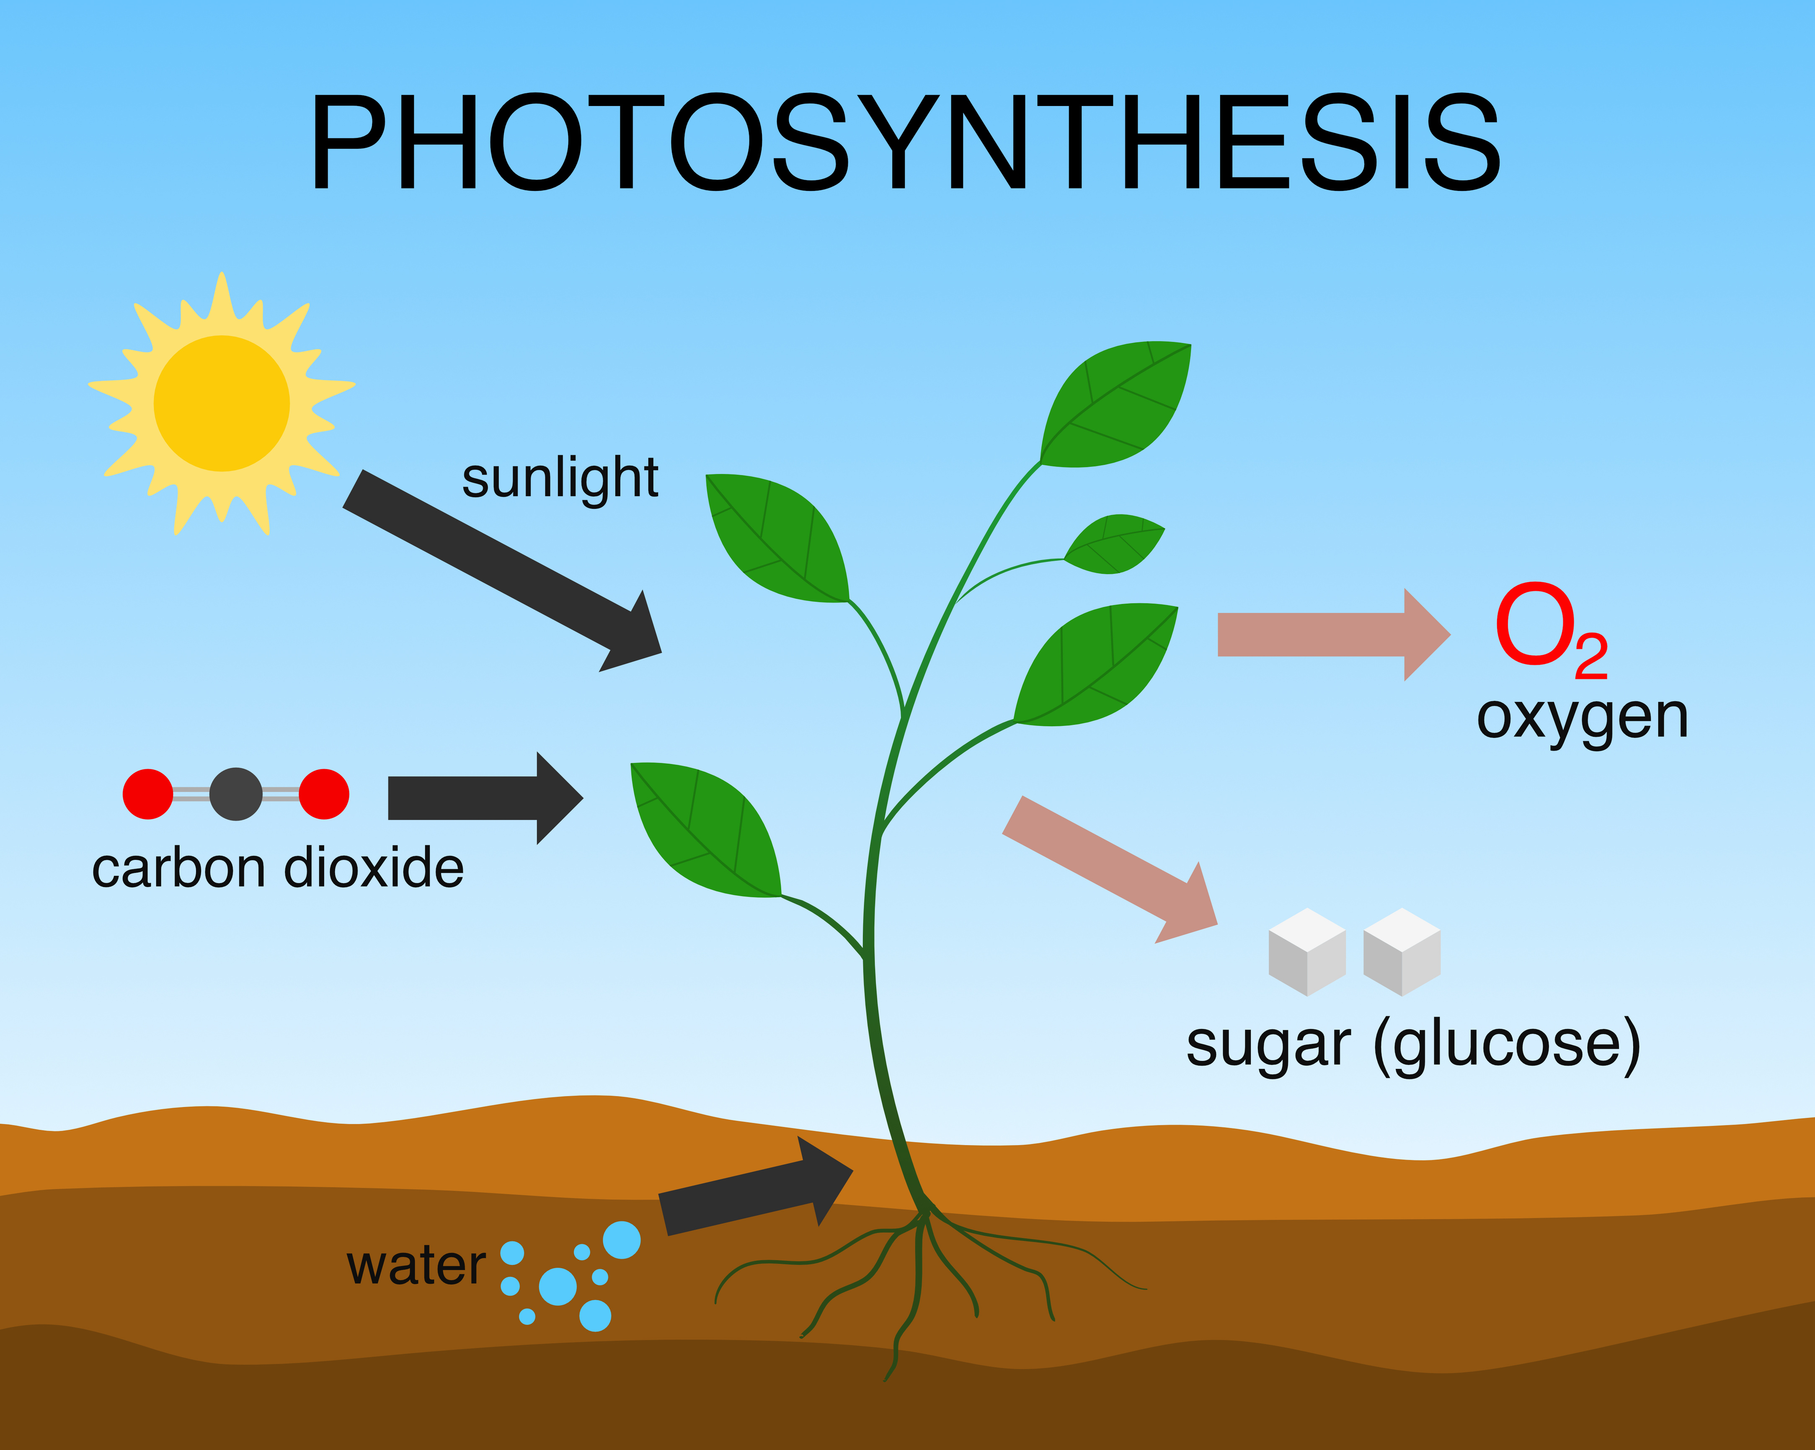
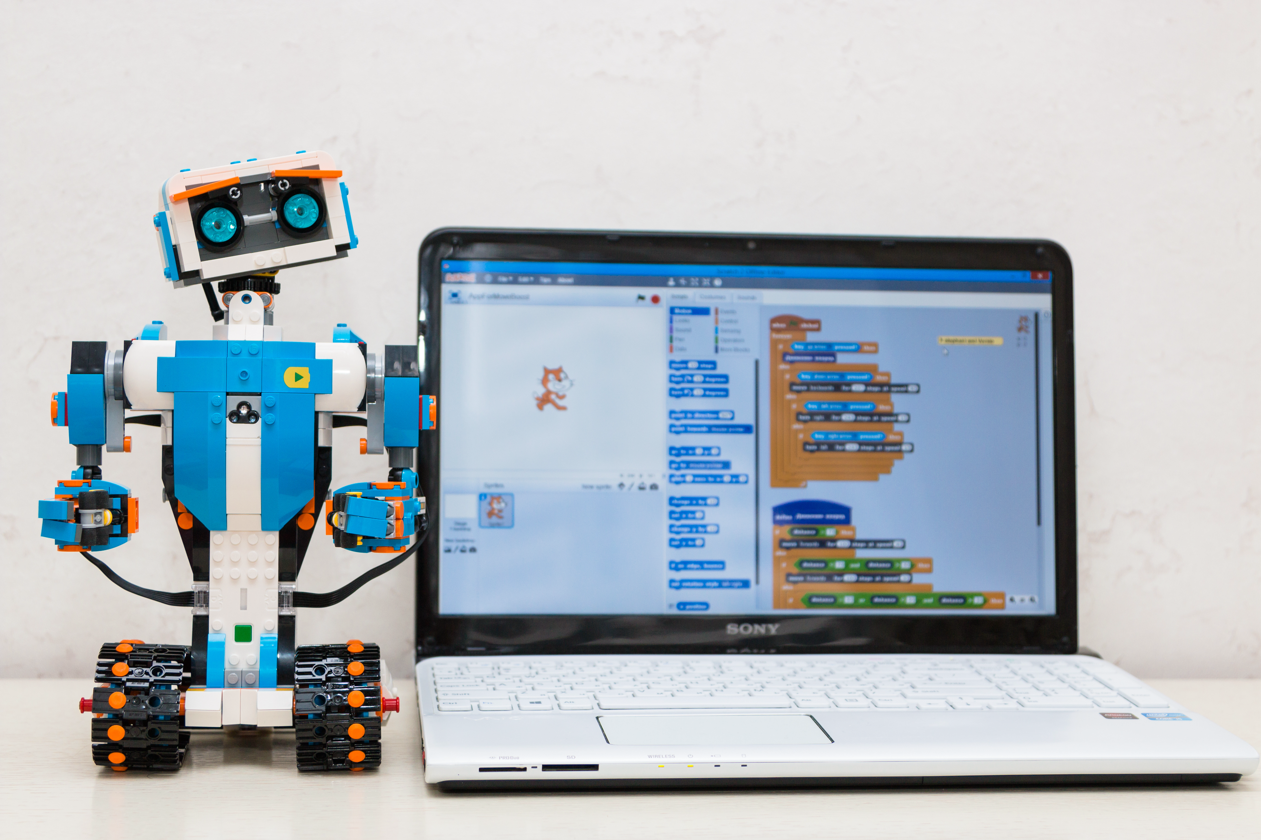
Debrief & Discussion
Key Concepts: Algorithms, Communication, Precision
Algorithms involve a series of steps that must be followed precisely to achieve a desired outcome.
Everyday tasks, such as cooking from a recipe or assembling furniture, require following a series of steps, much like an algorithm. Clear and precise instructions are crucial to successfully completing the task.

Slide 9
Extending the Learning
How might the process change if you had to give instructions for a more complex drawing?
What strategies can you use to make your instructions clearer and more precise?
Debugging Activity: Participants are given a set of instructions with deliberate mistakes or ambiguities and are asked to identify and correct them. This activity helps develop critical thinking and problem-solving skills.
Flowchart Activity: Participants create flowcharts for simple processes or problems, helping them to visualize and understand the flow of an algorithm.

