Slide 1
The Orange Game
CS Unplugged Activity – Routing & Deadlock

Slide 2

The Orange Game
duck
CS Unplugged Activity – Routing & Deadlock

Slide 3
Supplies
Name tag
Ducks
Houses

Slide 4
Getting Started
Take a pair of ducks with the same color from your group’s set. Write the color of your ducks on your nametag and place it on your shirt so others can easily see your color.
Place all the ducks in the center of the table. Then, each player takes two ducks from the center – they must be two different colors, and neither can be their original color.
Hold one duck in each hand. Randomly select one member from your group to place one of their ducks in the center of the table, this duck is removed from play.

Slide 5
Game Rules
Pass the ducks around the table, one pass at a time, until all players have their colored ducks. The player whose duck is out of play will end with only one duck.
Only one duck can be held in a hand, and a duck can be passed to either empty hand of a direct neighbor.

Slide 6
Game Rules
Pass the ducks around the table, one pass at a time, until all players have their colored ducks. The player whose duck is out of play will end with only one duck.
Only one duck can be held in a hand, and a duck can be passed to either empty hand of a direct neighbor.
That’s it – GO!
This is about group problem solving – communication is key!

Slide 7

Debrief & Discussion
How did you solve this problem?
What challenges did your group run into? What worked well?
How would you approach this problem if you were to do it again?
Did you find the best solution? How do you know? If you didn’t, what might it be?
Bonus: Was this computer science?

Slide 8
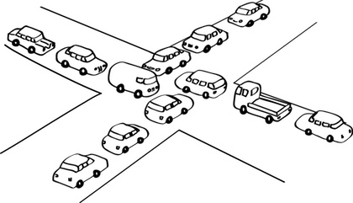
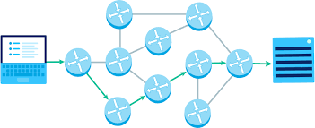
Debrief & Discussion
Key Concepts: Deadlock, Cooperative Problem Solving, Logical Reasoning
Routing and deadlock are common in many networks such as road systems, telephone and computer systems.
  Traffic congestion can lead to deadlock where no one can move their car.
  Parallel computing involves solving many problems like the Orange Game continuously to avoid deadlock in the network.

Slide 9
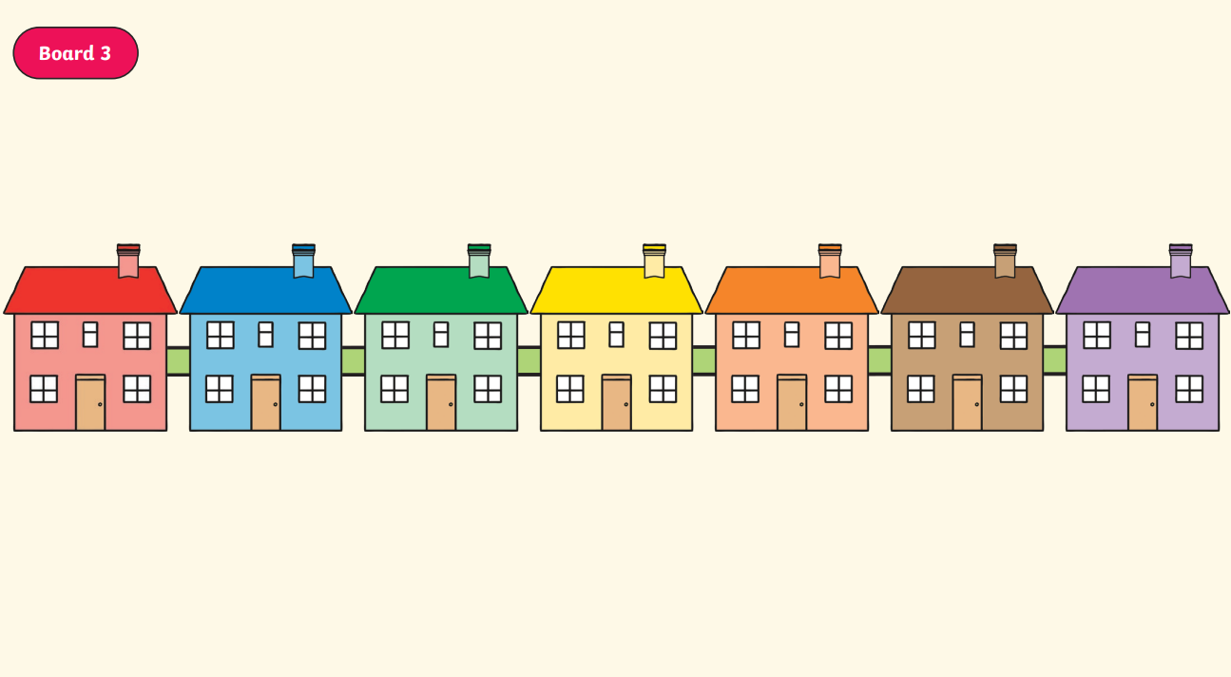
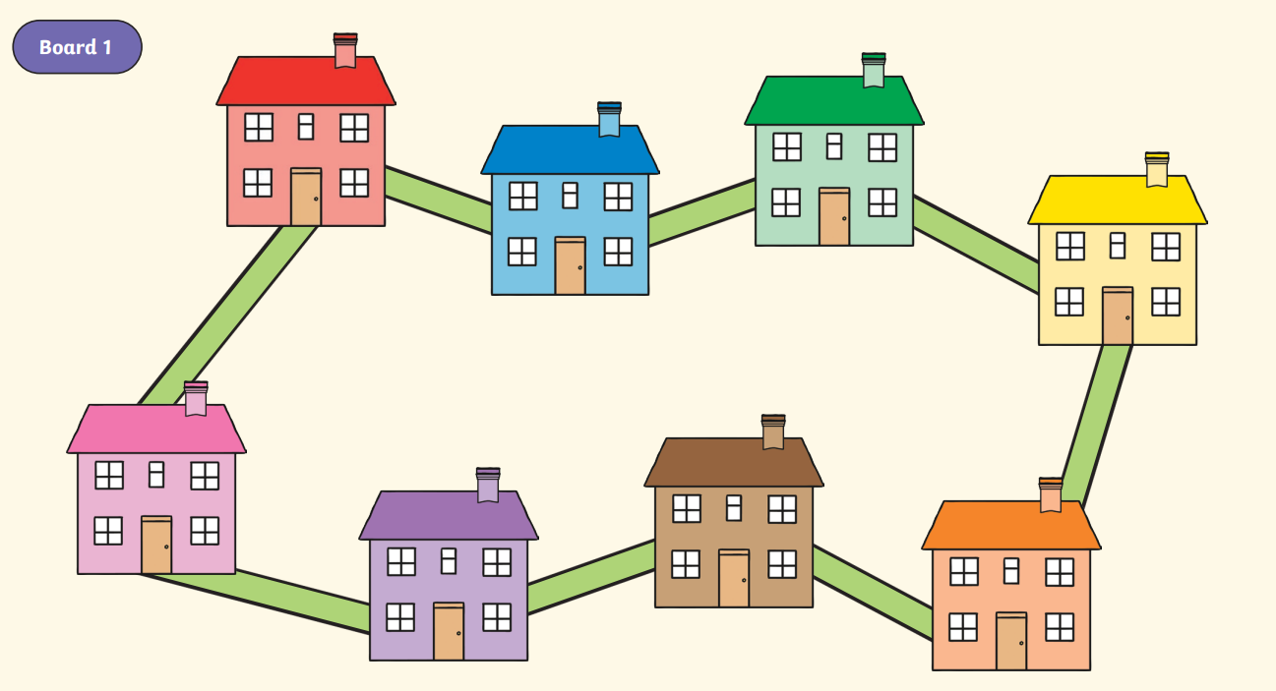
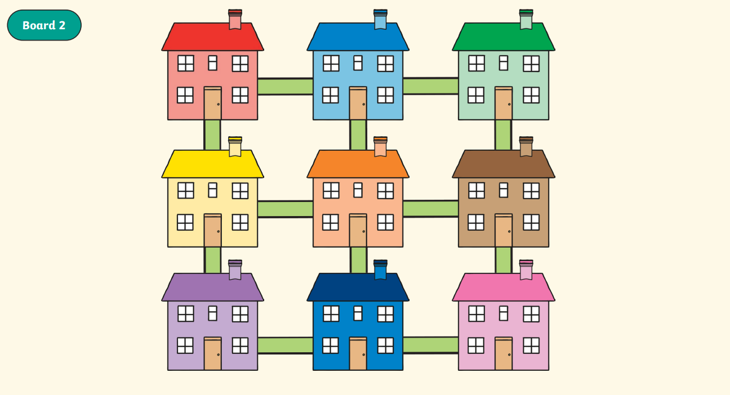
Extending the Learning
How might the process change with different numbers of people? Are there other rules that can make the game easier?
What about different configurations?

