Slide 1
Algorithms and games!

Slide 2
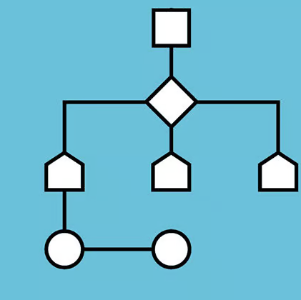
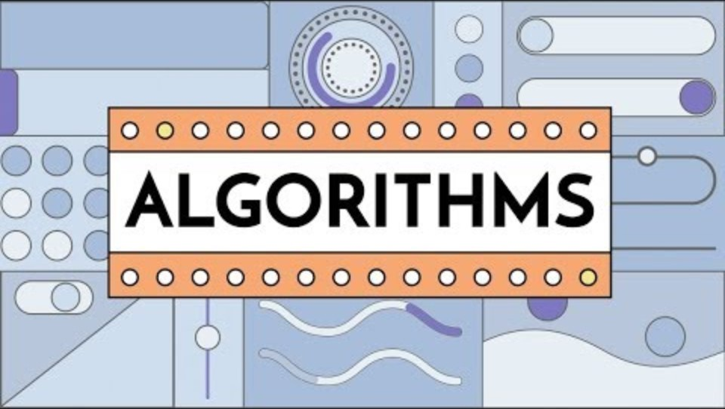
What is an Algorithm?

Slide 3
Algorithms are clear and specific
Algorithms are clear and specific so that at each step, a computer knows exactly what action it should take and what information it should use or change.

Slide 4
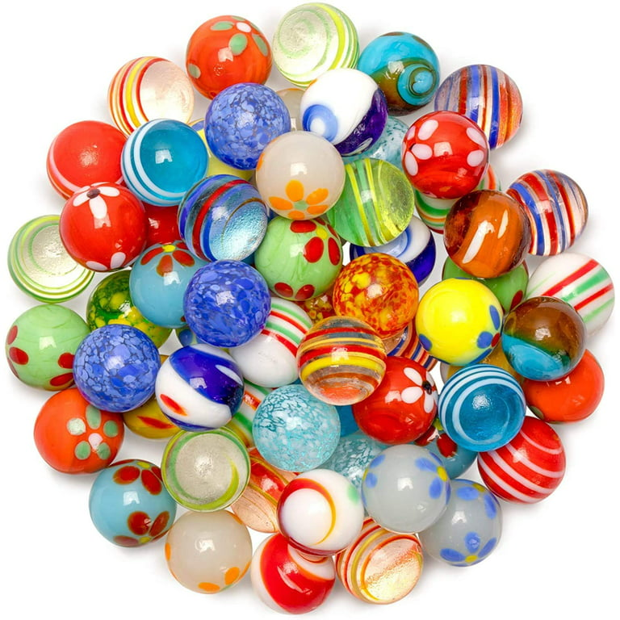
Algorithms are clear and specific
Algorithms are clear and specific so that at each step, a computer knows exactly what action it should take and what information it should use or change.
What’s wrong with these instructions? How can you make them clear and specific?
  “Put the peanut butter on the bread.”
  “Tie your shoe.”
  “Get the red marble.”

Slide 5
Algorithms are clear and specific
Algorithms are clear and specific so that at each step, a computer knows exactly what action it should take and what information it should use or change.
What’s wrong with these instructions? How can you make them clear and specific?
  “Put the peanut butter on the bread.”
  “Tie your shoe.”
  “Get the red marble.”
What can go wrong when instructions
are not clear or specific?

Slide 6
Algorithms should be accurate and efficient
Algorithms should be accurate: They should give us the right answer or complete a task correctly.

Slide 7
Algorithms should be accurate and efficient
Algorithms should be accurate: They should give us the right answer or complete a task correctly.
Algorithms should be efficient: They should not take extra time or waste resources.

Slide 8
Algorithms should be accurate and efficient
  Let n = 0
  Let m = 2
  For every pair of people in the room:
    Let n = n + 2
    Let m = m * m
  Do 10 jumping jacks
  Return n

Slide 9
Algorithms should be accurate and efficient
  Let n = 0
  Let m = 2
  For every pair of people in the room:
    Let n = n + 2
    Let m = m * m
  Do 10 jumping jacks
  Return n
What does this algorithm do?

Slide 10
Algorithms should be accurate and efficient
  Let n = 0
  Let m = 2
  For every pair of people in the room:
    Let n = n + 2
    Let m = m * m
  Do 10 jumping jacks
  Return n
What does this algorithm do?
Can we make this algorithm more accurate or efficient?

Slide 11
Algorithms are everywhere
An algorithm reflects a series of steps we take to complete a task, which we do all the time!
  Getting ready for school
  Getting to school
  Moving throughout our school day
  Getting school lunch
  Going grocery shopping

Slide 12
Algorithms are everywhere
An algorithm reflects a series of steps we take to complete a task, which we do all the time!
  Getting ready for school
  Getting to school
  Moving throughout our school day
  Getting school lunch
  Going grocery shopping
Let’s think: What other algorithms do you encounter?

Slide 13

Describe the steps of an algorithm you Followed so far today
45-Second Round Robin
(at your table!)

Slide 14
Flowcharts describe algorithms
A flowchart visually explains a series of steps. We can use them to visually represent an algorithm.

Slide 15
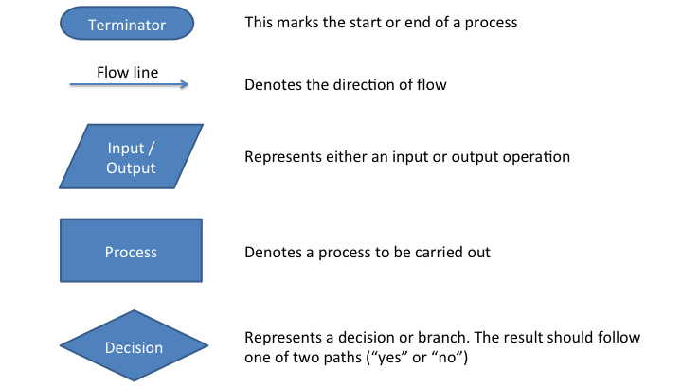
Flowcharts describe algorithms
A flowchart visually explains a series of steps. We can use them to visually represent an algorithm.

Slide 16
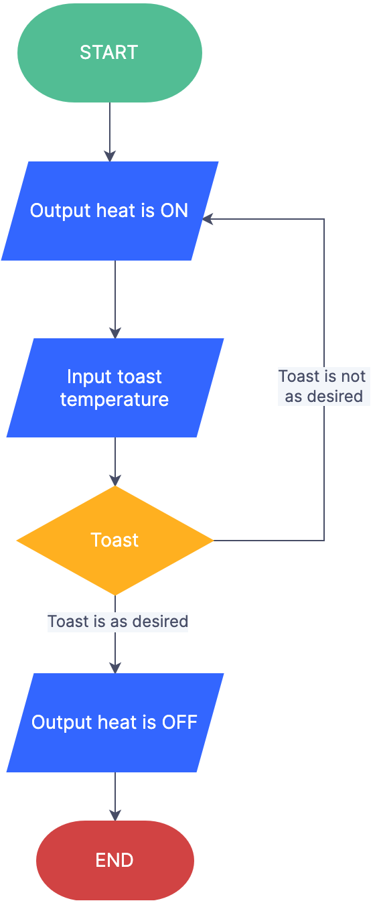
Flowcharts describe algorithms
A flowchart visually explains a series of steps. We can use them to visually represent an algorithm.
Toasted?

Slide 17
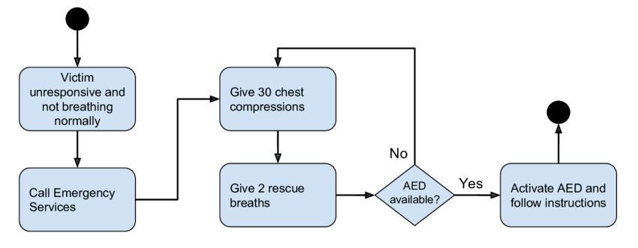
Flowcharts describe algorithms
A flowchart visually explains a series of steps. We can use them to visually represent an algorithm.

Slide 18
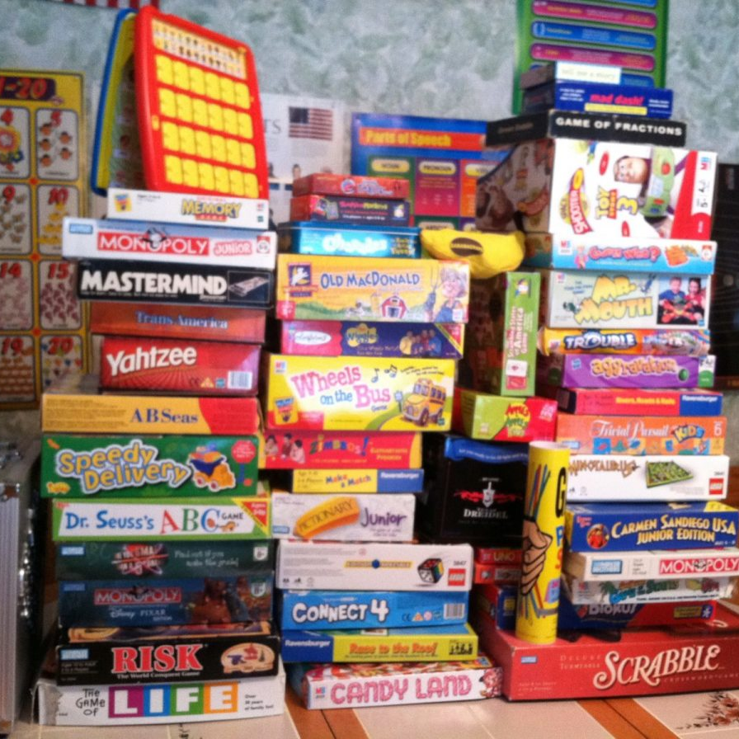
Games follow algorithms too!

Slide 19
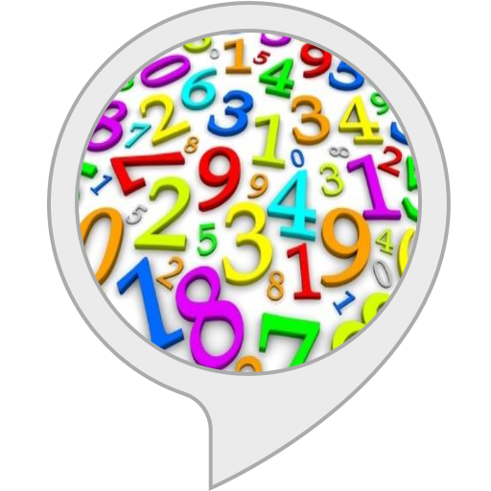
A Simple Game
Guess the Number
This game is for two players. Player 1 selects a secret number between 1 and 100. Player 2 tries to guess it. After each guess, the Player 1 says “correct” or “incorrect.” If Player 2’s guess is incorrect, they guess again until they correctly guess the number.
Can we write the algorithm for Player 2 to play this game?

Slide 20
A Simple Game
Guess the Number
This game is for two players. Player 1 selects a secret number between 1 and 100. Player 2 tries to guess it. After each guess, the Player 1 says “correct” or “incorrect.” If Player 2’s guess is incorrect, they guess again until they correctly guess the number.
Let x = 1
Repeat forever:
  Guess x
  If x is correct
    Stop! You win!
  Else
    Increase x by 1

Slide 21
A Simple Game
Guess the Number
This game is for two players. Player 1 selects a secret number between 1 and 100. Player 2 tries to guess it. After each guess, the Player 1 says “correct” or “incorrect.” If Player 2’s guess is incorrect, they guess again until they correctly guess the number.
Draw flowchart here:

Slide 22
A Simple Game
Guess the Number
This game is for two players. Player 1 selects a secret number between 1 and 100. Player 2 tries to guess it. After each guess, the Player 1 says “correct,” “too high,” or “too low.” If Player 2’s guess is incorrect, they guess again until they correctly guess the number.
Let’s discuss!
Do these new instructions change the algorithm for Player 2?
Will it take longer for Player 2 to win the game?
With these rules, is the algorithm to guess the correct number more efficient? Why?

Slide 23
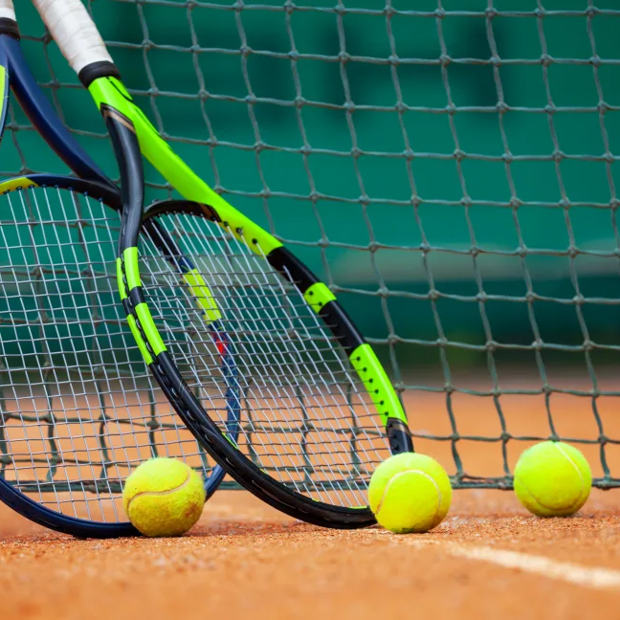
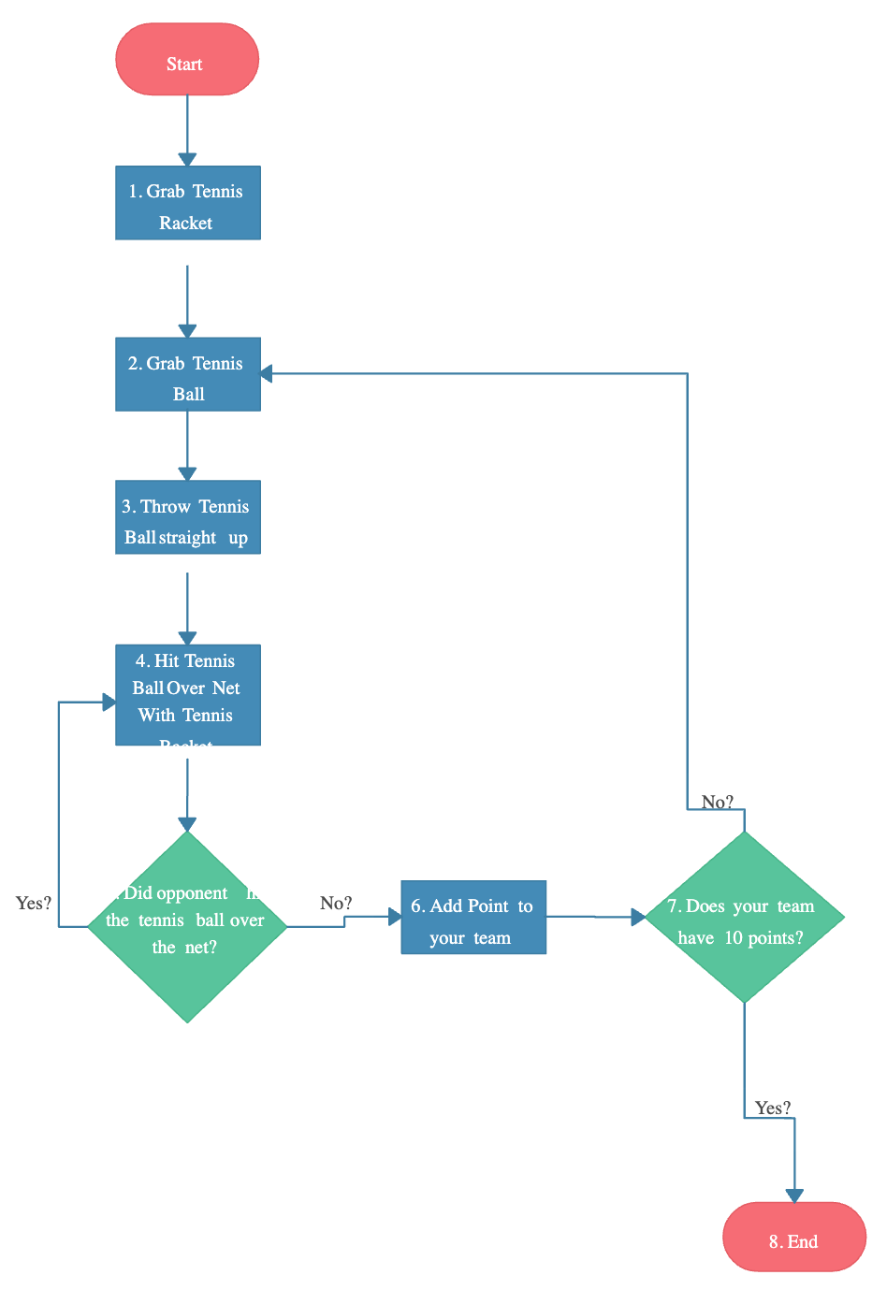
Algorithms in SPORTS

Slide 24
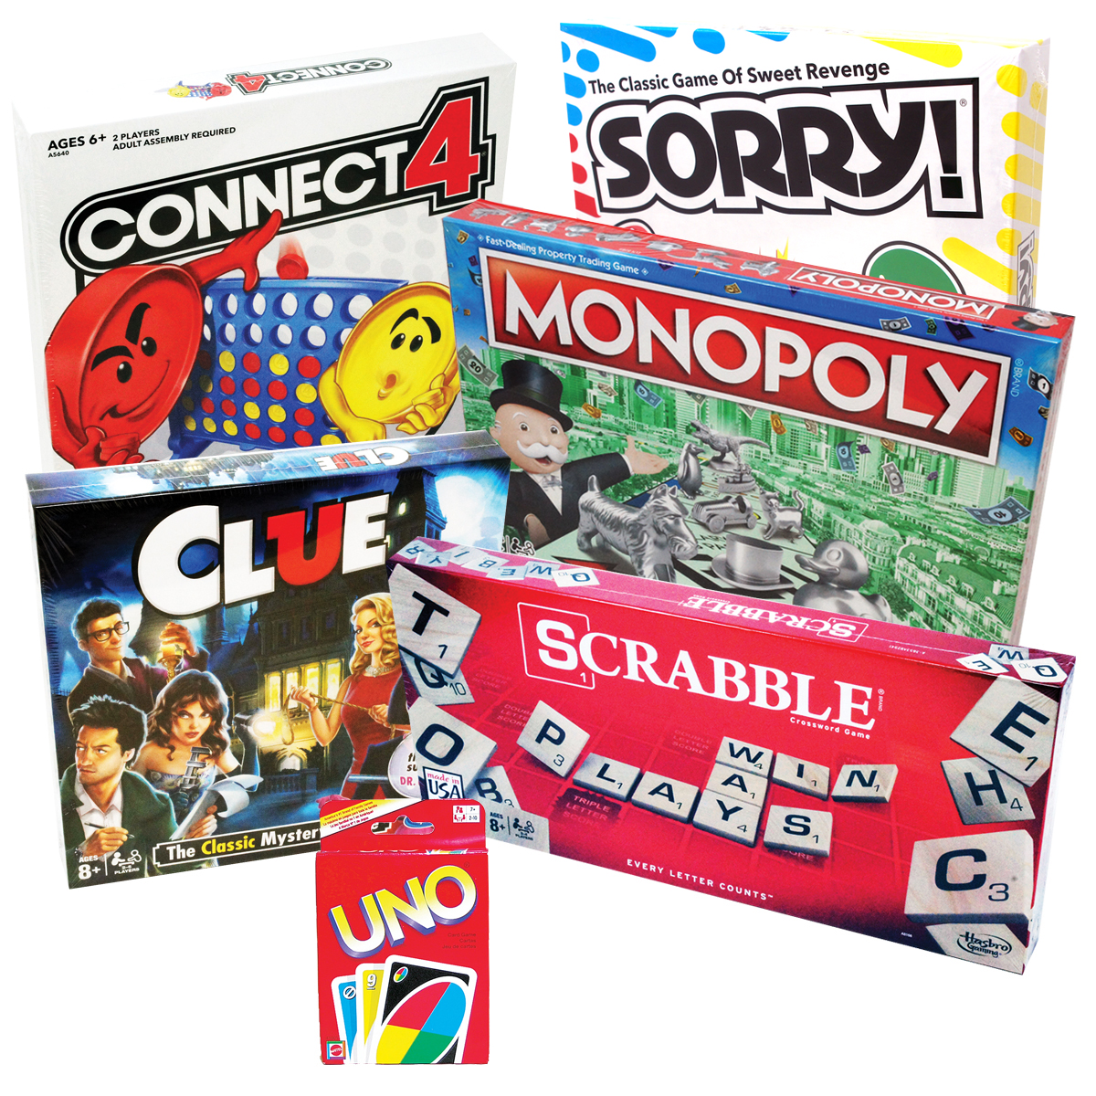
Your Turn.
At your tables, create a flowchart to describe the rules of a board game of your choice.
Break the game into subtasks. Draw flowchart to describe solution.
Use posters or draw.io to create your flowcharts.
Notes:
http://www.boardgamecentral.com/rules/
Game of your choice
Trouble https://www.hasbro.com/common/instruct/trouble.pdf
Sorry https://www.hasbro.com/common/instruct/Sorry.PDF

Slide 25
Create a flowchart for the algorithm of a simple game
Table Work

Slide 26
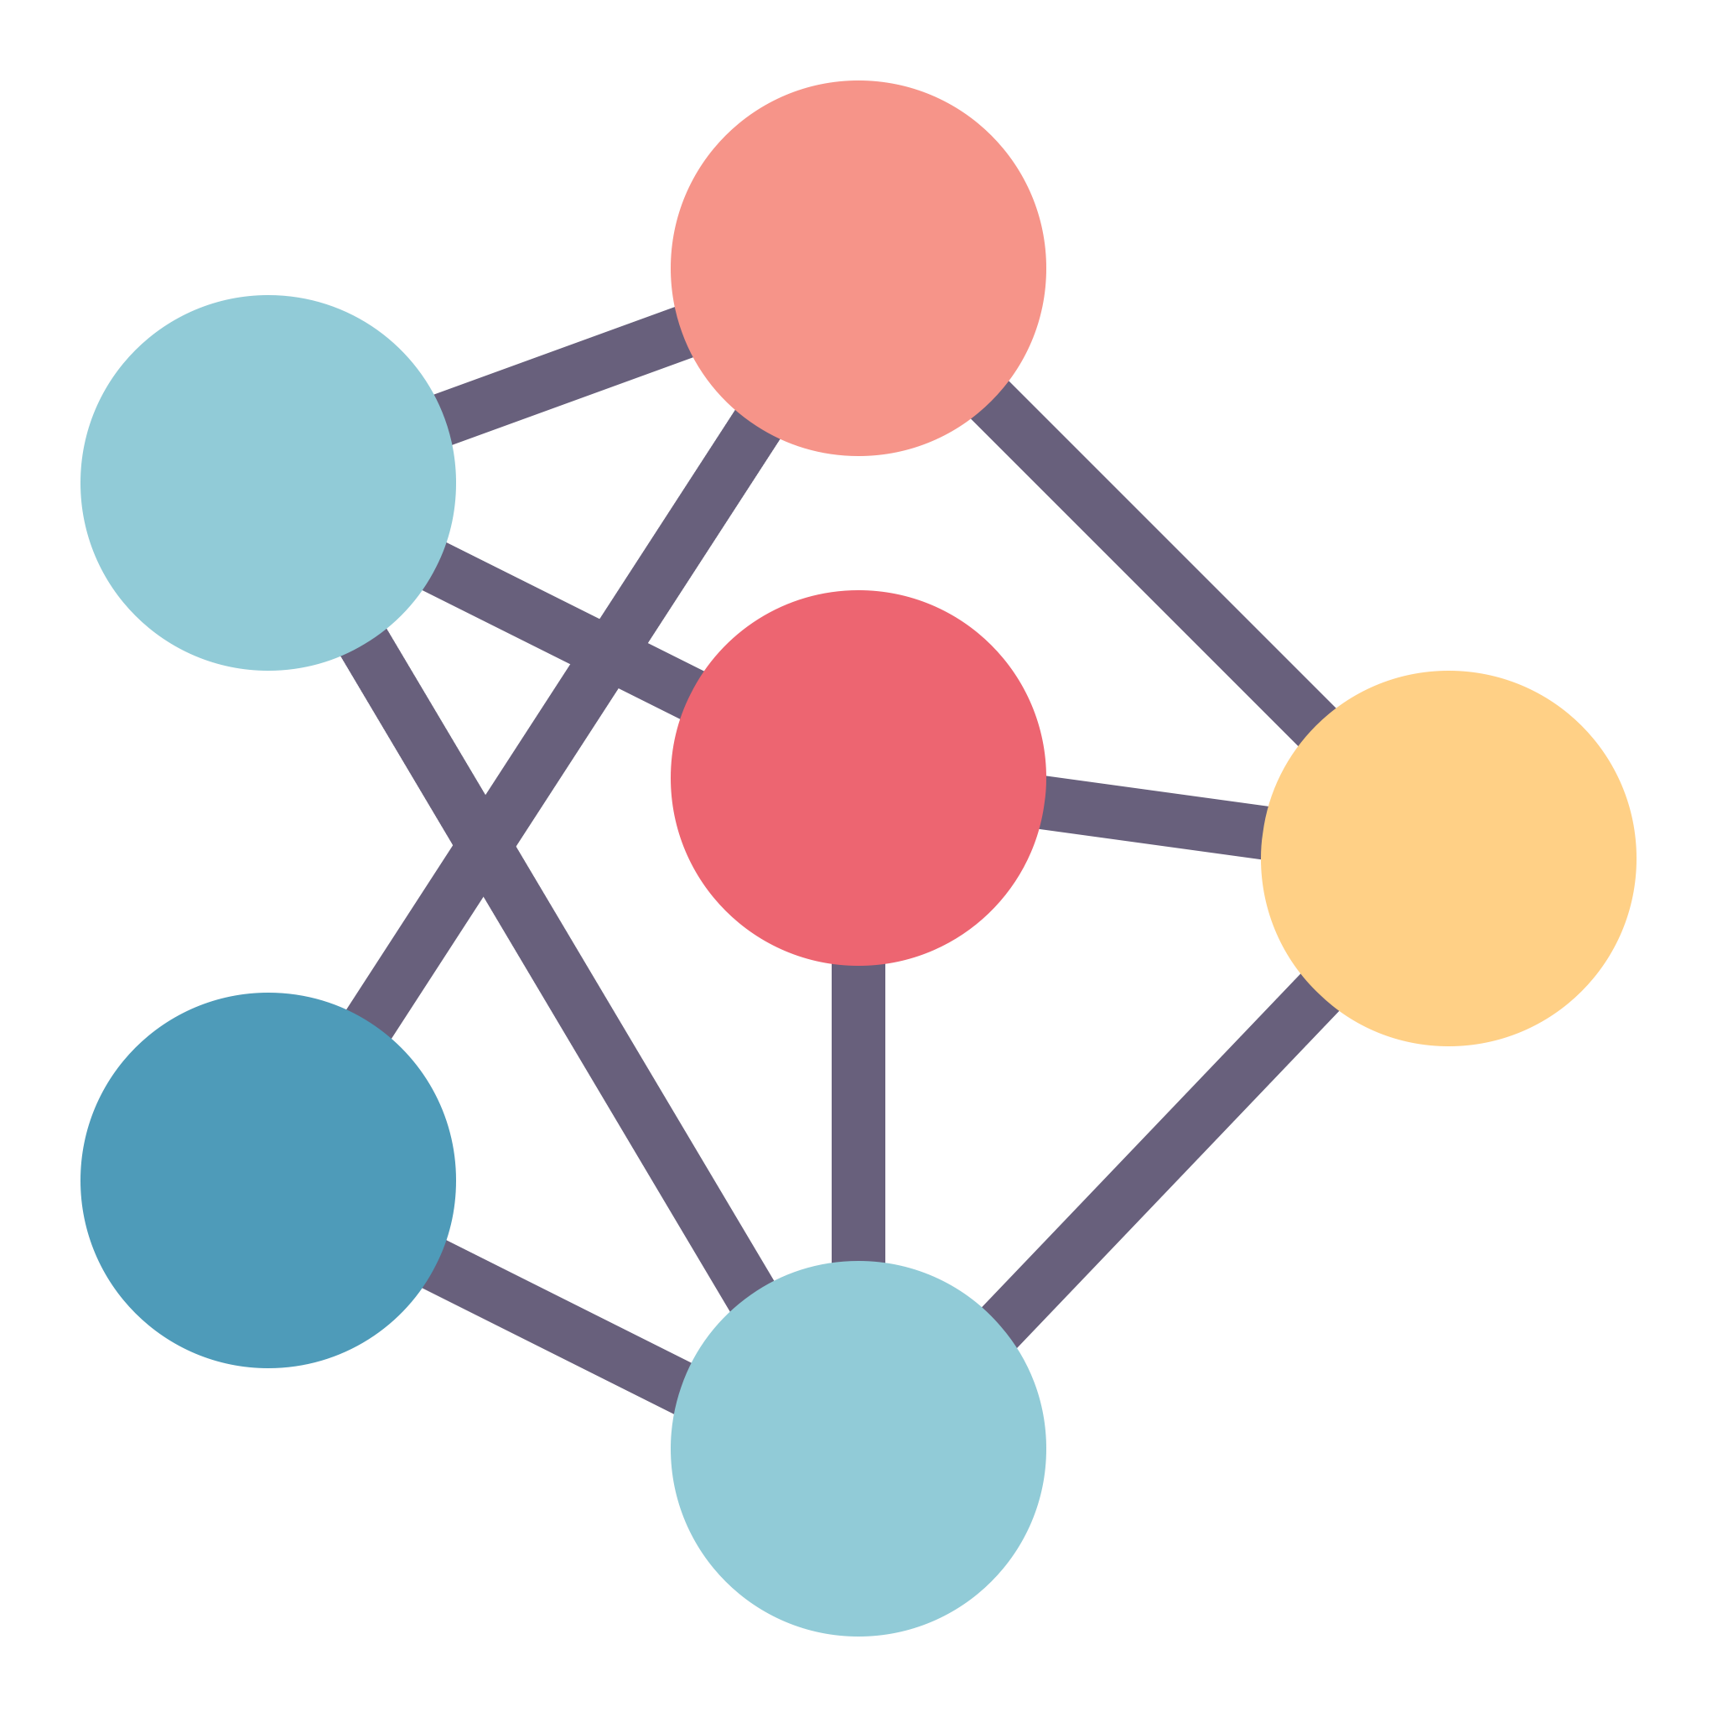
Recap
An algorithm is a set of steps to solve a problem or complete a task.
Effective algorithms are:
Clear
Specific
Accurate
Efficient
We encounter algorithms everywhere!
When we write code, we tell a computer what steps to take – we give it an algorithm to follow!

Slide 27

Food for Thought
“The Algorithm”
Why do we mean when we say “the algorithm”?
How does “the algorithm” decide what to show you?
Do you think it’s good or bad that an algorithm can learn what you like? Wy?
How might TikTok’s algorithm impact what people believe or think about the world?
If you could change how TikTok’s algorithm works, what would you do differently?
How much should TikTok’s algorithm cost? Why?

