Slide 1
Computing innovations

Slide 2
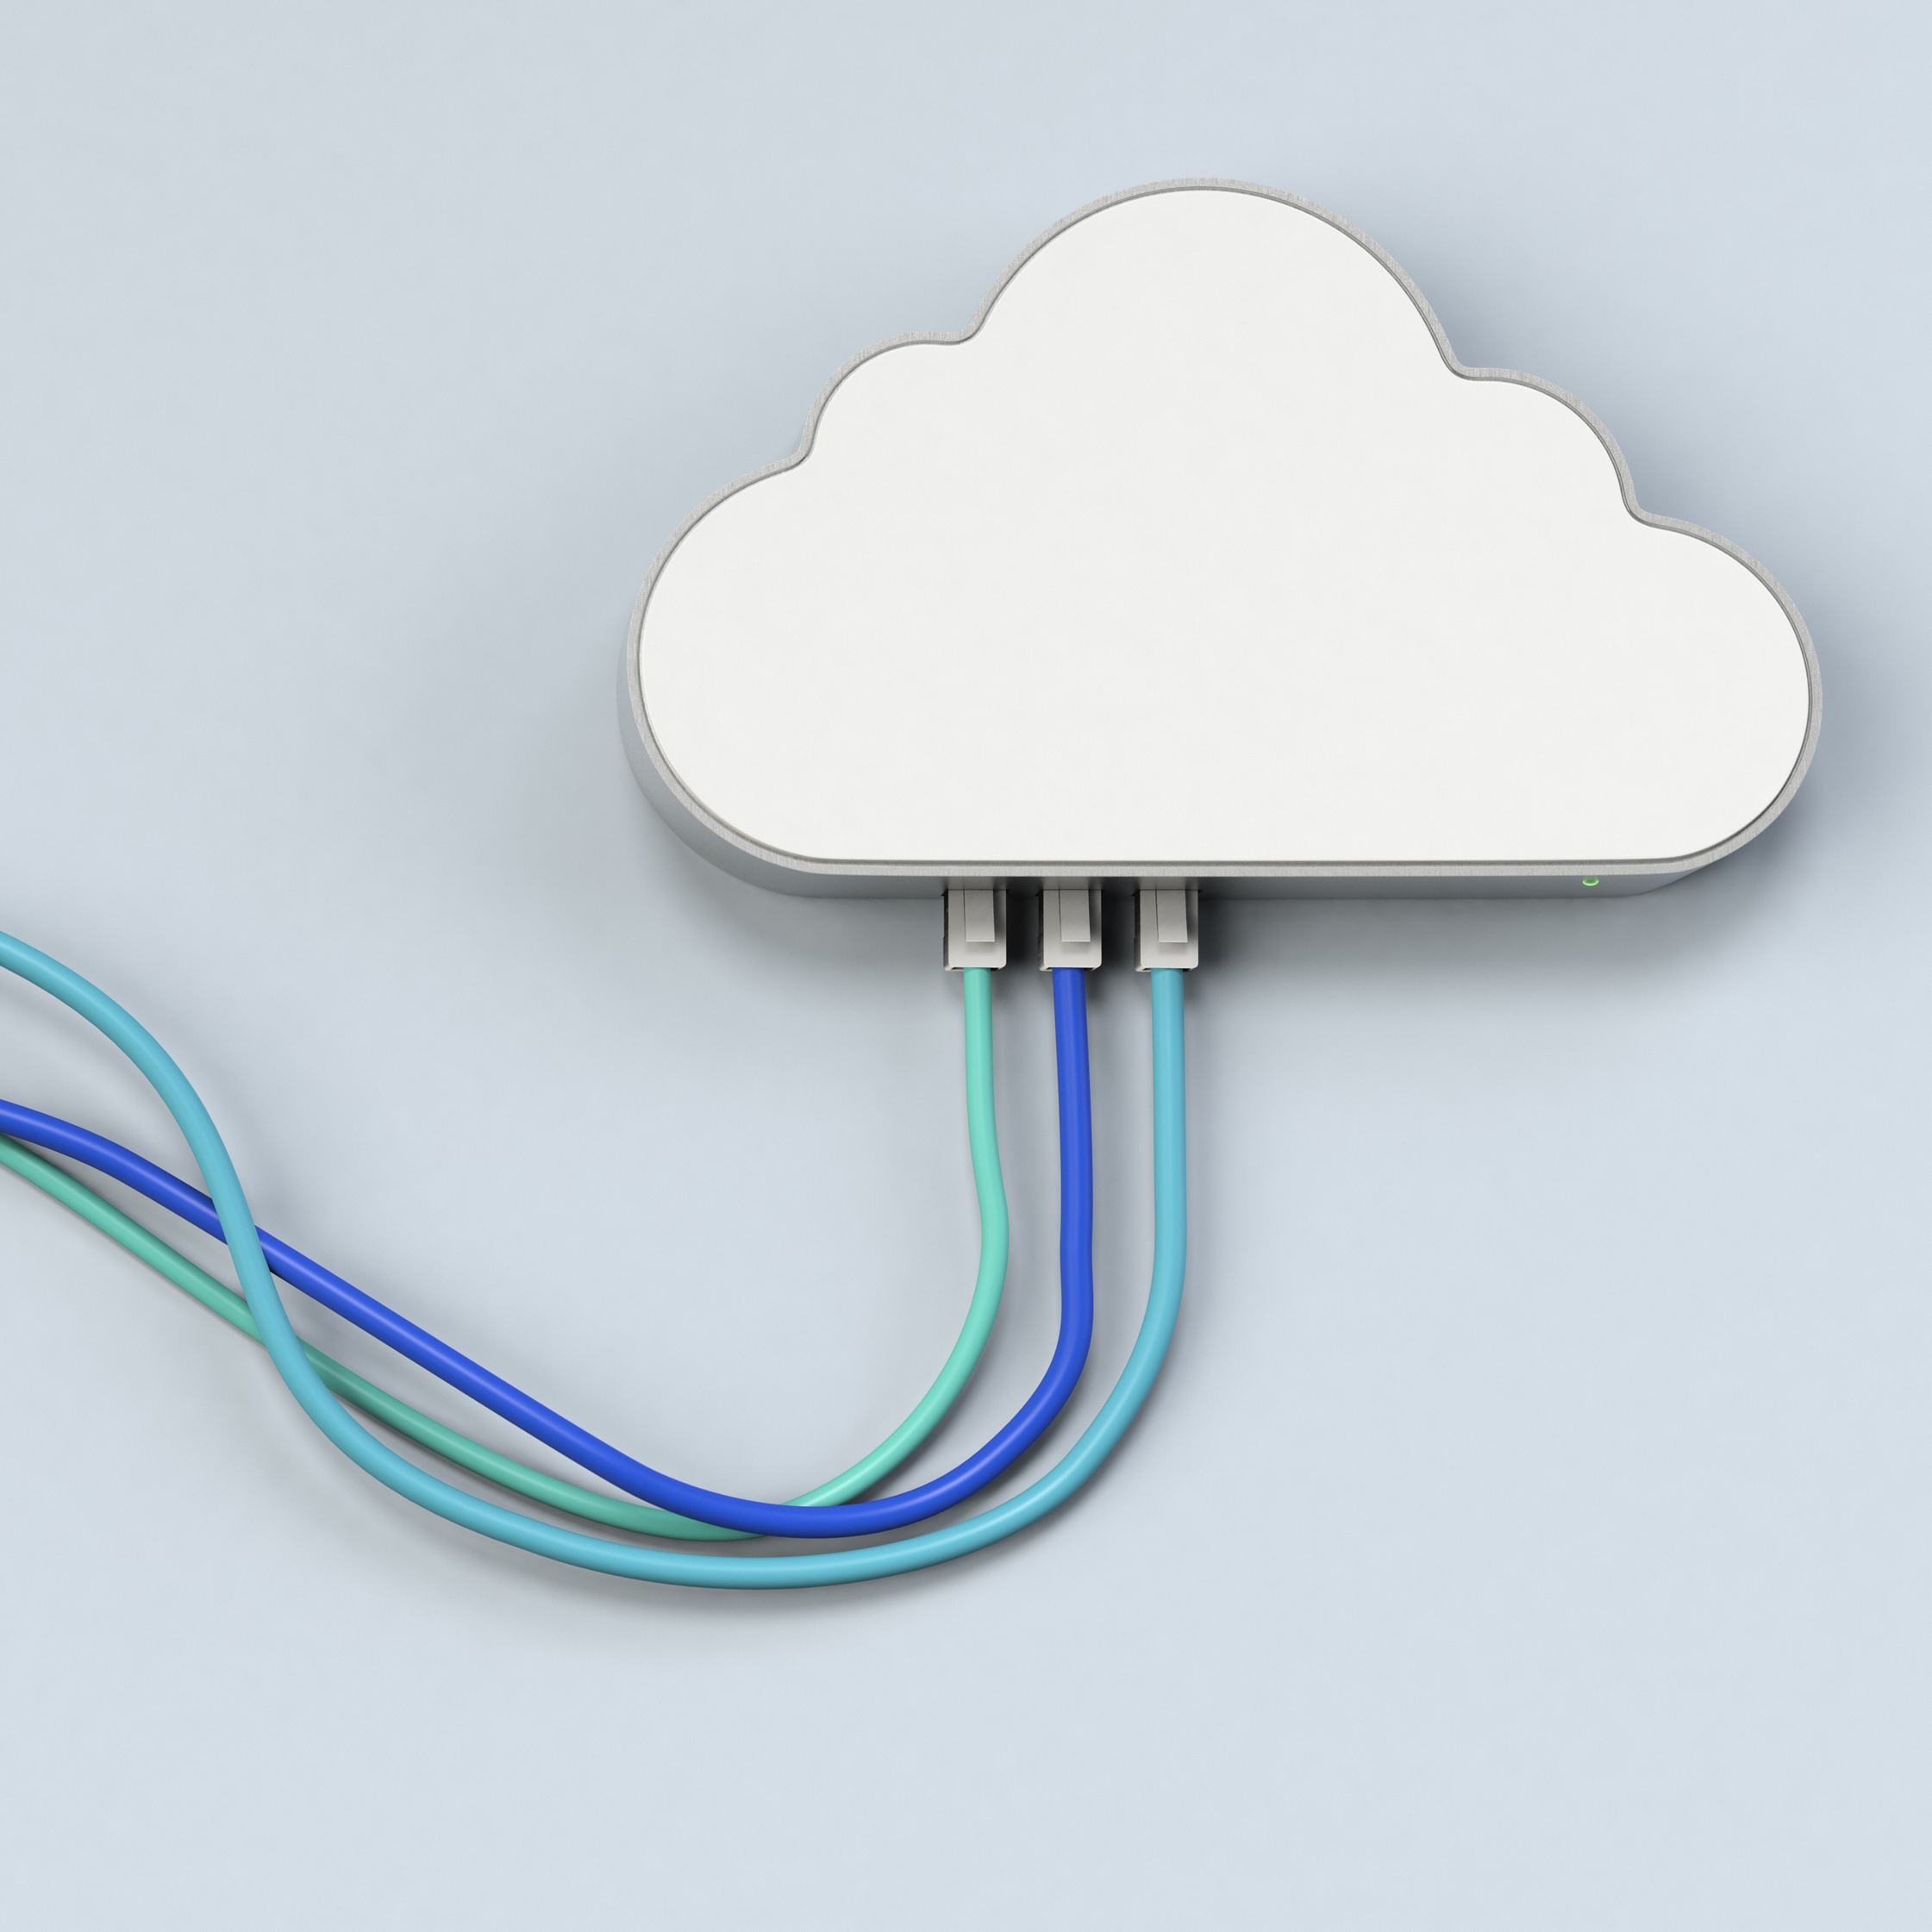
Computing innovations
A computing innovation is an innovation that includes a computer or program code as an integral part of its functionality.
Intended Use
Beneficial Effects
Harmful Effects
Data Use & Generation
Accessibility Issues
Bias Issues
Privacy/Security Concerns

Slide 3
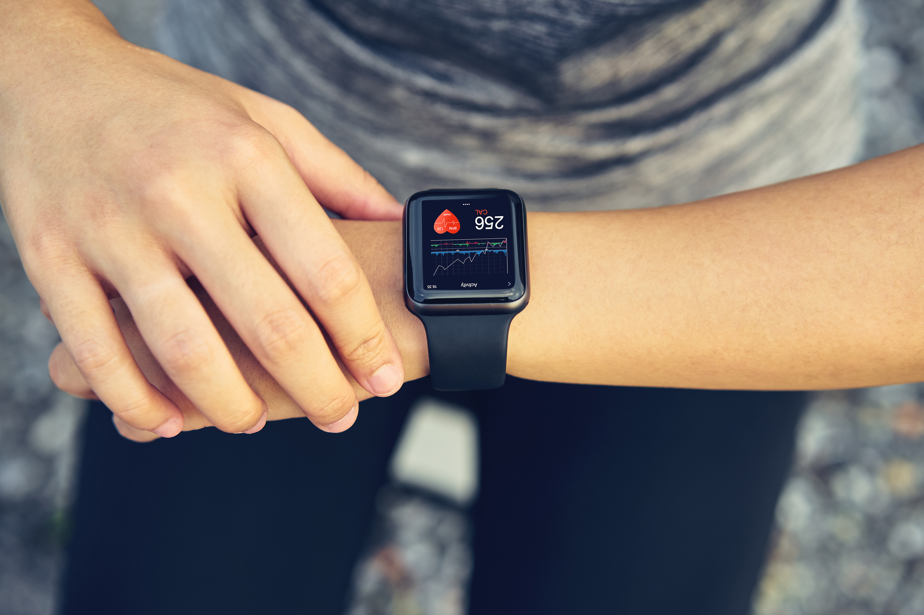
Wearable devices
ECG Monitoring watches
Intended Use: to allow individuals to monitor aspects of their heart-health in real-time and conveniently
Beneficial Effects: increases awareness of heart health, can reduce time to detect heart-health issues
Harmful Effects: unnecessary anxiety of self-diagnosis without medical expertise
Data Use: inputs include physical parameters like age, height, weight, generates heart rate data, health alerts, ECG report, fitness tracking data, outputs this data to the user in an app
Accessibility Issues: high cost may limit access
Bias Issues: ECG algorithms may only have been trained on a sample of individuals with particular characteristics
Privacy/Security Concerns: storing and sharing personal health data

Slide 4

the environment solar-powered water sensors
Intended Use: to continuously monitor water quality and other environmental qualities in aquatic environments
Beneficial Effects: helps in detecting pollution, can ensure safer water for communities, promotes sustainable water management
Harmful Effects: high cost of deployment, may require advanced maintenance technicians, could replace jobs
Data Use: generates data about water quality and solar power in real-time, outputs this data to users remotely
Accessibility Issues: high cost, technological complexity
Bias Issues: may only be available in areas where agencies have more funding and contribute to inequity in access to clean water
Privacy/Security Concerns: N/A

Slide 5

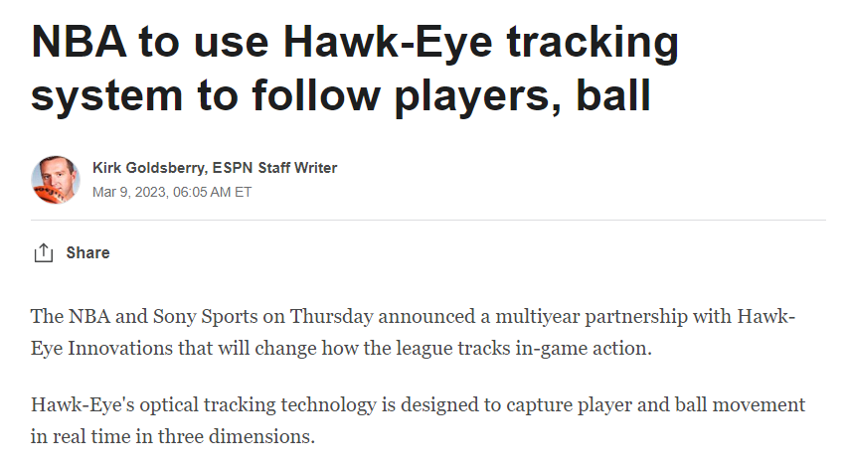
sports hawk-eye camera
Intended Use: to provide an unbiased, accurate way to call ins/outs in tennis matches
Beneficial Effects: makes the sport fair, improves player and spectator trust in the calls
Harmful Effects: could replace umpires, could make mistakes
Data Use: uses a camera as an input device, generates data about the speed and location of the tennis ball, outputs calls and images
Accessibility Issues: high cost
Privacy/Security Concerns: individuals could
tamper with the system

Slide 6

As a Class…
Snapchat
Intended Use
Beneficial Effects
Harmful Effects
Data Use
Accessibility Issues
Bias Issues
Privacy/Security Concerns
Notes:
### Snapchat
#### Intended Use of the Computing Innovation
- Snapchat is designed as a social media application that enables users to share ephemeral photos and videos, communicate through short-lived messages, and explore content from friends and media outlets.
#### Two Beneficial Effects
- **Enhances Social Interaction**: Snapchat provides a playful and dynamic way for users to communicate, enhancing social bonds through shared experiences, even when physically apart.
- **Promotes Creativity**: With various filters, lenses, and editing tools, Snapchat encourages users to express themselves creatively, impacting cultural trends and digital content creation.
#### Two Harmful Effects
- **Privacy Concerns**: Despite the ephemeral nature of content, there is a risk of private messages or images being saved or shared without consent, potentially leading to privacy violations.
- **Mental Health Impact**: The pressure to present an idealized version of one's life, fear of missing out (FOMO), and constant engagement can contribute to stress, anxiety, and negative body image among users.
#### How Does Your Computing Innovation Use Data? What Are the Inputs and Outputs?
- **Inputs**: User-generated content (photos, videos), personal information (for account creation), and user interactions (messages, views, likes).
- **Outputs**: Personalized content feeds, friend suggestions, targeted advertising based on user activity and preferences, and augmented reality experiences through filters and lenses.
#### Accessibility and/or Bias Issues
- **Accessibility Issues**: Users with certain disabilities may find navigating the app or engaging with content challenging due to the visual and interactive nature of the platform.
- **Bias**: The algorithms that curate content and ads can inadvertently reinforce biases, leading to a lack of diversity in the content presented to users or biased ad targeting.
#### Privacy or Security Concerns
- **Privacy Concerns**: There are concerns regarding the collection, storage, and potential misuse of personal data, including location information and personal preferences.
- **Security Concerns**: As with any digital platform, there is a risk of data breaches or unauthorized access to user accounts, compromising personal information and private communications.

Slide 7

Examples of computing innovations
Simultaneous RoundTable

Slide 8
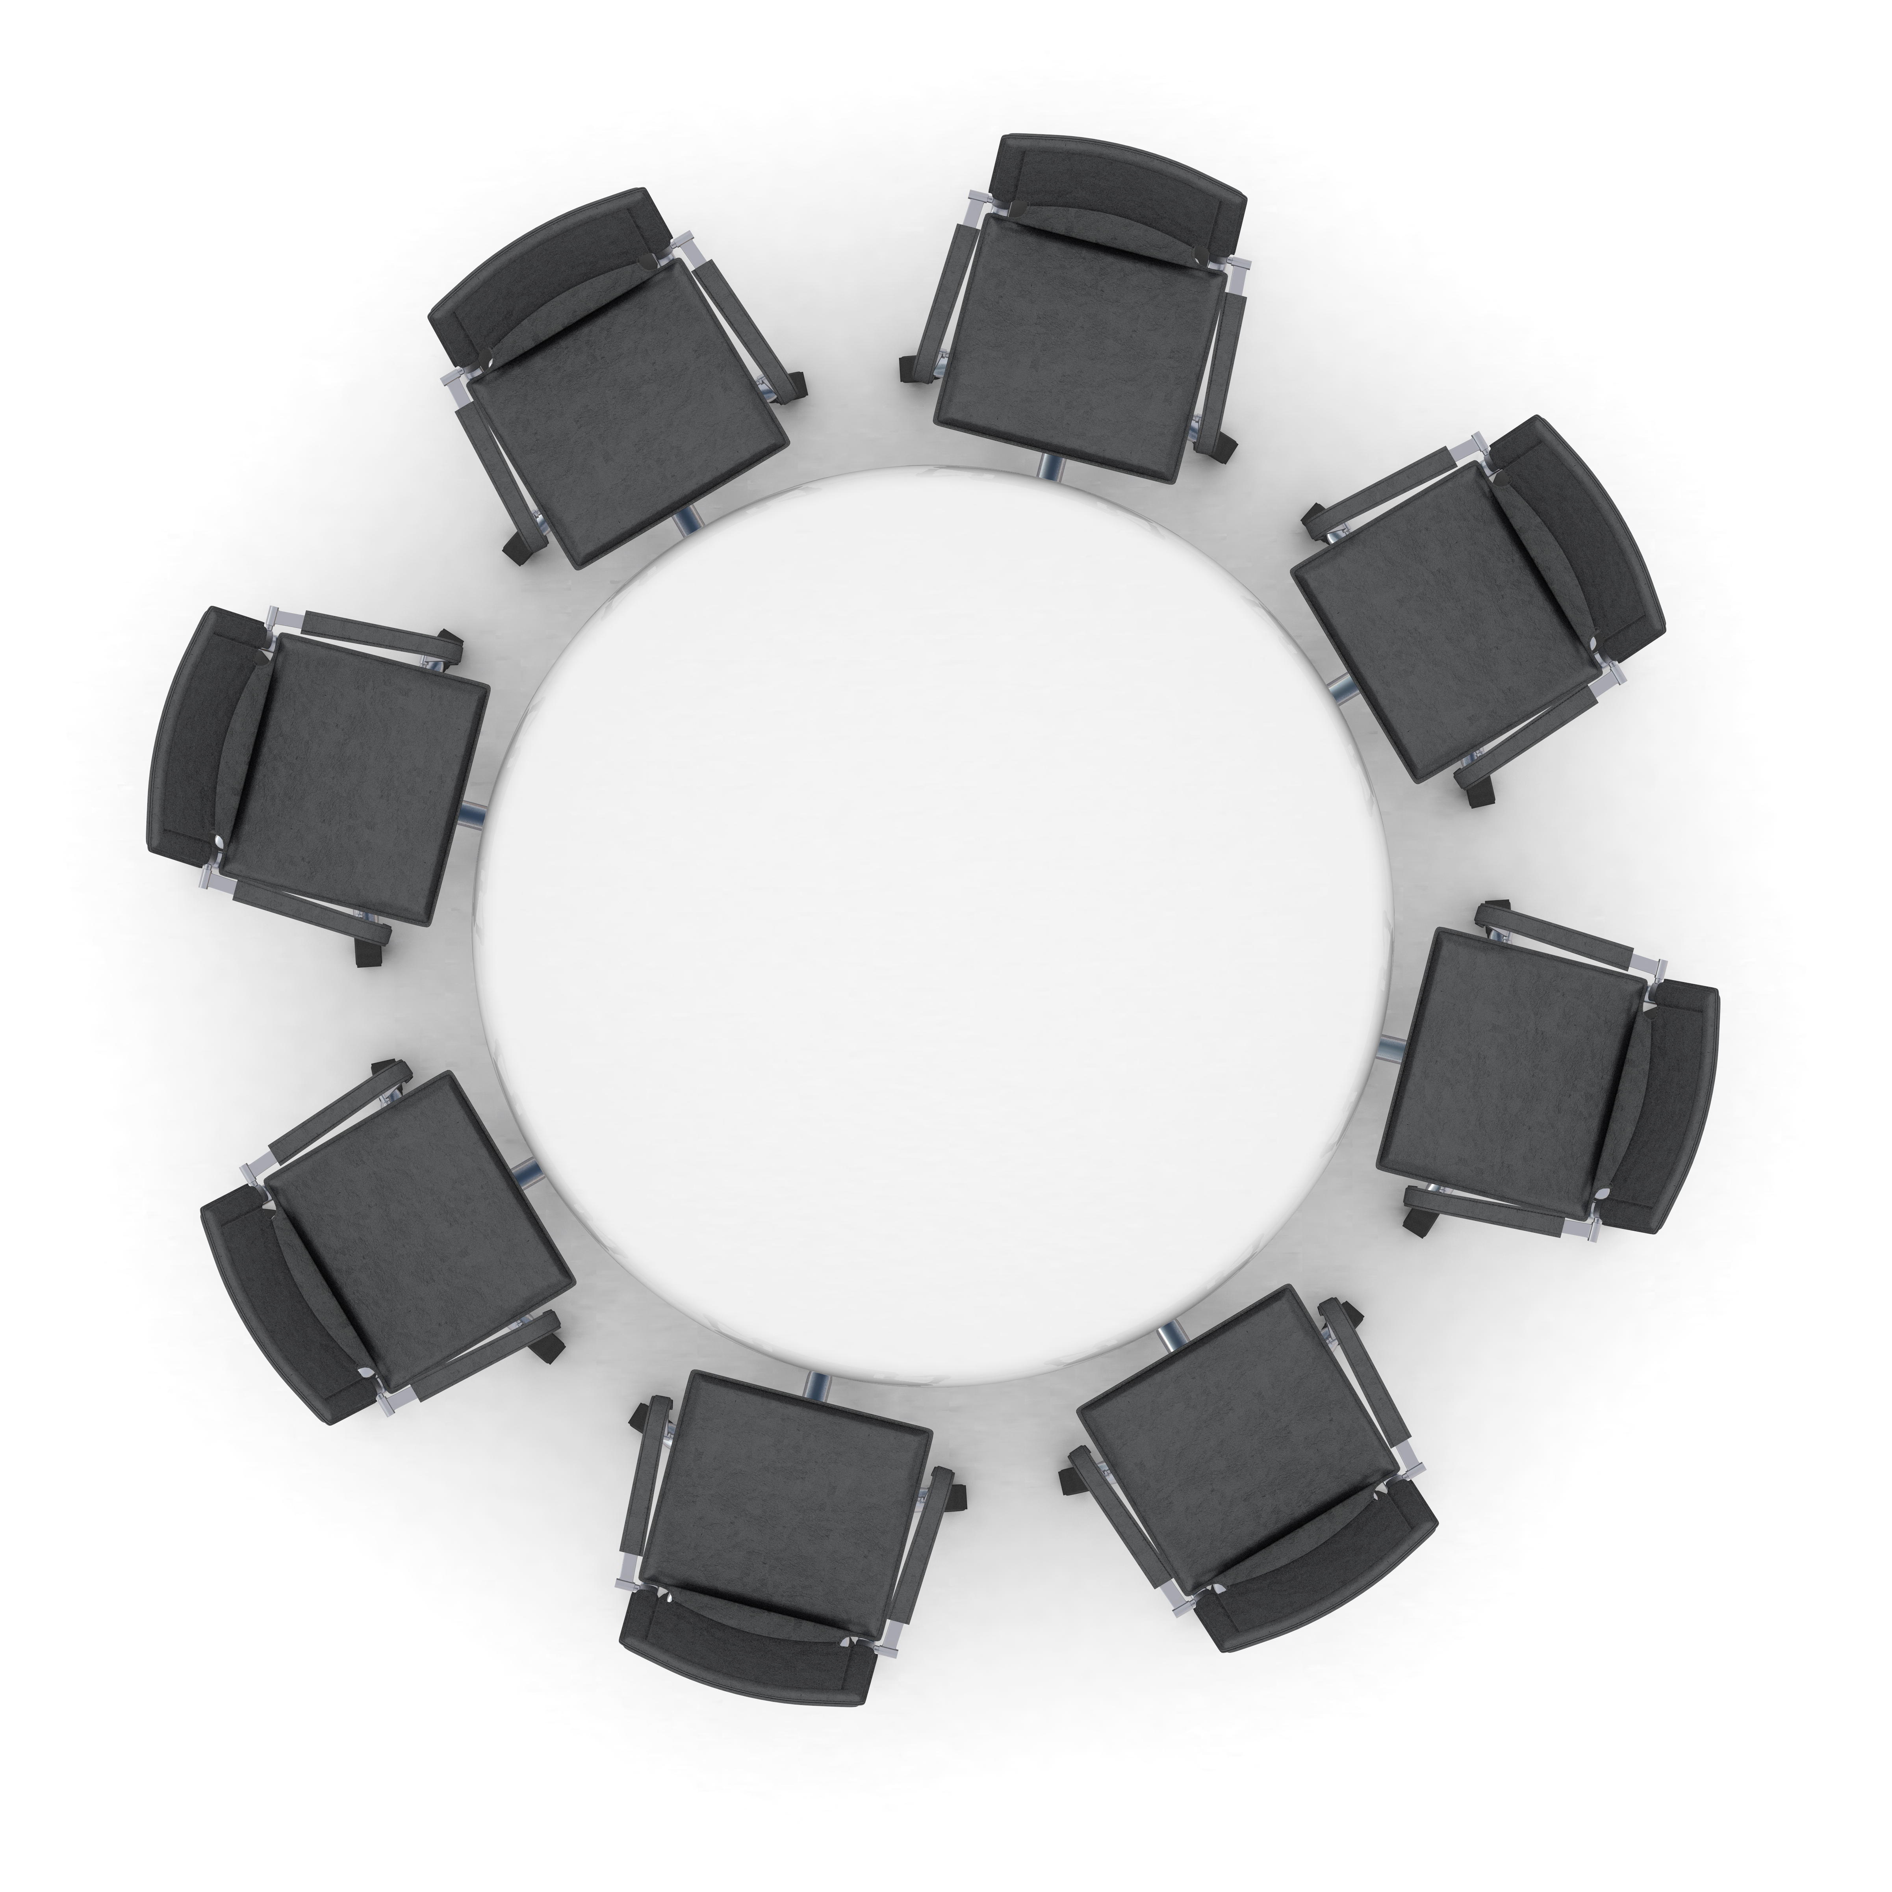
What computing innovation has affected you the most?
Round Robin Discussion

Slide 9
Assignment computing innovation infographic
Today, we learned about computing innovations and the ways that they can impact our lives. Now, you will select a computing innovation, learn more about it, and share your findings in an infographic.
Select a computing innovation related the environment, sports, or wearable devices.
Use the internet to research your computing innovation using the research template.
Use Canva to create an infographic. You should start from a template, and your infographic should contain at least:
  3 graphics elements (either added or changed from the template)
  2 photographs
  3 bullet points of information presented in a creative way
  A clear title and description of your computing device
Complete the two reflection questions at the end of the research template.
Turn in a PDF of your infographic and your completed research template.

Slide 10

Class work time
Time Remaining: 20 minutes

