Slide 1

Parity Magic
CS Demonstration – Fault Tolerance & Error Detection

Slide 2
Supplies
Labels for name and group number
2 Different Colored Post-It notes for Parity Magic

Slide 3
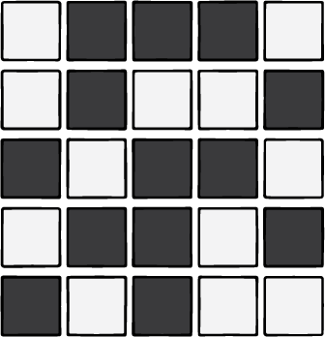
A Volunteer, Please!
Please create a 5x5 grid using two different colored post-it notes. Colors should be chosen completely randomly! No need for perfection and leave a little space between the post-its.
We’ll consider each post-it note to represent one bit, a 0 or a 1, which computers use to represent everything! One color indicates the bit is off (0), and the other represents the bit being on (1).

Slide 4
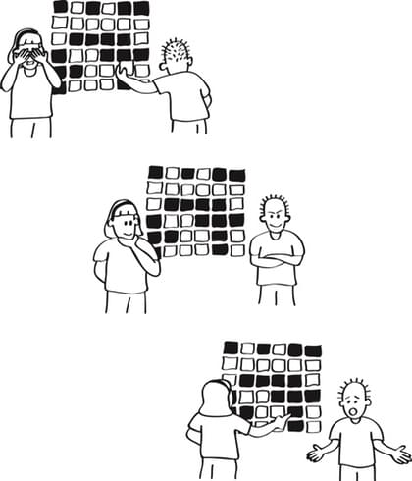
The Magic Trick
With the facilitator facing the other way, a member of the audience will randomly flip one of the bits on the grid.
Can the facilitator identify which bit was flipped?

Slide 5
The Magic Trick
With the facilitator facing the other way, a member of the audience will randomly flip one of the bits on the grid.
Can the facilitator identify which bit was flipped?
Behind the Curtain
The parity bits are used to check whether the number of 'on' bits in each row and column is odd or even.
If a card is flipped, it will cause a mismatch in the parity bits for its row and column, allowing the demonstrator to identify the flipped card.

Slide 6
Debrief & Discussion
Key Concepts: error detection, fault tolerance
What is the “price” we pay to include fault tolerance when we transmit our 5x5 grid of bits? Is it worth it?
How robust is our data validation strategy? Are there cases where we would not be able to detect an error?
Does this strategy scale?

Slide 7
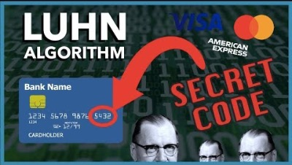
Extending the Learning
We see strategies to send data with built-in error checks all the time!
  Ensure that numbers are valid (credit cards, ISBNs, product numbers)
  Build in double checks to financial systems double-entry bookkeeping) proofreading, etc.).
Notes:
Invalid, valid, valid

Slide 8
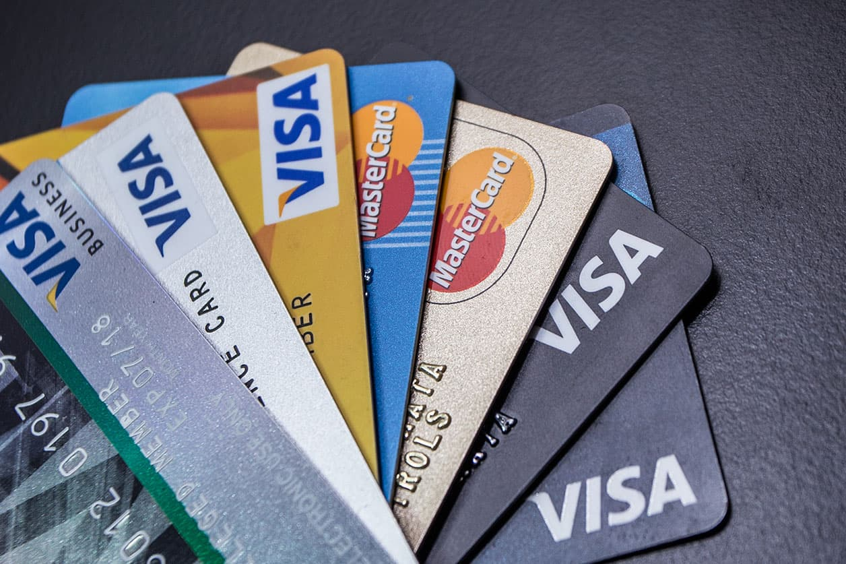
Extending the Learning
Double the value of every other digit, starting from the rightmost digit (which is the check digit) and moving left. If doubling a number results in a value greater than 9, subtract 9 from the result.
Sum all the digits of the number. This includes both the digits that were doubled and the ones that were not.
Check if the total modulo 10 is equal to 0. If it is, then the number is valid according to the Luhn formula; otherwise, it is not valid.
Are these valid numbers?
4532 0132 0023 7510
4716 1234 5678 9012
2951 5824 5041 9389

