Slide 1
How Computers Work

Slide 2
Day 1
Introduction to Computational Thinking

Slide 3
Warm-up Question
Think back to a large problem you have had lately. How did you solve it? How did you discover the solution? Did you get help?

Slide 4
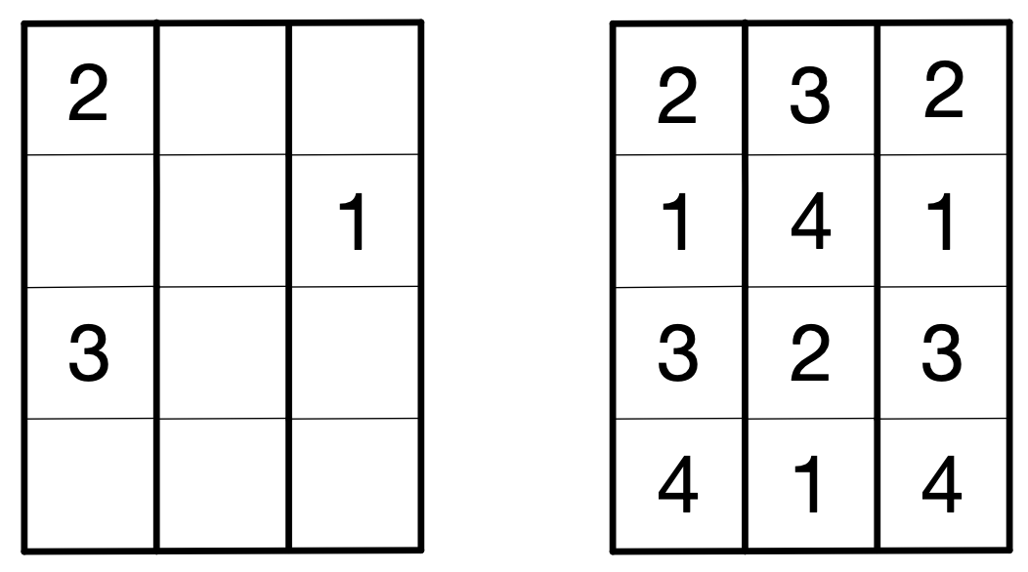
Activity: Cut the Block
Complete handout puzzle sheets 1 and 2

Slide 5
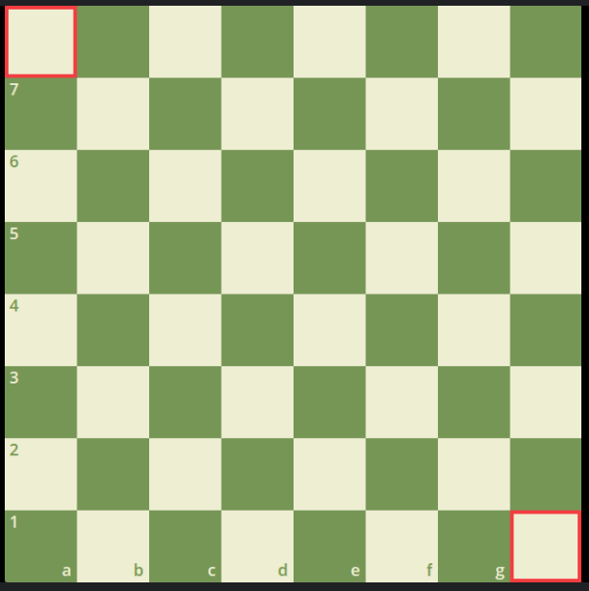
Activity: Eight Queens on a Chess Board
How does a Queen move?
Your task:
Safely fit 8 Queens on a chessboard
Hint: No 2 Queens can be in the same row, column or diagonal path

Slide 6
Activity: Eight Queens on a Chess Board
Hints!
Knight's Move: Think about how knights move in an "L" shape: two squares in one direction and then one square perpendicular to that. While this doesn't directly solve the queen's placement problem, it can help in visualizing non-linear movements on the board.
Zig-Zag Pattern: Try placing queens in a zig-zag pattern, moving diagonally up and down as they place each new queen. This helps avoid conflicts in both rows and columns.
Mirroring: Place the first few queens in one half of the board, and then try to mirror that pattern on the other half. This can create symmetrical patterns that help avoid conflicts.
Diagonals First: Focus on placing queens along the main diagonals first. Once the main diagonals are populated, it becomes easier to see safe spots for the remaining queens.
Corners and Edges: Start by placing queens in the corners or along the edges of the board. This reduces the number of squares that are threatened and can help in visualizing safe spots.

Slide 7
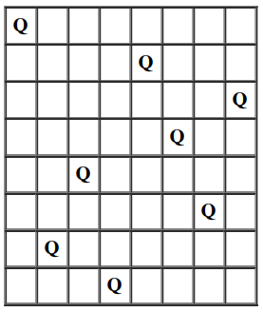
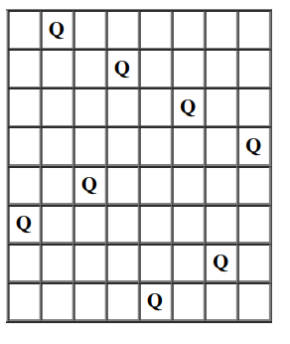
Is This a Solution?

Slide 8
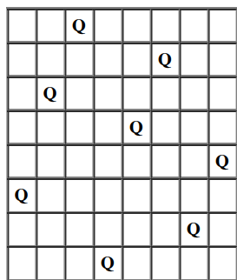
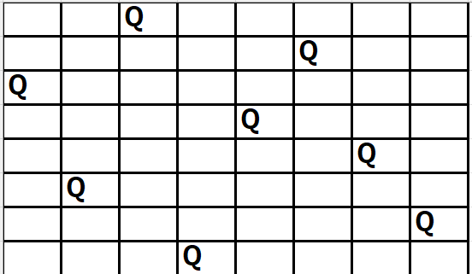
Is This a Solution?

Slide 9
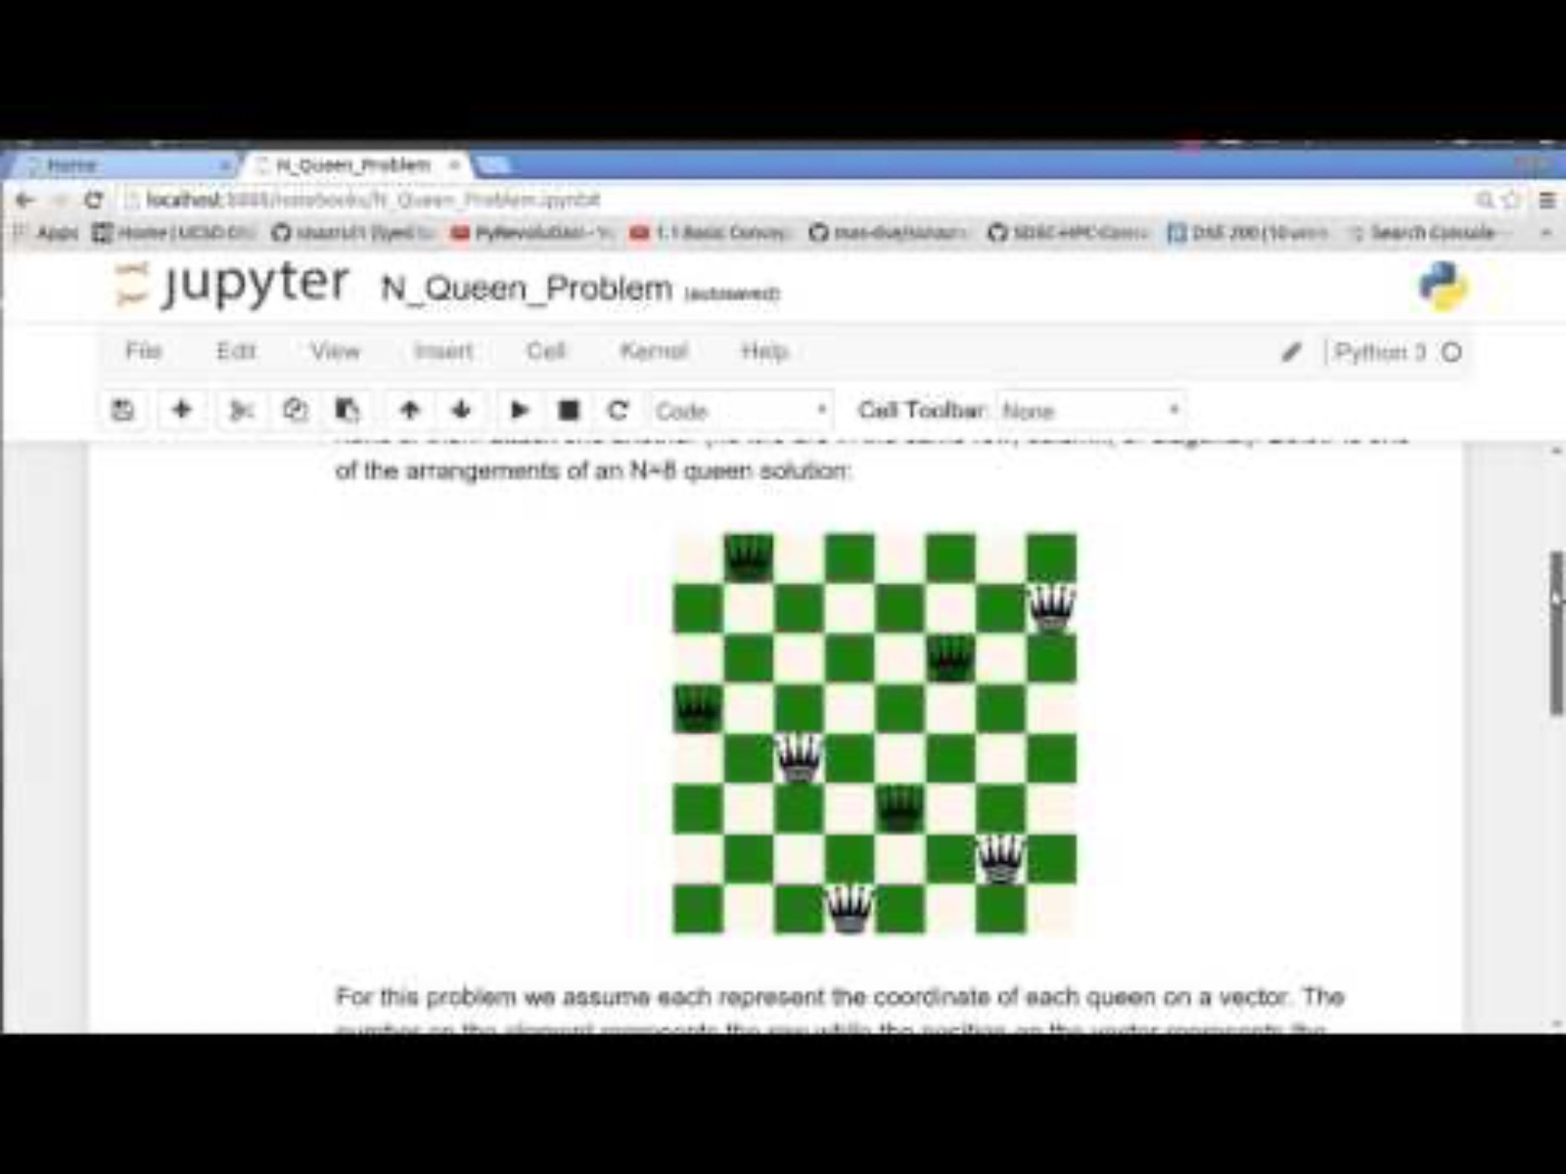
Watch a Computer Solve It

Slide 10
Class Reflection
Concept Check: What are the main rules that each queen must follow to ensure they are not attacking each other on the chessboard?
Pattern Recognition: How many different solutions did you find for placing the 8 queens on the board? Did you notice any patterns or similarities among the solutions?
Strategy: What strategies did you use to figure out where to place each queen? How did you determine whether a placement was safe or not?
Problem Solving: If you had to place 9 queens on a chessboard instead of 8, what changes would you need to make to your approach? How might the problem become more complex?
Visualization: How did visualizing the chessboard and the positions of the queens help you in solving the problem? Did drawing out the board or using physical pieces make a difference?

Slide 11
Class Reflection Continued
Reflection: What was the most challenging part of solving the 8 Queens problem for you, and how did you overcome it? What did you learn from this activity about problem-solving and strategy?
Learning Experience: How did working on the 8 Queens problem change the way you think about puzzles and challenges? Did it help you develop any new skills or approaches that you can use in other areas?
Teamwork and Collaboration: If you worked on this problem in pairs or groups, how did collaborating with others affect your approach to finding solutions? What did you learn from your peers, and how did working together impact the overall process?

Slide 12
Day 2
How algorithms Solve problems

Slide 13
Warm-up Question
Think back to a large problem you have had recently. How did you solve it? Did you get help?

Slide 14
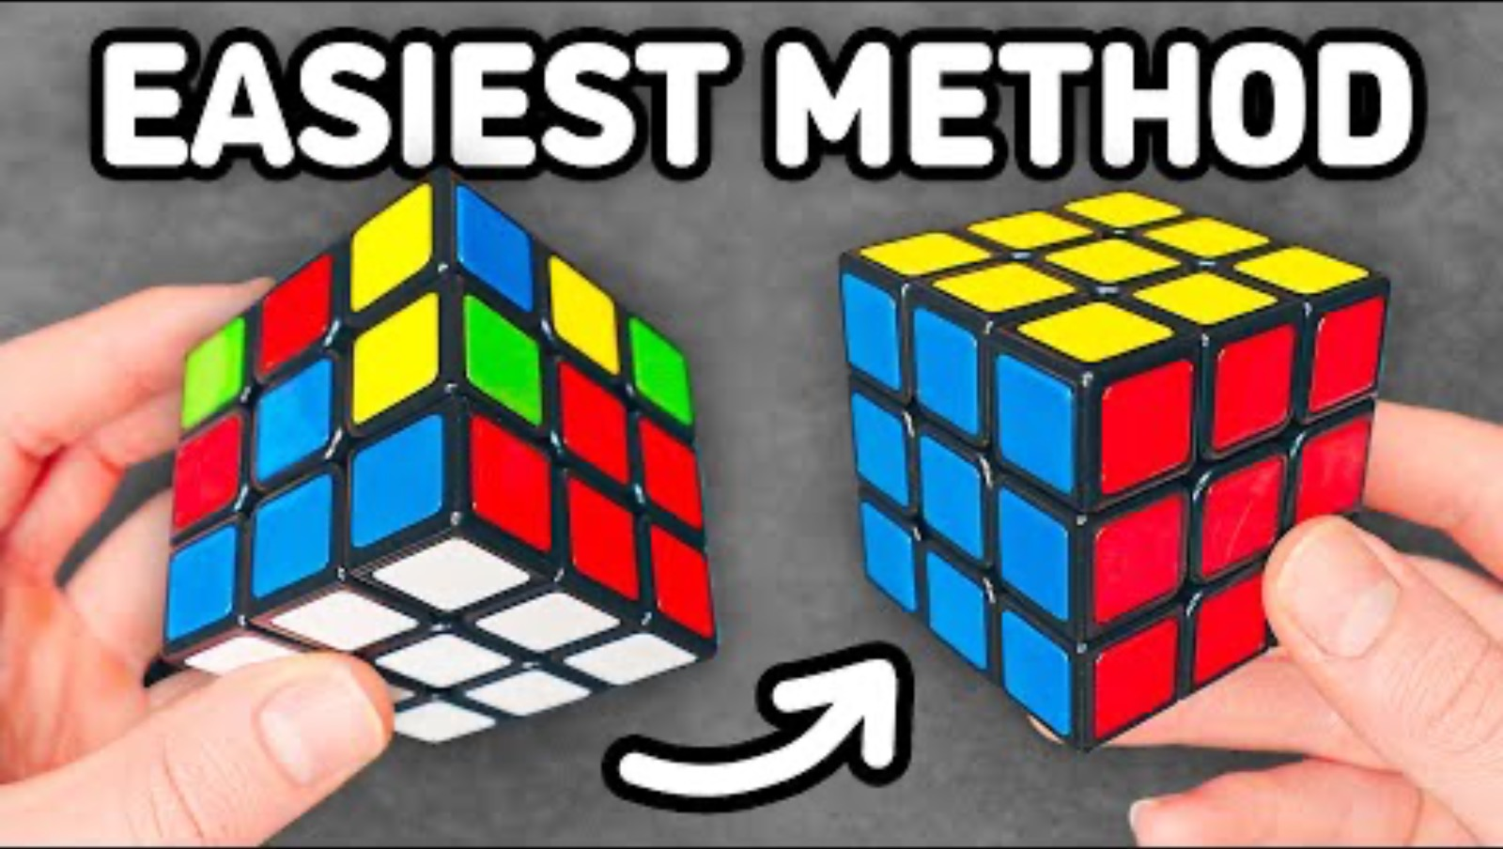
How to Solve a Rubik’s Cube

Slide 15
Bubble Sort: Put in Number Order
Place all cards face down
Flip first 2 cards over...move the lower number to the left
Flip both cards back face down
Now flip cards 2 and 3 over…move the lower number to the left
Flip both cards back face down
Now flip cards 3 and 4 over
Flip both cards back face down
Now repeat. Start from the step 1 with flipping over cards 1 and 2.
Repeat this process until the cards are in number order.

Slide 16
Bubble Sort: Take the Larger Number with You
Place all cards face down
Flip first 2 cards over...move the lower number to the left
Flip over the smaller number and take the larger number with you (leave face up)
Now flip cards 3 over…move the lower number to the left
Flip over the smaller number and take the larger number with you (leave face up)
Now flip card 4 over… move the lower number to the left
Flip over the smaller number and take the larger number with you (leave face up)
Now repeat. Start from the step 1 with flipping over cards 1 and 2.
Repeat this process until the cards are in number order.

Slide 17
Day 3
How Computers process information

Slide 18
Warm-up
Important Definitions
Computer Science: The study and use of computers and computational thinking to solve problems
Computational Thinking: A set of skills that help to set up a problem in a way that a computer can help you solve it
Decomposition: Breaking a problem down into smaller, more manageable parts
Pattern Recognition: Finding similarities between items as a way of gaining extra information
Algorithm: a list of steps that can be followed to carry out a task
Abstraction: Ignoring certain details in order to come up with a solution that works for the more general problem
Your class is planning a school event like a talent show. How could the four Computational Thinking skills help organize the work?

Slide 19
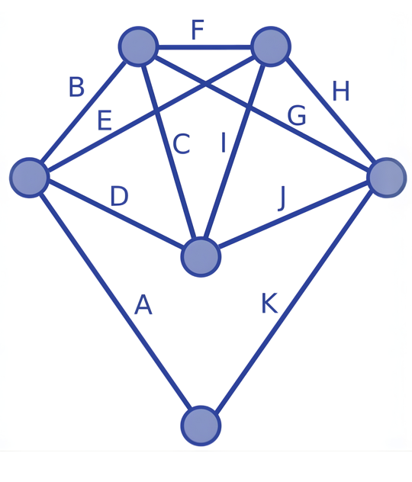

Activity: The Traveling Salesman
What is the longest path you can find?
What is the shortest path you can find?

Slide 20
Wrap-up Riddle!
I am the brains of the devices you use every day, handling tasks in an organized way. What am I?

Slide 21
Day 4 gg

Slide 22
Warm-up Question
If you wanted a computer to draw a picture or move a character on the screen, what instructions would you need to give it?

