Slide 1

Introduction to Cybersecurity
Class 1: Cybersecurity and Passwords

Slide 2
What is Cybersecurity?

Slide 3
Cybersecurity is about protecting protecting systems, networks, programs, and data from digital attacks, unauthorized access, or damage.
Protection = Prevention + (Detection + Response)
Cybersecurity isn’t just about stopping attacks, it’s also about what you do before, during, and after something goes wrong.
Notes:
Prevention → stop attacks
Detection → notice attacks
Response → fix damage

Slide 4
Scenario: a company is hacked and customer data is leaked
What should they have done before the leak?
How would they know their data was leaked?
What should they do after they find out about the leak?

Slide 5
The CIA
(not the one you’re thinking of…)
3 Main Goals of Cybersecurity:
Confidentiality
Integrity
Availability
Notes:
Ask the class: “What do you think each of these means?”

Slide 6
Confidentiality
Keeping information private
Examples:
Passwords
Messages
Personal data
Notes:
“When hackers steal passwords or personal data, confidentiality has been broken.”

Slide 7
Integrity
Keeping information accurate and unchanged
Examples:
Grades
Bank accounts
News articles
Notes:
“If someone can change data, you can’t trust it anymore.”

Slide 8
Availability
Being able to access information when you need it.
Examples:
Websites
Gradebook
Wi-FI
Notes:
“Even if data is safe and correct, it doesn’t matter if you can’t access it.”

Slide 9
Data Exists in Different States
At rest → data is stored (e.g., saved word file in a folder)
In transit → moving from one place to another (e.g., sending a text message)
In use → being used/accessed (e.g., editing a google document)

Slide 10
Complete the CIA worksheet and let’s discuss!

Slide 11
Achieving CIA – Primary Tools
Authentication
  Think logging in to an account with your username and password
Access control
  Your teacher can update your gradebook, but you cannot.
Auditing
  Think of tracking changes in a document: someone else can look at them and know where you began, and how you got to the changes you made. The same happens with digital systems (e.g., who logged in, and what did they do?)
Notes:
Authentication → who are you?
Access Control → what are you allowed to access?
Auditing → what happened?

Slide 12
Authentication – Proving Who You Are
3 Types of Authentication
  What you know (passwords)
  What you have (phone, digital “passkeys”)
  What you are (fingerprint, face)
    Also called biometric authentication
Notes:
“All three are important, but today we’re going to focus on authentication—because it’s something you use every day.”

Slide 13
Password Attacks
Stealing passwords (phising, data breaches)
Guessing a password (a computer or person guesses a common password like “password” or “1234”)
Longer and more complex passwords are harder to crack, but humans tend to make predictable passwords!
How can we make sure passwords are complex enough to be hard to crack?

Slide 14
Think You Can Make a Strong Password?
Let’s practice!
Grab a partner and see if you can come up with a password that is hard to crack.
  Don’t use one of your own passwords, make a new one.
Go to cyber.org/find-curricula/test-strength-your-passwords
Was your password strong?
Notes:
Have students visit this site for the activity: https://cyber.org/find-curricula/test-strength-your-passwords

Slide 15
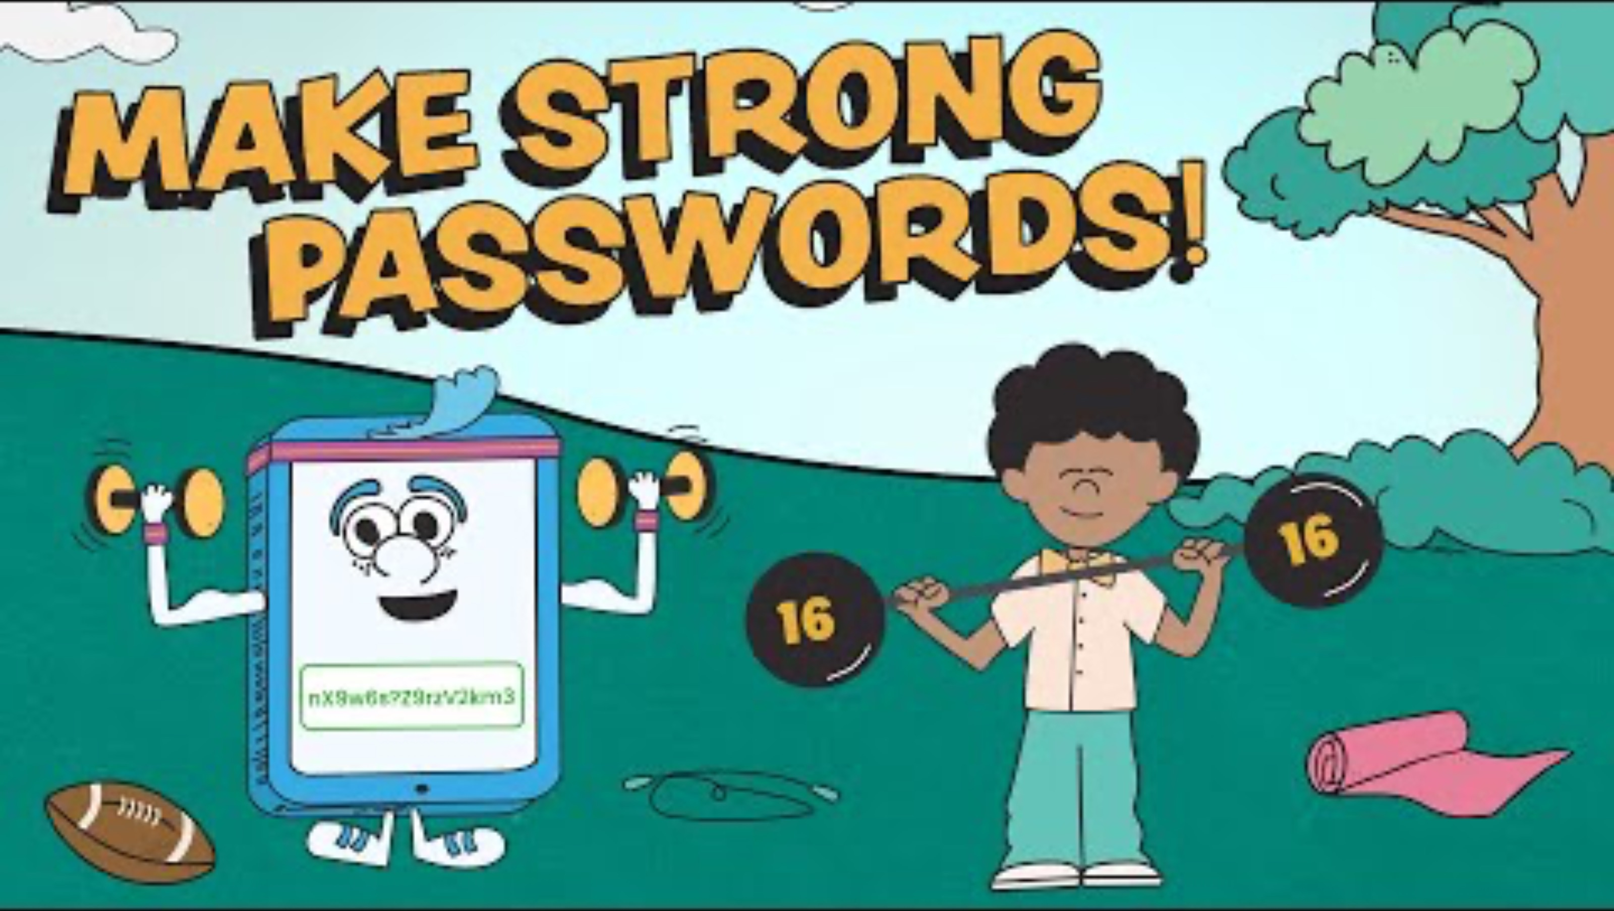
What Makes a Strong Password?
Notes:
If you prefer a non-cartoon video, show your class this one instead: https://www.youtube.com/watch?v=FZoB7yUGh7Y&list=PL-BF3N9rHBLJjjiMk-sjhfoRZObMhBNYr&index=9
View this playlist for more educational videos on cybersecurity (optional):
https://www.youtube.com/playlist?list=PL-BF3N9rHBLJjjiMk-sjhfoRZObMhBNYr

Slide 16
Wrap-up Class Discussion
How did your password strength improve over time as you completed the activity?
What are some personal changes you need to make to your own passwords?

Slide 17
Introduction to Cybersecurity
Class 2: Authentication & Password Attacks

Slide 18
What Data Breaches Have You Been Involved In?
Warm-up
Got to: haveibeenpwned.com and put in your email to check

Slide 19
Think You Can Crack a Password?
Today we will:
  Turn a password into a secret code (“hashing”)
  Try to crack someone else’s password
  Learn how to make passwords stronger
Remember from yesterday – don’t use real passwords for these activities! Only made-up ones.

Slide 20
How Passwords Are Stored
Hashing (What Websites Do)
Your password is turned into a scrambled code
  Example: dog123 → a7c9f2b4…
Websites don’t store your real password, they store the hash.
Why?
If the system is hacked, your password isn’t exposed
So, hashing is another way that computers try to protect your information

Slide 21
Rainbow Tables
Attackers use:
  Common passwords people use (like “123456”)
  Databases of millions or billions of passwords and their hashes (Rainbow Tables)
  Tools that generate and then test passwords automatically.
Why does this work?
  Many people use the same simple passwords
  Hashing always gives the same output for the same input
  Attackers reuse huge databases from past data breaches
  Computers can test millions of guesses per second
So - If your hash is already in one of these lists, they can figure out your password easily.
Notes:
Make sure students know that there isn’t just one rainbow table. Hackers use many different kinds of password lists and tools (so students don’t think there is just one master rainbow list out there that all hackers use).

Slide 22
“Salting” Your Passwords
What is “Salt”
  A random string of characters added to a password before you hash it.
    Example: dog123 → dog1238392
What happens next?
  The salted password is now hashed.
    Dog1238392 → completely new hash
    Evan a tiny change will create a totally different hash
Notes:
“A salt is extra randomness added to your password before it’s turned into a hash.”

Slide 23
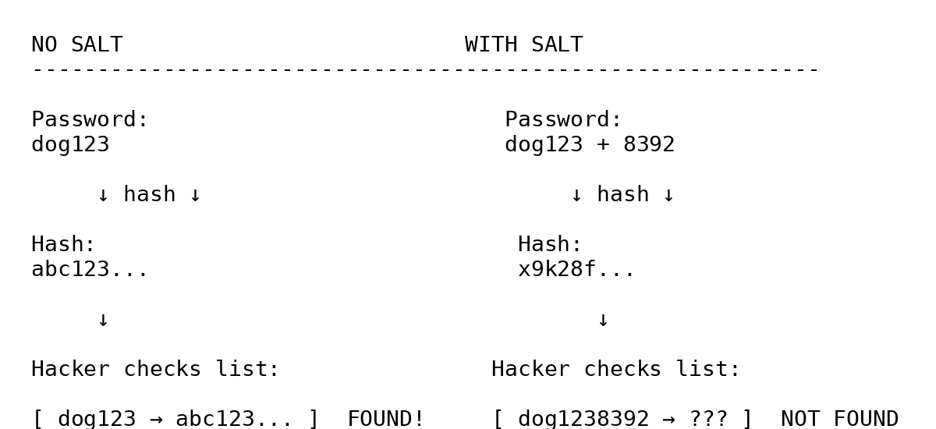

Slide 24
“Salting” Your Passwords Continued
Why does salting help?
  Because rainbow tables only work for known passwords
  When you add a salt:
    The password becomes unique
    It’s NOT already in attackers databases
    Hackers can’t just “look it up” anymore
Notes:
Key Idea
No salt → password might already be known
With salt → attacker must start from scratch

Slide 25
Now Let’s Test This in Real Life
Find a partner
You will:
  Turn a password into a hash
  Try to crack a partner’s password
  See how salt makes it harder to crack

Slide 26
Hashing a Password: Practice
Go to the CyberChef site: gchq.github.io/CyberChef
Come up with an easily guessed password (e.g. password123) and enter it under “input”.
There are many types of hashing algorithms (ways of hashing), but today we will all use the same one, MD5.
  Using the left panel, first click on “hashing”, and then double click on “MD5” to add it to your “recipe”.
Enter your “easily guessed password under “input”. The hashed “output” will be automatically generated.
  Note: if the “auto bake” check box is deselected, you will have to click on the green “BAKE!” at the bottom to generate your hashed output.
The generated “output” is the password you chose, but hashed!
Notes:
gchq.github.io/CyberChef
Why are we only using MD5 for this activity?
“These are just different ways to scramble passwords. Some are stronger than others, but today we’re using MD5 so we can see how cracking works.”
It’s fast → works well for classroom demo
It’s widely supported by cracking tools like CrackStation (which we will use later)
It’s more likely to successfully “crack” simple passwords (which is what we want for this lesson)

Slide 27
Hashing a Password: Continued
Share your hash with your partner, NOT your original password.
Go to crackstation.net
Paste in your partners hash
  So…did it work?
Try salting the same easily guessed password before you hash it. Share this new hash with your partner, and use crackstation.net to see if it can still be cracked!
Notes:
Common pitfalls:
Students paste wrong thing (password instead of hash)
Students use different hash types (fix: always MD5)
Some passwords don’t crack → this is OK (good discussion!)
Make sure students only select MD5 ONCE for their “recipe”. If they have it or other encryption methods in the recipe, it will become too complex to be decrypted easily.

Slide 28
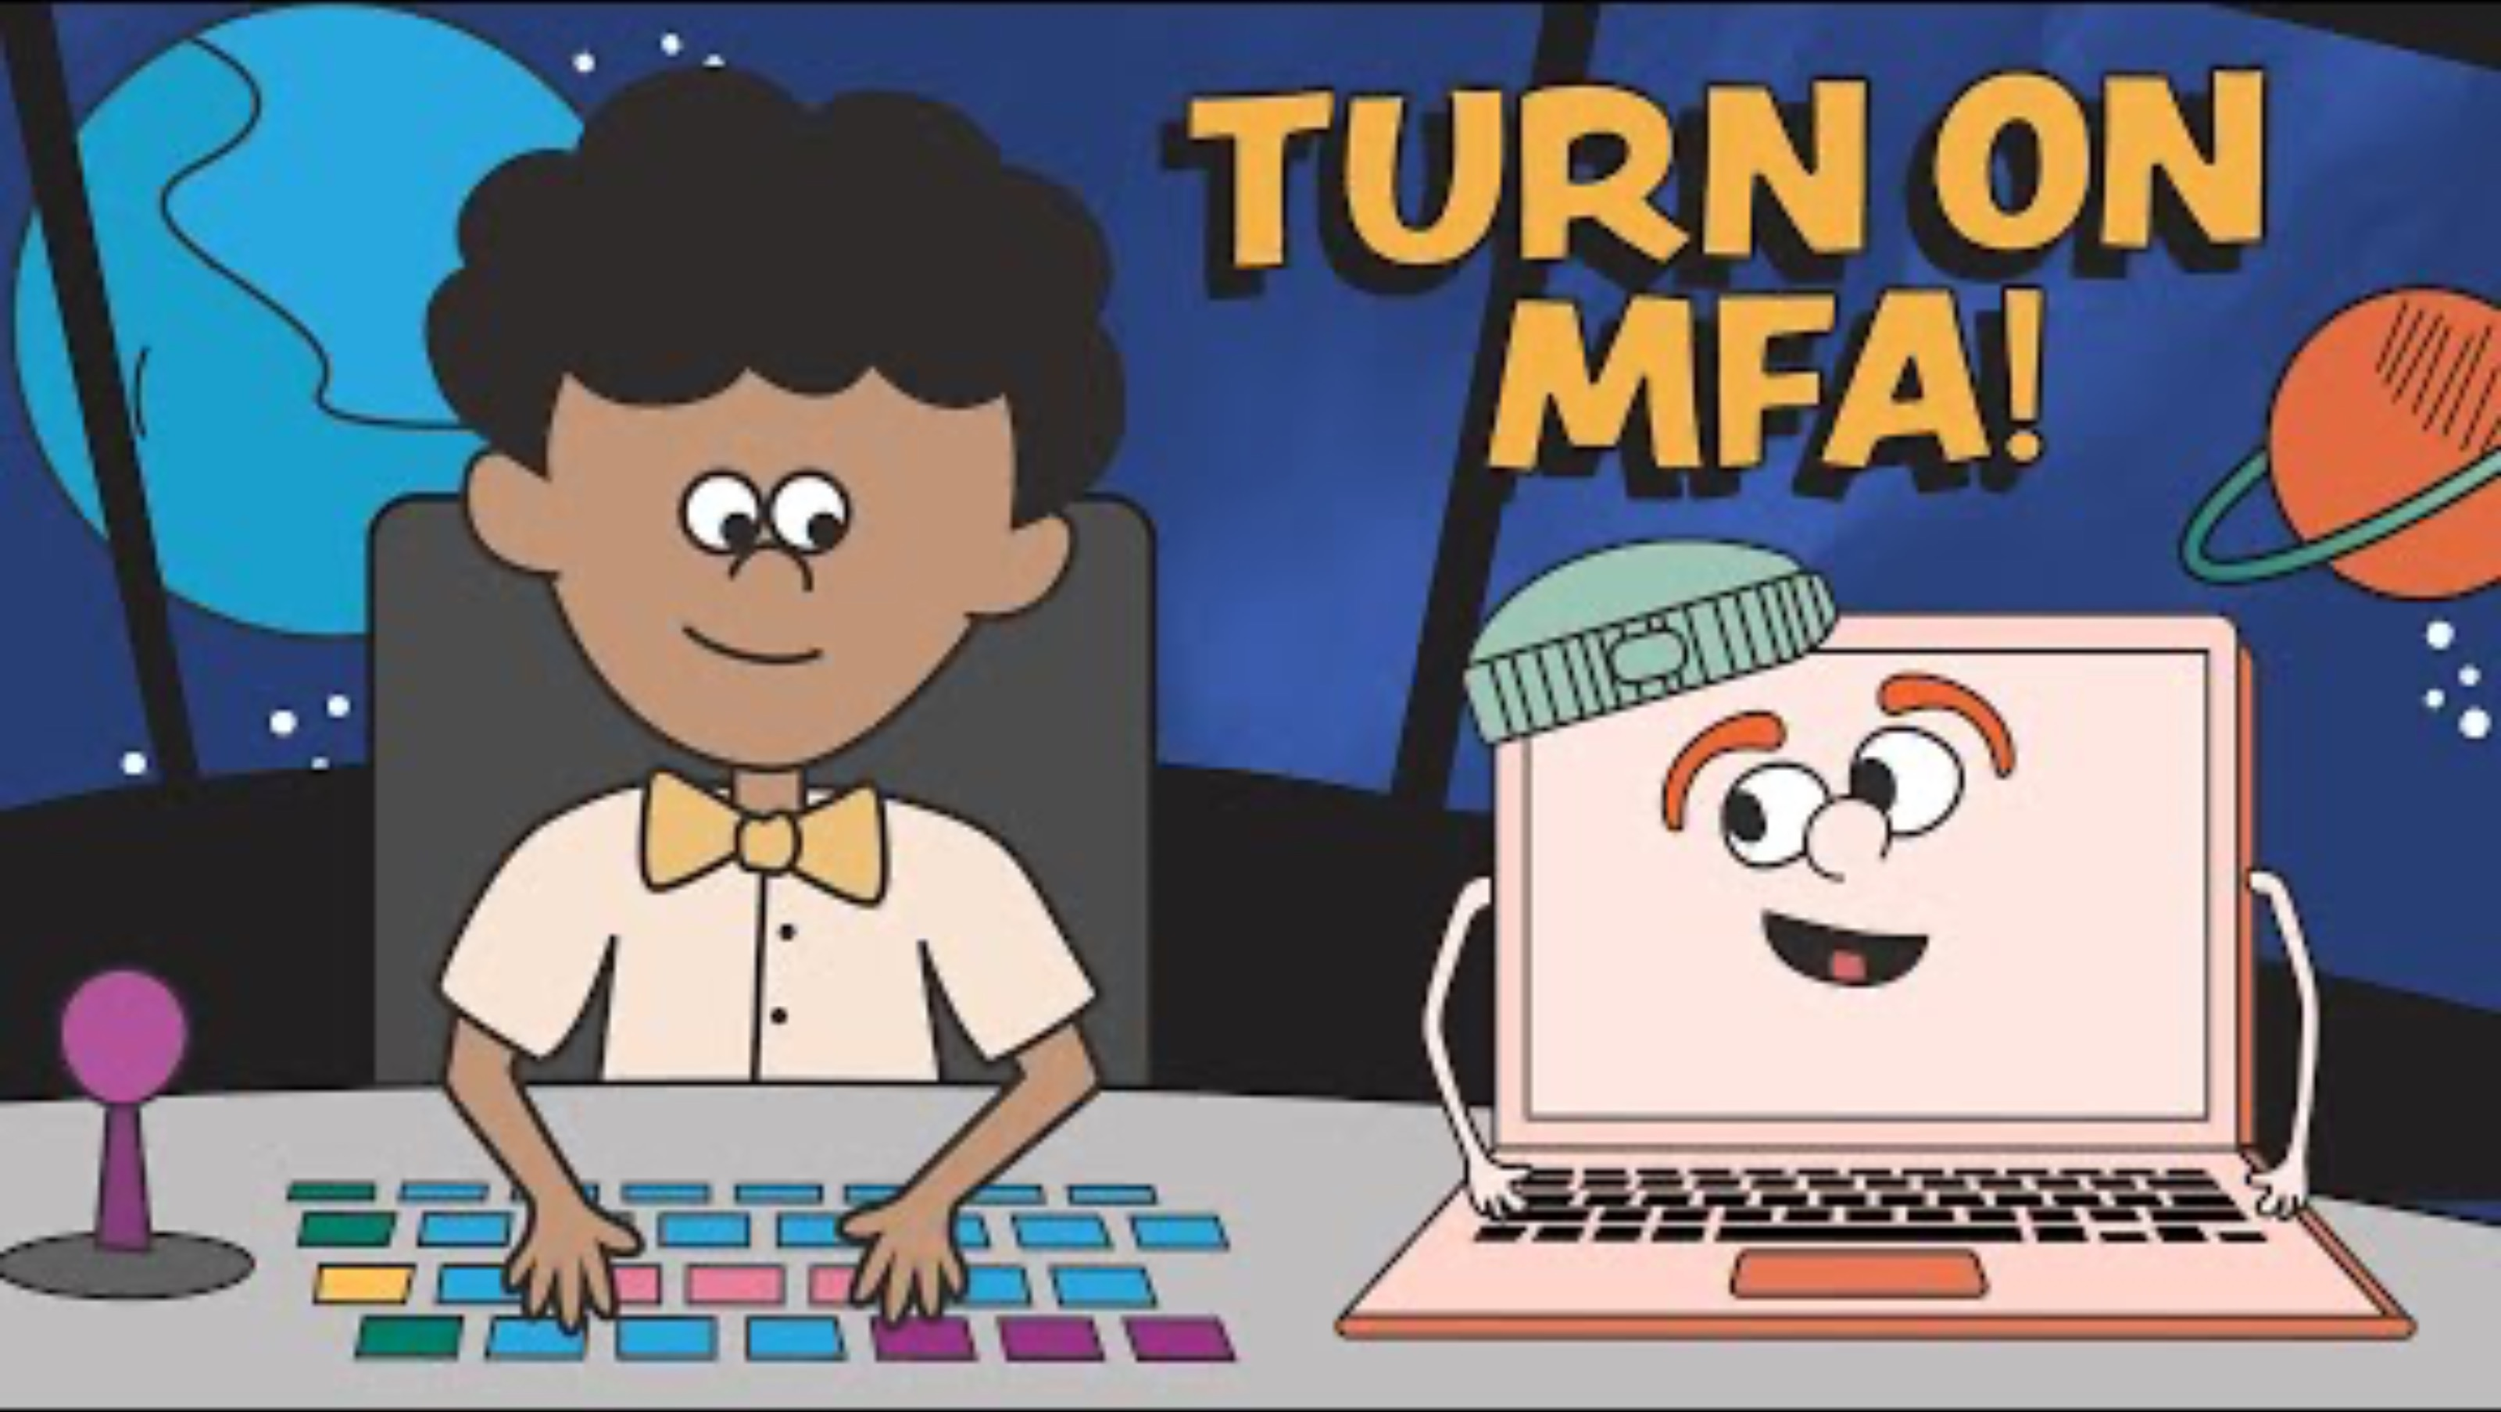
Types of Authentication
Notes:
If you prefer a non-cartoon video, show your class this one instead: https://www.youtube.com/watch?v=XIlF2qkav5c=9

Slide 29
Introduction to Cybersecurity
Class 3: Malicious Code & Hacking

Slide 30
Warm-up
A hospital’s computers suddenly stop working. A message appears on all the screens:
Pay $100,000 or your data is gone forever.
What do you think just happened?
Notes:
Goal: introduce ransomware/malware without naming it

Slide 31
What does it mean to “hack” something?
Hacking means gaining access to a computer, system, or account in a way that was not intended or allowed.
It can be done to steal information, cause damage, or sometimes to test and improve security.

Slide 32
What is Malware?
Malware is designed to harm, steal information, or take control of a computer
Common Types of Malware:
  Viruses
  Worms
  Trojan Horses
  Ransomware
  Spyware

Slide 33
Viruses
What it does → Damages or changes files on a computer
How it spreads → when people open or share infection files or programs
Why it’s dangerous → it can corrupt (ruin) files and spread quickly between users
How to protect yourself → Don’t open unknown files or downloads, and use antivirus software

Slide 34
Worms
What it does → Spreads across computers and networks, often slowing or crashing systems
How it spreads → Spreads automatically without people needing to click anything
Why it’s dangerous → It can infect many computers very quickly
How to protect yourself → Keep your software updated and use security protections like firewalls.

Slide 35
Keyloggers
What it does → Records everything you type on your keyboard.
How it spreads → Hidden inside downloads or malicious software.
Why it’s dangerous → It can steal passwords, messages, and personal information.
How to protect yourself → Avoid suspicious downloads and use security software.

Slide 36
Trojan Horse
What it does → Creates a way for hackers to access or control a computer.
How it spreads → Tricks users into downloading it by pretending to be something safe or useful.
Why it’s dangerous → It hides in normal-looking programs, so people don’t realize they installed it.
How to protect yourself → Only download apps/files from trusted sources and be careful of pop-ups.

Slide 37
Ransomware
What it does → Locks files or the entire computer and demands payment to unlock it (like in the hospital example)
How it spreads → Often through email attachments, downloads, or infected websites.
Why it’s dangerous → People or companies can lose access to important data unless they pay.
How to protect yourself → Don’t click suspicious links or attachments, and back up important files regularly.

Slide 38
Research your assigned Cybersecurity event and complete the worksheet!

