Slide 1
Physical Computing

Slide 2
Class 1: Introduction to Physical Computing & Micro:bits

Slide 3
Warm-up
What kinds of technology respond when you touch, move, or interact with them?
Notes:
Encourage students to think about game controllers, phones, smart watches, automatic doors, etc.

Slide 4
What is Physical Computing?
Physical computing is when we interact with computers through physical means.
Physical computing devices can:
  Sense information
  Respond to people
  React to movement, sound, light, and touch
Notes:
“Physical computing means coding devices that can sense and react to the world around them.”

Slide 5
How Do Computers Interact?
Inputs - Information going INTO the computer.
  pressing a button
  movement
  sound
  temperature
Outputs - Information coming OUT of the computer.
  lights
  sounds
  messages
  movement
Notes:
“Computers take in information, make decisions, and respond.”

Slide 6
Input & Output Examples
Device | Input | Output
Phone | Touch screen | Sound/display
Video Game Controller | Button press | Vibration
Smart Watch | Movement | Step count
Micro:bit | Button press | LED lights

Slide 7
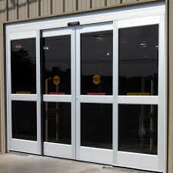
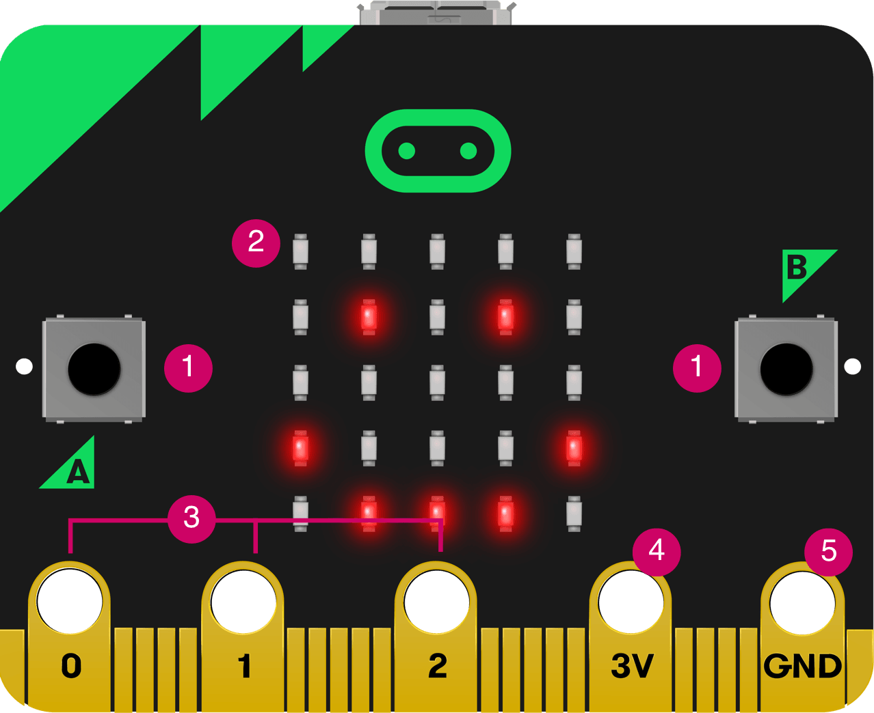
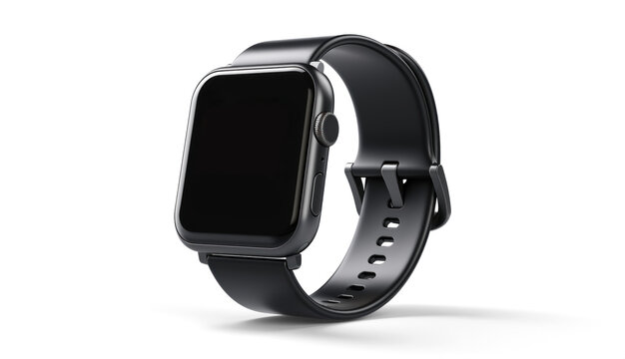
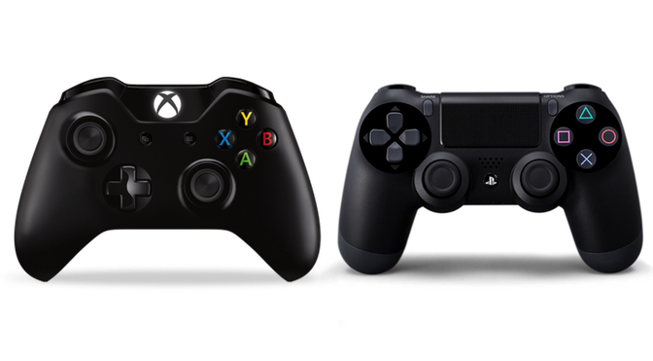
Physical Computing is Everywhere
Notes:
Ask the class: how are each of these a computing device? How do they interact physically? What are some other examples you can think of? What are the inputs and outputs of each?

Slide 8
Meet the Micro:bit
A Micro:bit is a tiny programmable computer
It can:
  show lights
  play sounds
  sense movement
  detect button presses
  run programs you create
Notes:
Emphasize the students that this is not a toy, it’s a real computer designed for beginners.

Slide 9
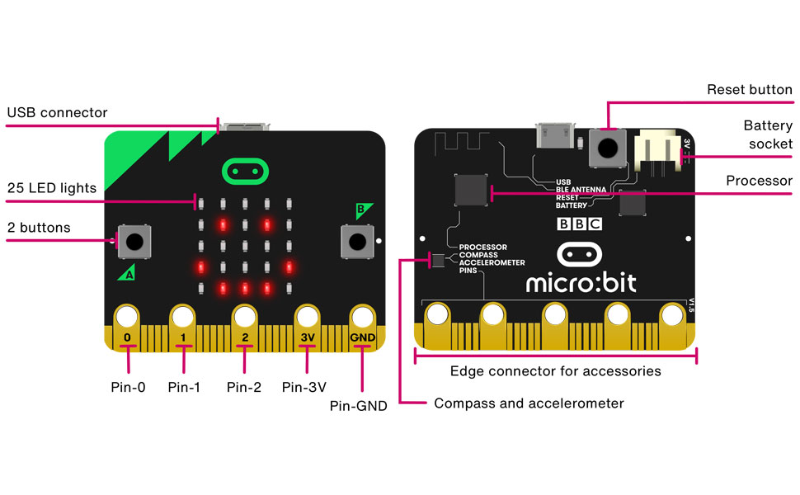
Parts of the Micro:bit

Slide 10
Activity
Now, let’s explore! Today we will:
Examine the Micro:bit
Identify its parts
Connect it to the computer
Begin coding!

Slide 11
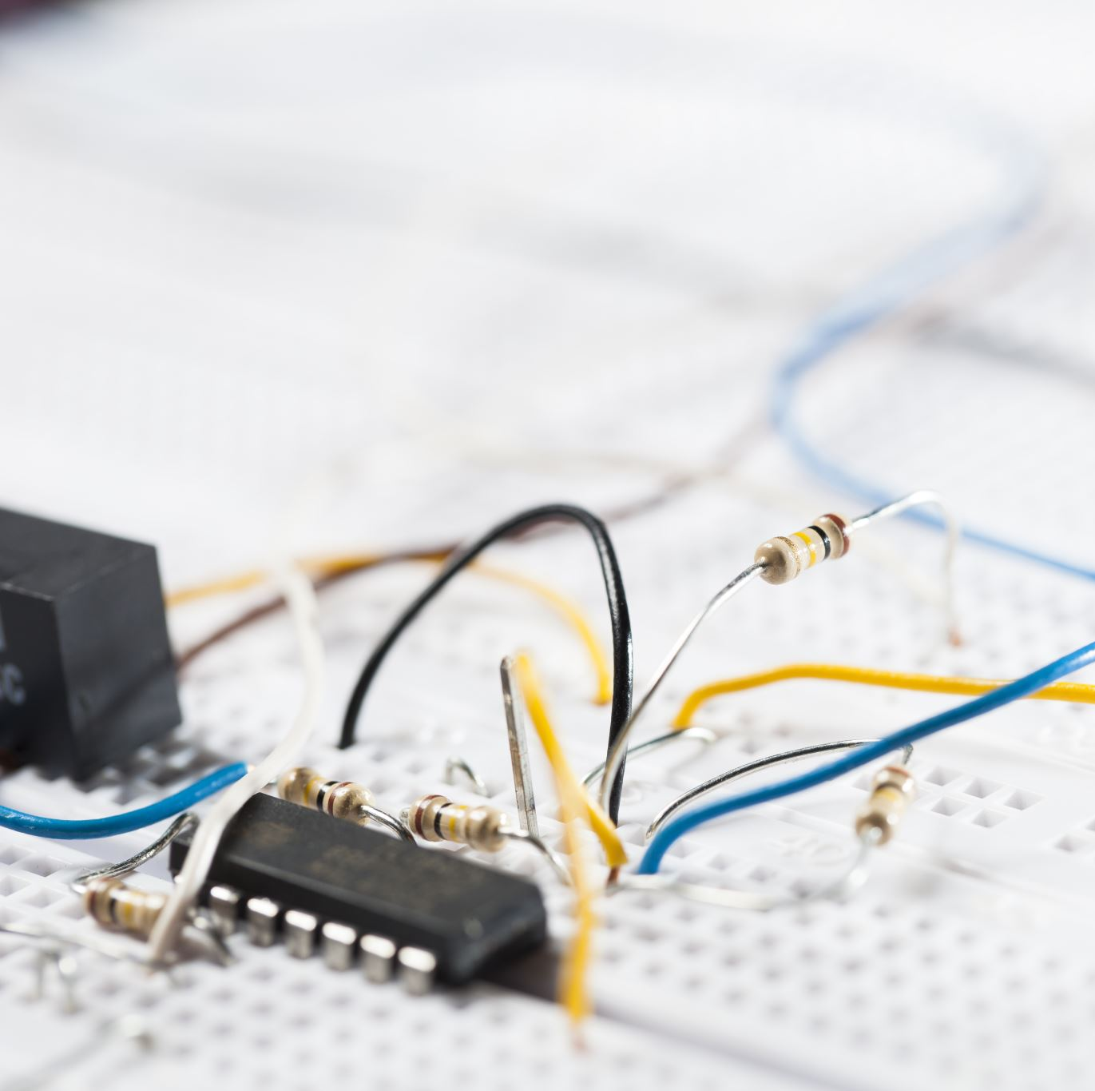
Wrap-Up
What are some inputs on the Micro:bit?
What are some outputs?

Slide 12
Class 2: Coding with Micro:bits

Slide 13
Warm-Up & Review
What happens if a computer program has incorrect instructions?
Notes:
This slide naturally introduces de bugging.
Possible discussion around: glitches, errors, freezing, wrong actions

Slide 14
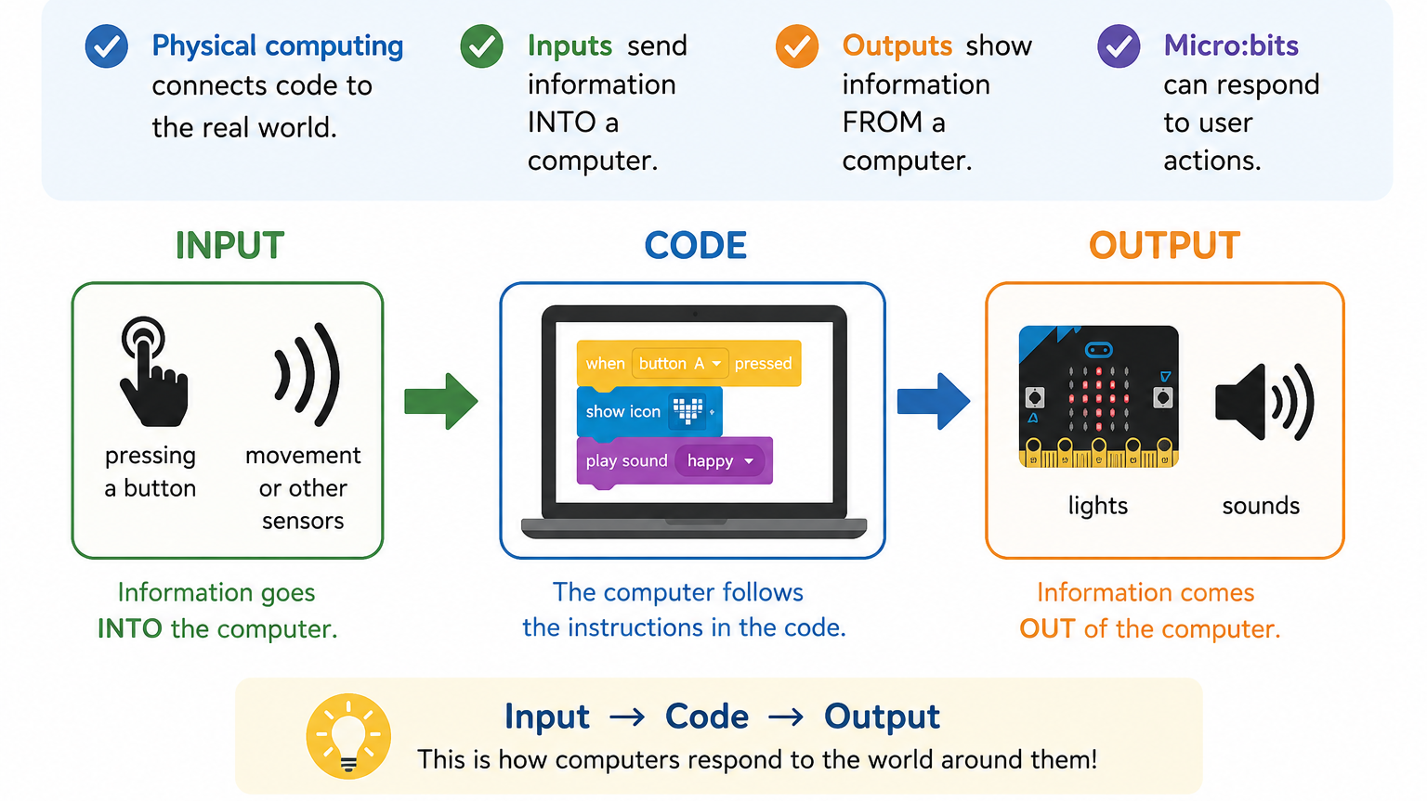

Slide 15
Coding & Debugging
Coding = Giving Instructions
Computers follow instructions exactly.
Programs tell the computer:
WHEN something happens
WHAT to do
HOW to respond
Debugging = Fixing Problems in Code
If your program does not work:
Check your connections
Reread instructions
Test one step at a time
Try again
Keep in mind: mistakes are a normal part of coding!

Slide 16
Today we will…
Test connecting the Micro:bit to Scratch
Build a simple interactive program
Test and improve our code
Choose a Project from These Options
Visit: makecode.microbit.org
Step Counter
Roll a Die
Rock, Paper, Scissors
Coin Toss
Notes:
Students may work independently or with a partner.

Slide 17
Let’s get started!

Slide 18
Wrap-Up Reflection
What did your program do?
What input triggered the action?
What output did the Micro:bit produce?
What problems did you solve while coding?

Slide 19
Class 3: Algorithms

Slide 20
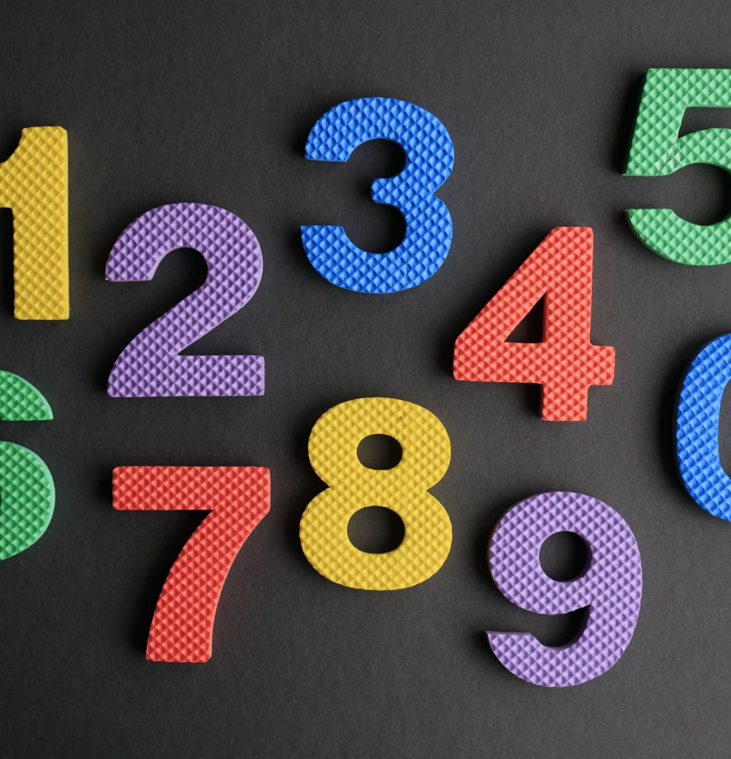
Mystery Algorithm
Rules:
  Begin with all students standing and holding the number 1 on a sticky note or white board.
  Find another person standing up.
  Add your two numbers together.
  Write this sum on one person’s note / board, and the other person should sit down.
  Repeat this until there is only one person left standing.
Notes:
This activity physically models an algorithm, removes computers initially, and helps students realize algorithms are not “magic”.

Slide 21

What Just Happened?
What does this number mean?
What problem did the algorithm solve?
What steps were repeated?
Was the process organized?
Notes:
Goal here is for students to begin recognizing: patterns, repetition, and logical sequencing.

Slide 22
Warm-Up
Can there be more than one correct way to solve a problem?

Slide 23
Accuracy vs. Efficiency
Accuracy
Does the algorithm give the correct answer?
Efficiency
How quickly or easily does the algorithm solve the problem?
Takeaway: not all algorithms are equal!
Notes:
Discuss with the class alternative counting methods (other ”algorithms”). The goal here is to introduce the idea that algorithms are different, and some are better than others.
Some examples include:
Counting one-by-one
Counting in pairs (what they just did)
Counting by rows or tables

Slide 24

Algorithm Design Challenge
Get into small groups (of 3-5). Each group will have one Micro:bit device
Using only your Micro:bit tools, design an algorithm to count the number of people in the room.
Your final total must display on the Micro:bit LED screen.

Slide 25
Class 4: Code & Create Project

Slide 26
Warm-Up
What makes technology fun, useful, or interesting to use?
Notes:
Examples:
games
music apps
fitness trackers
smart devices
interactive toys
Teacher note:
Encourage multiple answers.
There is no single “correct” response.

Slide 27
Code & Create Project!
Today you will start to design your own Micro:bit project.
Your project may:
  Solve a problem
  Entertain users
  Display information
  React to inputs
  Use lights, sounds, or buttons
Requirements:
  Must use the Micro:bit
  Must function without being connected to the computer
  Must be tested and revised
  Must include a completed worksheet reflection

Slide 28
The Design Process
Good Designers…
Plan
Build
Test
Revise
Improve
Remember:
Your first version does NOT need to be perfect.
Mistakes and revisions are part of the design process!

Slide 29
Want Some Inspiration?
You could create:
  A game
  A reaction timer
  A step counter
  A digital pet
  A sound machine
  A mini animation
  A quiz game
  A mood display
  A random number generator

Slide 30
Let’s get started!

Slide 31
Wrap-Up
What does your project do?
What inputs and outputs does it use?
What challenges have you faced?
What improvements are you still making?

Slide 32
Final Class: Finish and Showcase your Projects!

Slide 33
Warm-Up
What is one thing you learned about problem solving during this unit?

Slide 34
Continue Working On Your Project

Slide 35
Showcase Your Work!
As you view other projects, think about:
  What problem does this solve?
  What makes this project creative?
  How does the Micro:bit respond to inputs?
  What would you improve or expand?

Slide 36
Unit Wrap-Up
What was your biggest challenge?
What project or activity did you enjoy most?
How did your ideas improve through testing and revision?
How does coding connect to real-world technology?

