Slide 1
The Elements of
Computational Thinking
CSE Content and Pedagogical Learning

Slide 2
Supplies
Labels for name and group number
Print Mad Gibs Sheets
Print Mad Mines sheet on cardstock
  Have Folders for Dividers
  Pencil and paper for drawing
Print Board Games
  Pencil and Paper to write
Print Cryptograms Sheets

Slide 3
Computational Thinking
Decomposition: Breaking down data, processes, or problems into smaller, manageable parts
Pattern Recognition: Observing patterns, trends, and regularities in data
Abstraction: Identifying the general principles that generate these patterns
Algorithm Design: Developing the step-by-step instructions for solving this and similar problems

Slide 4
Abstraction
Breaking down data, processes, or problems into smaller, manageable parts
Example: Recipe For Making A Pizza!
Activity: Mad Gibs
Notes:
Example: Recipe for making Pizza
Activity: Mad Gibs
NOTE: Use a template similar to (maybe shorter) https://code.org/curriculum/course4/5/Activity5-MadGlibs.pdf with TWO stories with blanks.
This template requires you to ADD DETAILS
NOW, give them a worksheet like https://code.org/curriculum/course4/5/Assessment5-MadGlibs.pdf
This template has you REMOVING details.
So, if I said, what did you have for waffles this morning? Or what did you have for toast yesterday? It’s hard for you to understand. I am giving you ONE detail…What did you have for breakfast? ABSTRACTION…each of us can view this with our own details.

Slide 5
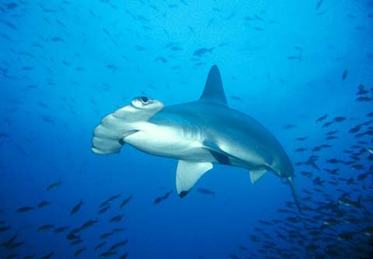

Abstraction: A Visual Example
479 x 332 = 159,028 pixels
Each pixel: RGB (Red Green Blue) components
  RGB, 255 values each, 8 bits each (1 byte) = 24 bits (3 bytes)
    Looks like 11001100 00000000 01100110 = 24 bits (3 bytes)
    OH MY!! 479 X 332 X 24 = 3,816,672 bits
How many bits in a one-hour video with each frame at 640 x 480, 24bits/pixel, 25 fps (frames per second)
  Do the math, how many bits/bytes?
  = 640 X 480 X 24 X 25 X 3600 WHAT!!!!! (82.8 GB)
Computers use abstracting to create meaning out of data stored in bits by displaying them as text, pictures, colors, etc.

Slide 6
Decomposition
Breaking down data, processes, or problems into smaller, manageable parts
Examples: Recipe for making a pizza!
Activity: Secret Board Game
Notes:
Example: Recipe for making Pizza
Activity: Mad Gibs
NOTE: Use a template similar to (maybe shorter) https://code.org/curriculum/course4/5/Activity5-MadGlibs.pdf with TWO stories with blanks.
This template requires you to ADD DETAILS
NOW, give them a worksheet like https://code.org/curriculum/course4/5/Assessment5-MadGlibs.pdf
This template has you REMOVING details.
So, if I said, what did you have for waffles this morning? Or what did you have for toast yesterday? It’s hard for you to understand. I am giving you ONE detail…What did you have for breakfast? ABSTRACTION…each of us can view this with our own details.

Slide 7
Algorithms: Classroom Activities
FOLLOW THE STEPS of this algorithm:
  Stand up.
  Assign yourself the number 1.
  While more than one person standing:
  Find someone else standing.
  Add your number with your partner's number.
  One person remembers the sum and remains standing; the other person sits.
  Repeat steps 4, 6
What task does this algorithm describe?
Another algorithm?
  With your shoulder partner think of at least one other algorithm that accomplishes the same thing.
  SHARING……
Which algorithm is more efficient, pair-up or count-off? Why?
THINK-PAIR SHARE
SHARE OUT

Slide 8
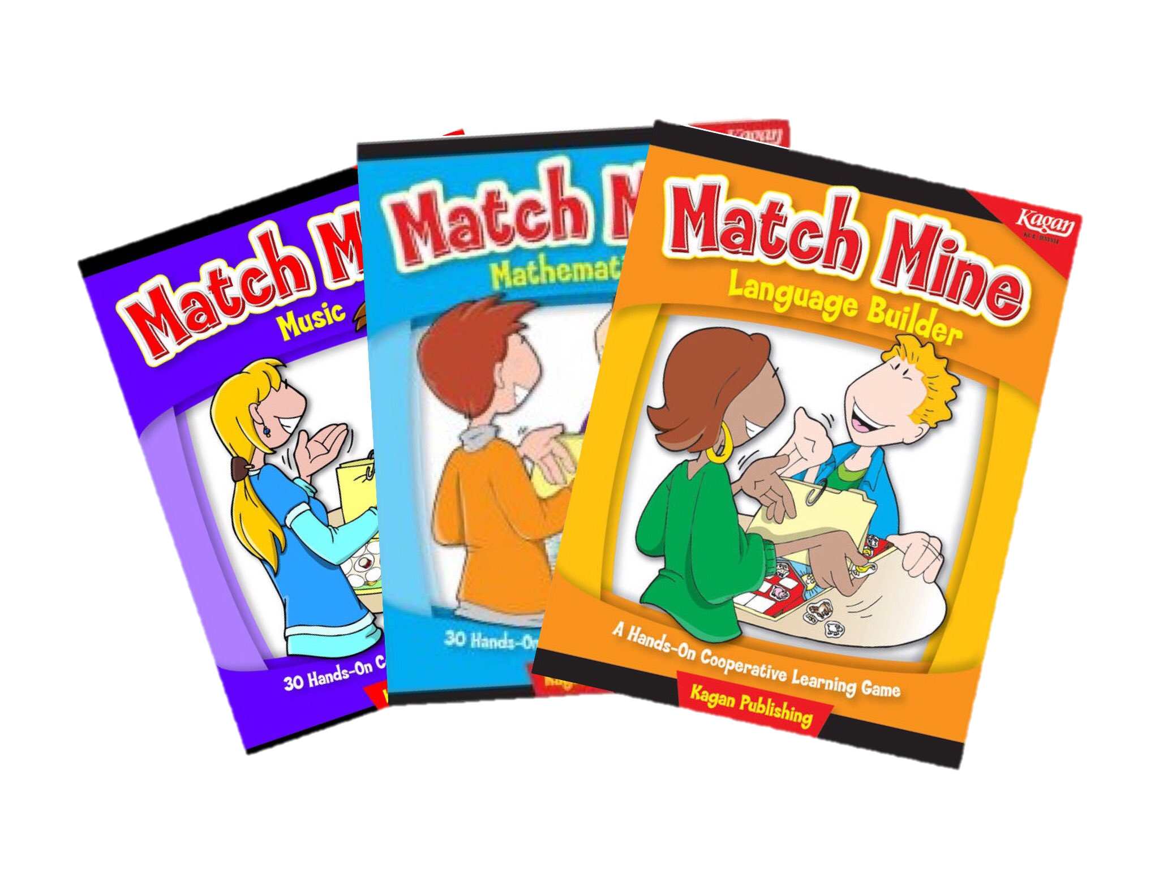
Algorithms
Developing the step-by-step instructions for solving similar problems
Activity: Match Mine
One person gives instructions to draw a figure that is provided on an index card.
No questions during activity.
The directions should only describe geometric instructions (no body parts or hints to what figure might be).
The person giving directions should NOT use their hands!
The person giving the directions cannot see how the drawings are progressing.
There should be a barrier between giver and receiver.
Notes:
Example: Recipe for making Pizza
Activity: Mad Gibs
NOTE: Use a template similar to (maybe shorter) https://code.org/curriculum/course4/5/Activity5-MadGlibs.pdf with TWO stories with blanks.
This template requires you to ADD DETAILS
NOW, give them a worksheet like https://code.org/curriculum/course4/5/Assessment5-MadGlibs.pdf
This template has you REMOVING details.
So, if I said, what did you have for waffles this morning? Or what did you have for toast yesterday? It’s hard for you to understand. I am giving you ONE detail…What did you have for breakfast? ABSTRACTION…each of us can view this with our own details.

Slide 9
Pattern Matching
Observing patterns, trends, and regularities in data
Examples: Watching Netflix
Activity: Cryptograms
Notes:
Example: Recipe for making Pizza
Activity: Mad Gibs
NOTE: Use a template similar to (maybe shorter) https://code.org/curriculum/course4/5/Activity5-MadGlibs.pdf with TWO stories with blanks.
This template requires you to ADD DETAILS
NOW, give them a worksheet like https://code.org/curriculum/course4/5/Assessment5-MadGlibs.pdf
This template has you REMOVING details.
So, if I said, what did you have for waffles this morning? Or what did you have for toast yesterday? It’s hard for you to understand. I am giving you ONE detail…What did you have for breakfast? ABSTRACTION…each of us can view this with our own details.

Slide 10
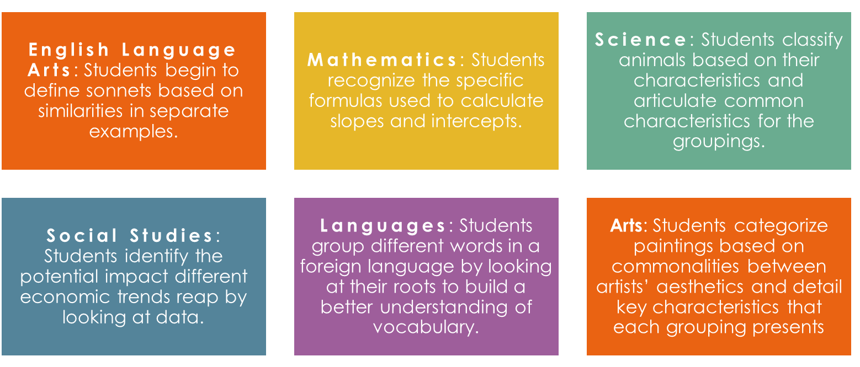
Pattern Matching
Pattern Matching can be seen in multiple subject areas

