Slide 1
Cooperative Learning
Pedagogical Strategies from Kagan

Slide 2
Supplies
Create groups for Round Robin
Labels to number for Jigsaw

Slide 3

Cooperative Learning
We will include many Cooperative Learning Activities that focus on PIES.
  Positive Interdependence: Positive correlation of activity to outcome/work of everyone in group contributes to the outcome.
  Individual Accountability: contribution is required and done individually.
  Equal participation: All have equal time to respond, and each is required to respond.
  Simultaneous Interaction: All students involved and active.

Slide 4
The Round Robin
Kagan Cooperative Learning Structures ensure equal participation. All voices are heard, and all students participate actively! Assign each person in your group a number (1, 2, 3, and 4).
Everyone quietly thinks about their answer
Using their assigned numbers, each group member shares their thoughts for 40 seconds. During this time, they are the only person communicating (verbal or otherwise)!
We will let you know when it’s time to rotate!
After each person has spoken, the group has a collective debrief discussion.

Slide 5


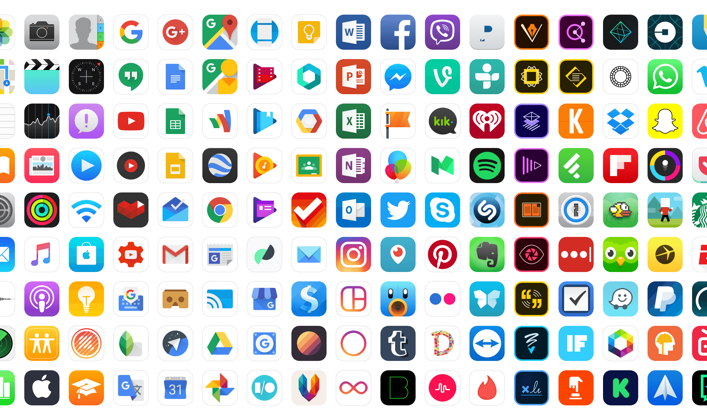
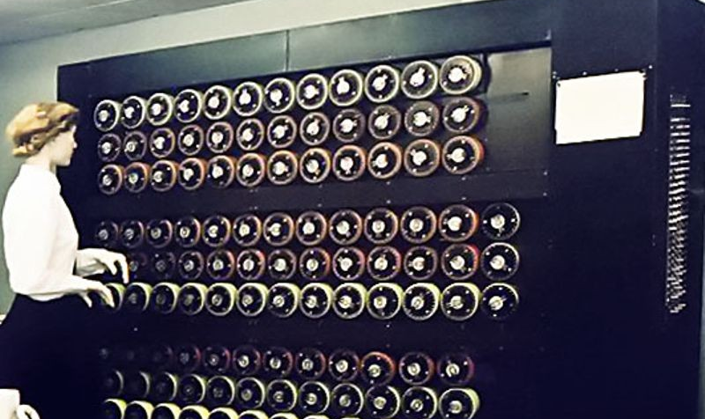


Computing Innovations
A computing innovation is an innovation that includes a computer or program code as an integral part of its functionality.
Accessibility, Availability
Impacts, Reach
Implications
Applications
Pros, Cons
Vulnerabilities

Slide 6
Computing Innovations
Round Robin
Think about your subject area (in general).
What Computing Innovation has affected this area (and your instruction of it) the most?
Remember: Think about positive effects and negative effects!
Group Discussion: Collectively come up with the most significant innovation mentioned in the RR with its positive and negative effects.
Notes:
WHAT IS A computing innovation? Note: has a computer or comping software.
Maybe ask what CI they discussed in June…THEN talk about positive and negative effects.
All have POSITIVE effects AND NEGATIVE effects.
Example: Electric cars
Positive: Energy efficient, reduce emissions;
Negative: Not so environmentally friendly as they seem:
Notes: Electric cars rely on electricity from power plants which still use fossil fuel. Battery consumption/recycling is not environmentally friendly, Tires wear out faster die to car weight(recycling not environmentally friendly); Lithium battery fires cause release of toxic gasses – if car in accident and catches fire.
Important for you (and students) to think about NEGATIVE EFFECTS OF COMPUTING INNOVATIONS as well as POSITIVE EFFECTS.
Negative effects should focus on THE INNOVATION, not how people USE the innovation. Assume the innovation is used as it is intended to be used: Powerful electric cars have FAST acceleration and the misjudgment of unexpected accelerations is the main cause of accidents with electric cars.

Slide 7
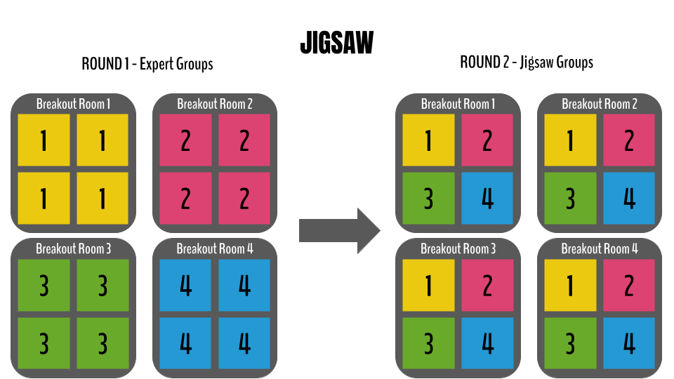
Notes:
All #1s in a group, all #2s in a group, etc. CONTROL THE TIME HERE!
RR: Share out with new group.
GROUP DISCUSSION: Note what is similar and what is different.
Share out with class.

Slide 8

What is the most significant outcome of this activity?
Collaborative debrief
Notes:
Debrief: What is the most significant outcome of this activity? (for you?for your students?)
Note: Listening skills, realization that just because technology gives us conveniences doesn’t mean everything is super good. THERE ARE HARMFUL effects that we subconsciously ignore.

