Slide 1
Extending the CS Pipeline: Enhancing Rigor and Relevance in Middle School CS
School Recruitment Resource Packet
Suggested citation:
Center for Effective School Practices (2024). School Recruitment Resource Packet. Rutgers University. https://www.rutgerseir.com/post/school-recruitment-resource-packet
Education and Innovation Research (EIR) Grant Award
United States Department of Education
January 2021 – June 2026
USDOE EIR Award # S411C200084

Slide 2
Introduction to Extending the CS Pipeline Project
Primary Goals
Approach
To build the capacity of middle school teams to effectively develop, implement, and strengthen high-quality and inclusive computer science education.
Team of experienced CS faculty members and researchers from Rutgers work side-by-side with MS educators to improve their CS offerings.
Personalized technical assistance plans are designed to address local school needs.
EIR Extending the CS Pipeline Project Abstract

Slide 3
Recruitment Goals
Raise awareness about the project
Encourage schools’ participation in the project
Highlight the benefits of participation
Create an opening for productive conversations around the opportunities and challenges within middle school computer science
Share information about available incentives for teachers’ participation

Slide 4
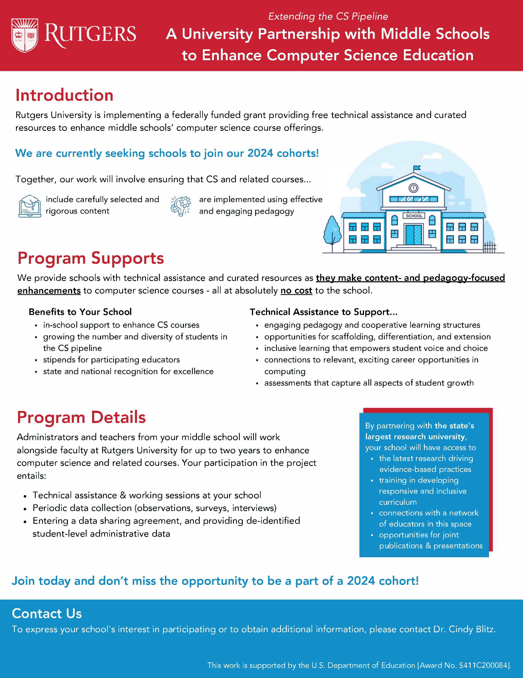
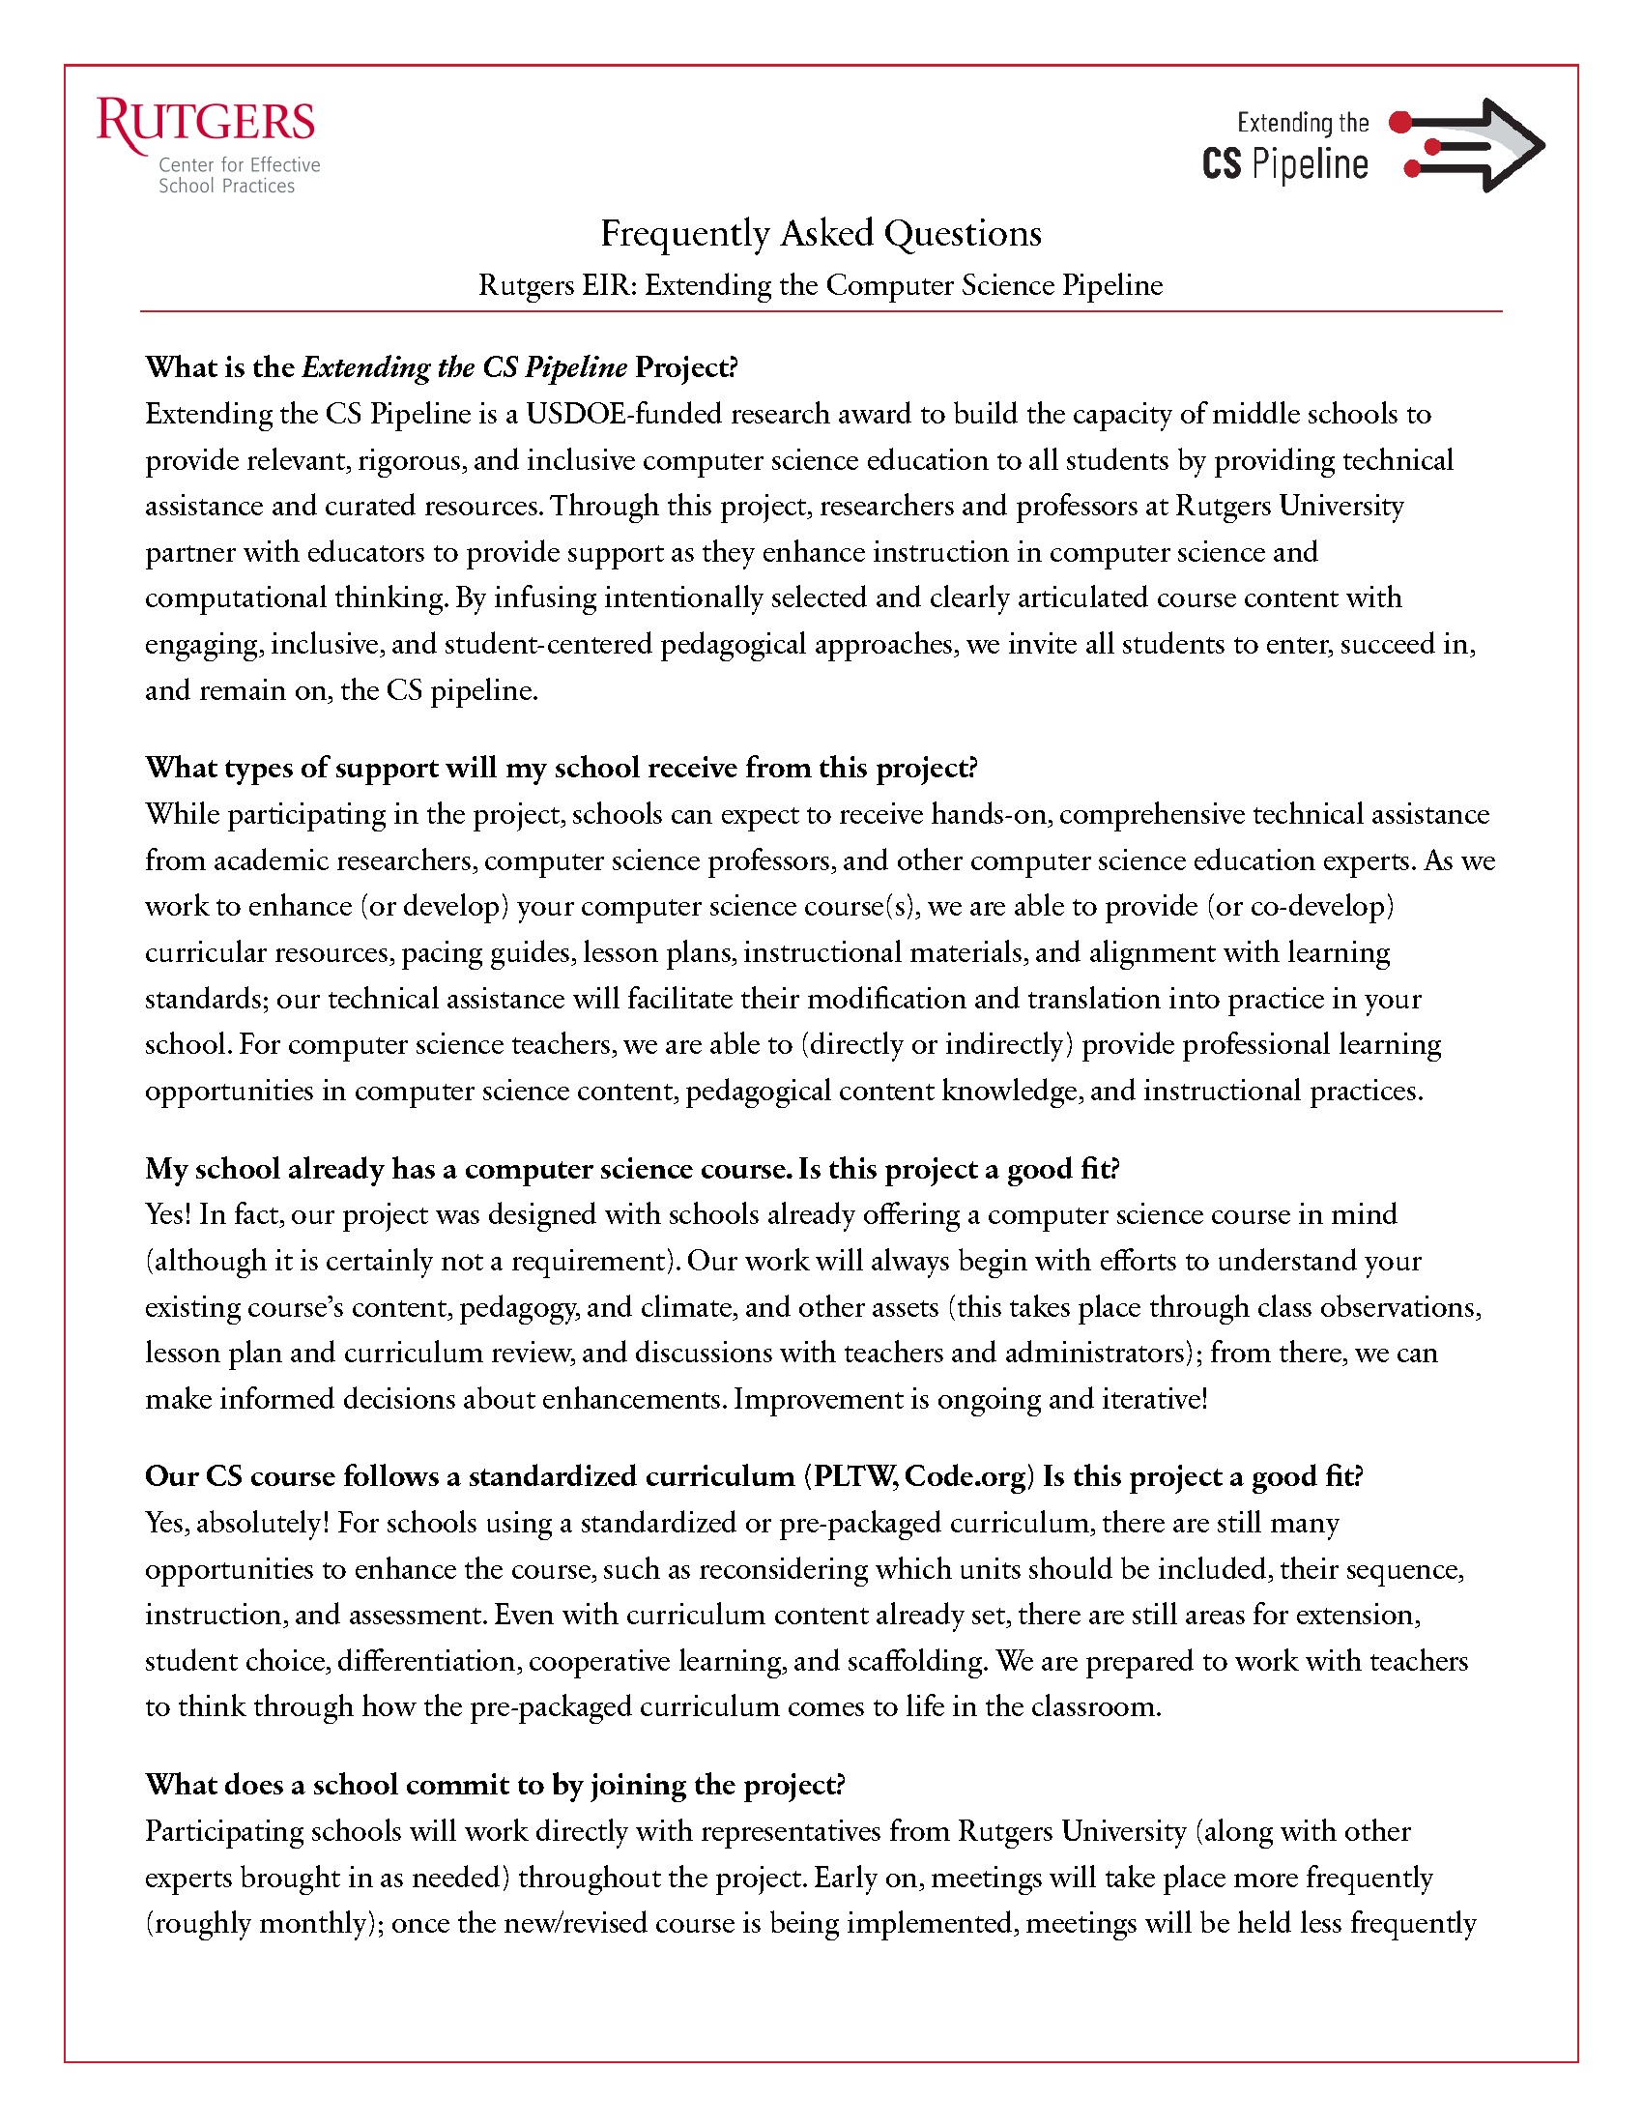
1. Recruitment Materials
First, we created a recruitment packet of materials to generate the opportunity for conversation and generate a first impression among potential participants. The packet included the following:
Introductory email
Direct mail: Recruitment letter, program flyer, center brief.
FAQs (added to direct mail in subsequent mailings)

Slide 5
2. Recruitment Process
Identify middle schools that meet recruitment criteria
Target key decisionmakers at districts and middle schools
Send out initial emails and recruitment packets
Follow-up telephone calls to decisionmakers
Follow-up meetings (via Zoom or in person)
with decisionmakers and key stakeholders

Slide 6
Recruitment Materials

Slide 7
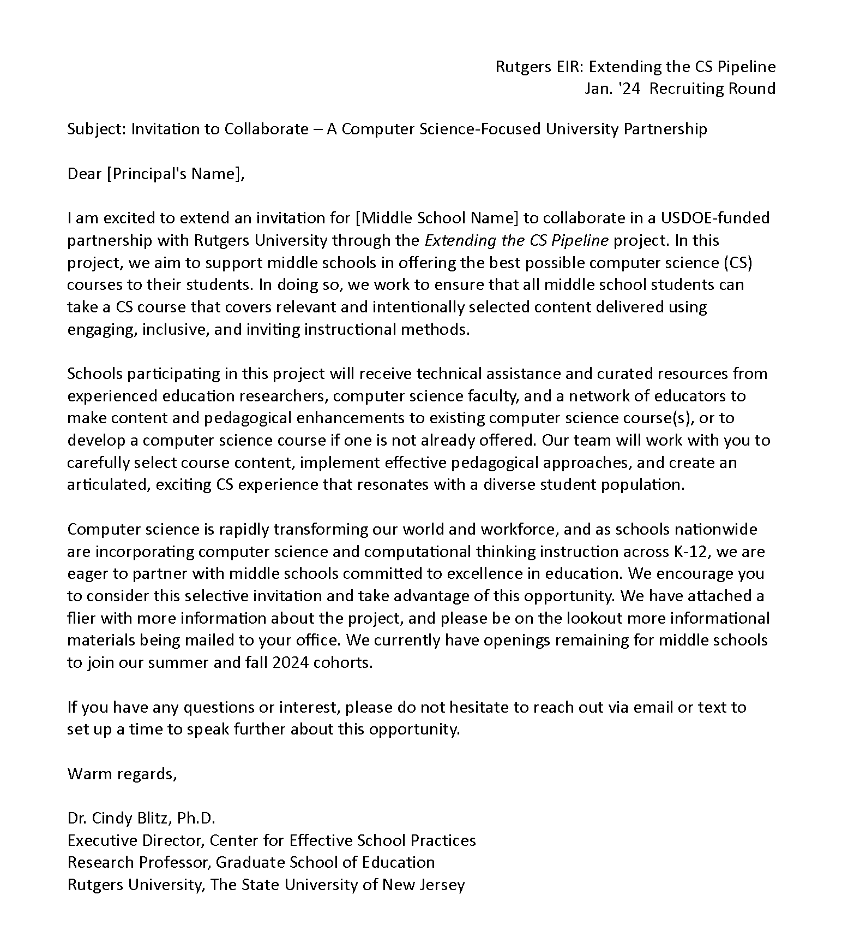

1a. Recruitment Materials: Initial Email
Our approach followed generally accepted principles of research recruitment, such as personalized messages, highlighting incentives being offered to participants, and emphasizing the potential positive impacts of the project (Manohar et al., 2018)¹.
Superintendents and principals (plus additional school and district staff such as curriculum directors and teachers) all received introductory email.
Double click on the icon for full size document.
¹ Manohar, N., MacMillan, F., Z. Steiner, G., Arora, A. (2018). Recruitment of Research Participants. In: Liamputtong, P. (eds) Handbook of Research Methods in Health Social Sciences. Springer, Singapore. https://doi.org/10.1007/978-981-10-2779-6_75-1

Slide 8
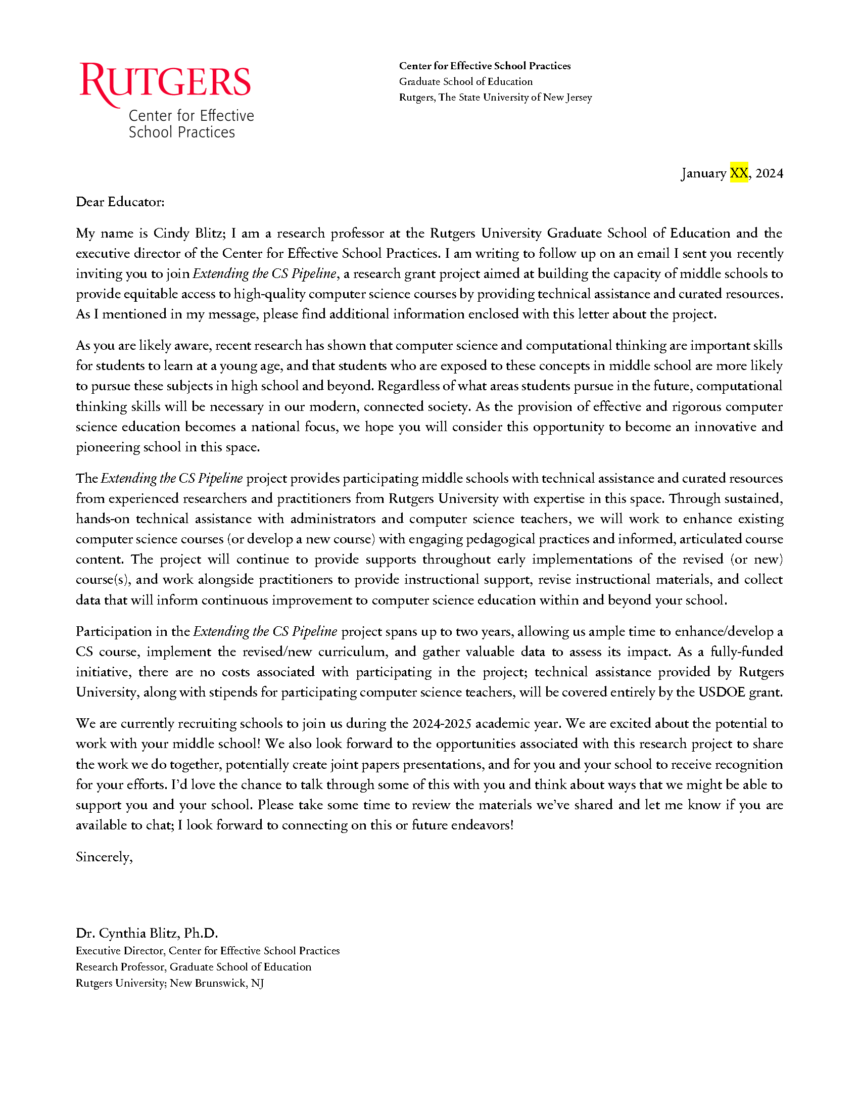
1b. Recruitment Materials: Cover Letter
Decision makers and key stakeholders received direct mail one week later.
To make the direct mail packet stand out, materials were mailed in a red, Rutgers branded envelope. This also helped to show that the mailing was not marketing or from a vendor.
Double click on the icon for full size document.

Slide 9
1c. Recruitment Materials: Program Flyer
Earlier versions of the program flyer contained a great deal of information about the project.
We moved information from the program flyer into the FAQs document to avoid overloading the program flyer.
By giving the program flyer more white space, key details are better able to stand out.
Double click on the icon for full size document.

Slide 10
1d. Recruitment Materials: FAQs
The question-and-answer format of the FAQs document was an additional way for schools to gauge the fit of the project with their needs.
Double click on the icon for full size document.

Slide 11
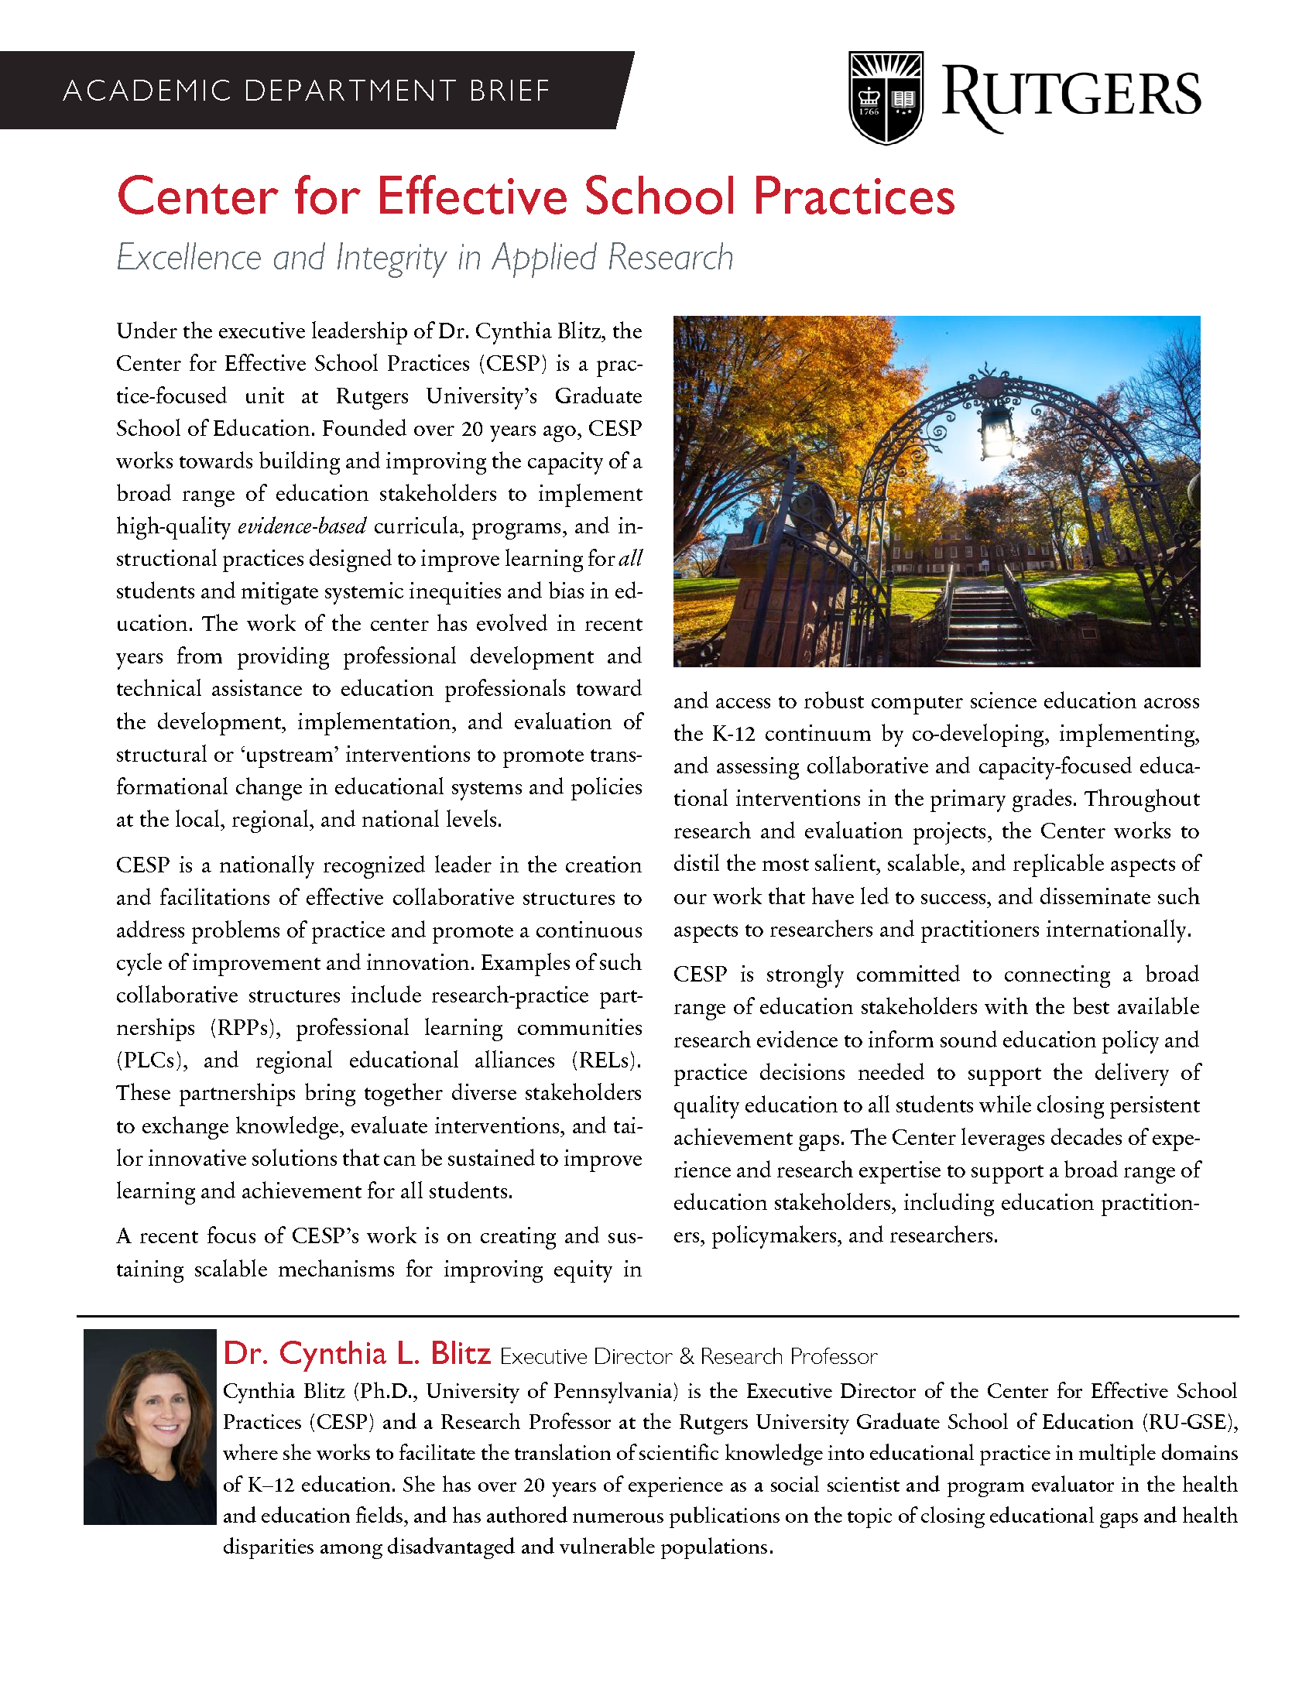
1e. Recruitment Materials: CESP Brief
We added this brief about the Center for Effective School Practices (CESP) to emphasize the legitimacy of the project.
The brief tells reader who we are and provides information about our past work in similar areas.
The brief is also a way of showing schools that we are not vendors who are trying to sell them something.
Double click on the icon for full size document.

Slide 12
Recruitment Process

Slide 13
2a. Recruitment Process: Recruitment criteria
Middle school in New Jersey enrolling at least 600 students in grades 6-8
40% or more of the student population eligible for free or reduced-price lunch, and/or 40% or more of the student population are members of underrepresented minorities (Black and Latinx).
Agreement by a diverse set of instructional stakeholders at the school and district to participate in Rutgers-led technical assistance activities.
Agreement to participate in project evaluation activities:
  Teacher and administrator online surveys and interviews
  Provision of multiple years of administrative data (student-level course enrollments, demographics, and course grades)
  Provision of detailed course descriptions and syllabi

Slide 14
2b. Recruitment Process: Target key decisionmakers and send out emails and packets
We cast a wide net within each district to promote awareness of the project across multiple stakeholders:
  District Superintendents
  Middle School Principals
  Supervisors of Curriculum and Instruction
  STEM Supervisors
  CSE Teachers
  Lead Teachers
  Department Chairs
Initial contact was via email.
A hard copy of the recruitment packet was sent a week later (postal mail).
Phone calls to stakeholders were placed by the Principal Investigator two weeks after the mailing of the packet.

Slide 15
2c. Recruitment Process: Follow-up calls and meetings (Zoom and in-person)
Listening to the schools that responded to the initial emails or recruitment packet mailers was critical to our recruitment process.
These discussions were important opportunities for our team to learn about middle schools’ CSE programs, their available resources, and the challenges they faced.
Conversations helped schools and the project team assess the fit of the project with the school’s needs as well as with the grant’s requirements.

Slide 16
2d. Recruitment Process: After the meetings
Meetings were followed up with:
  A summary of the meeting
  Any additional information that may have been requested by the school
As part of the iterative recruitment process, we adjusted the information in our recruitment materials and our recruitment strategies in response to what we learned from educators:
  Simplified the program flyer
  Created an FAQs document
  Expanded the list of recipients of the recruitment packet

