Slide 1
DATA
Part 2
Fran Trees (fran.trees@cs.Rutgers.edu )

Slide 2
DATA
TOPICS (included in CSP curriculum-BI#2)
2.1 Binary Numbers
2.2 Compression
2.3 Extracting Information from data
  Tell a story
  Answer (or formulate) questions about data
2.4 Using PROGRAMS with data
  Use spreadsheet (Excel) tools or write programs to manipulate (or view) data.

Slide 3
Today’s Plan
This is Computer Science!
Bits and Binary Numbers
  Number conversions (Binary and Hexadecimal)
  Bits and File sizes
Data Compression

Slide 4
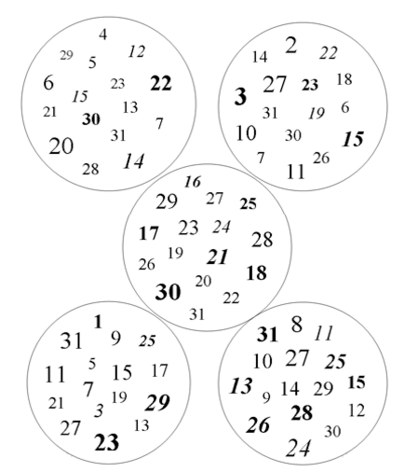
Mental Break
Guessing Game
Notes:
Number Guessing Game….what’s the trick? Thinking of a number between 1 and 31.
http://apcentral.collegeboard.com/apc/members/courses/teachers_corner/45338.html
SUPPOSE you chose the number 19. I would ask…Answers would be NO-YES-YES-YES-NO.
How did I do that?
SUPPOSE YOU CHOSE THE NUMBER 9 answers: NO NO NO YES YES

Slide 5
It's all bits…and BINARY
Khan Academy: https://bit.ly/APSI-Binary
  Intro to number systems (10 minutes) – VERY BASIC
  Converting Decimal to Binary (3 minutes) - BASIC
  Converting larger numbers to binary - BASIC
  Adding and multiplying in binary – OPTIONAL!!!
Blown to Bits: http://www.bitsbook.com/excerpts/
  Read chapters 1 - 5, Appendix (Internet)
Binary Numbers Unplugged Activity: https://classic.csunplugged.org/binary-numbers/
Notes:
Counting on hands
Counting with cards

Slide 6
Number systems
123 Base 10 uses 10 digits (0,1,2,3,4,5,6,7,8,9)
10,000 1,000 100 10 1
10⁴ 10³ 10² 10¹ 10⁰
1 2 3 = (1 x 100) + (2 x 10) + (3 x 1)

Slide 7
Number systems
Base 2 uses 2 digits (0 and 1)
128 64 32 16 8 4 2 1
2⁷ 2⁶ 2⁵ 2⁴ 2³ 2² 2¹ 2⁰
1 0 1 1 0 1
^{Equivalent to base 10}
(1 x 32) + (1 x 8) + (1 x 4) + (1 x 1) = 45 (base 10)

Slide 8
Number systems
Base 2
Convert 95 From base 10 to base 2 (method 1).
128 64 32 16 8 4 2 1
1 0 1 1 1 1 1
^{Equivalent to base 10}
(1 x 64) + (1 x 16) + (1 x 8) + (1 x 4) + (1 x 2) +(1 x 1) = 95 (base 10)
95 – 64 = 31
31 – 16 = 15
15 – 8 = 7
7 – 4 = 3
3 – 2 = 1

Slide 9
Convert decimal to binary
Here is another method for converting the decimal number 95 to a binary number (base 2). Keep executing the pattern until the quotient is 0. Read the binary number equivalent from bottom to top.
95 / 2 = 47 remainder 1
47 / 2 = 23 remainder 1
23 / 2 = 11 remainder 1
11 / 2 = 5 remainder 1
5 / 2 = 2 remainder 1
2 / 2 = 1 remainder 0
1 / 2 = 0 remainder 1
95 base 10 is equivalent to 1011111
A good programming problem!

Slide 10
Convert decimal to binary
public static String convertIteratively (int n){
  String s = "";
  while (n > 0){
  int remainder = n%2;
  s = remainder + s;
  n = n/2;
  }
  return s;
}

Slide 11
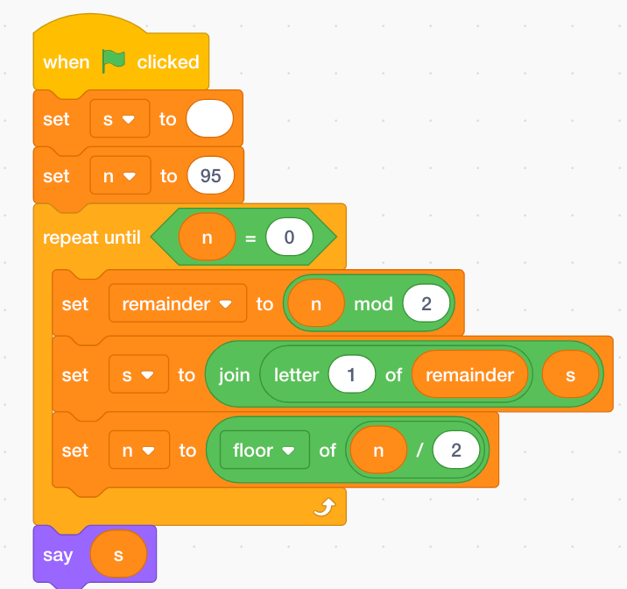
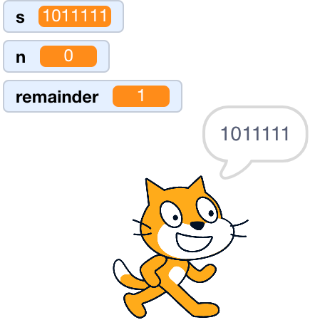
Convert decimal to binary

Slide 12
Convert decimal to binary
Here is the method for converting and printing the decimal number 95 to a binary number (base 2).
95 / 2 = 47 remainder 1
47 / 2 = 23 remainder 1
23 / 2 = 11 remainder 1
11 / 2 = 5 remainder 1
5 / 2 = 2 remainder 1
2 / 2 = 1 remainder 0
1 / 2 = 0 remainder 1
Now, let's look at this same problem recursively.
First, know how to take one step: A step seems to be "Divide by 2; Note the quotient and the remainder"
Second, break each problem down into one step plus a smaller problem:
The quotient is smaller than the original number.
The above process is now done with the quotient.
Therefore I have a smaller problem.
Know how and when to stop: Stop when the quotient is 0.
Actually, the recursion stops when the quotient <= 0. Print out the remainders when I finally have a quotient of 0.
The last remainder must be written first.

Slide 13
Convert decimal to binary
public static String convert(int N){
if (N <= 0 ) return "";
return convert(N/2) + (N % 2);
}
}

Slide 14
Number systems
Base 16 uses 16 digits (0,1,2,3,4,5,6,7,8,9,A,B,C,D,E,F)
4096 256 16 1
16³ 16² 16¹ 16⁰
1 A
^{Equivalent to base 10}
(1 x 16) + (10 x 1) = 26
1 A
0001 1010
11010
16 + 8 + 2
Hexadecimal numbering system is often used by programmers to simplify the binary numbering system. ... This means that one hexadecimal digit is equivalent to four binary digits. Computers use binary numbering system while humans use hexadecimal numbering system to shorten binary and make it easier to understand. (4 bits often called a nibble!)

Slide 15
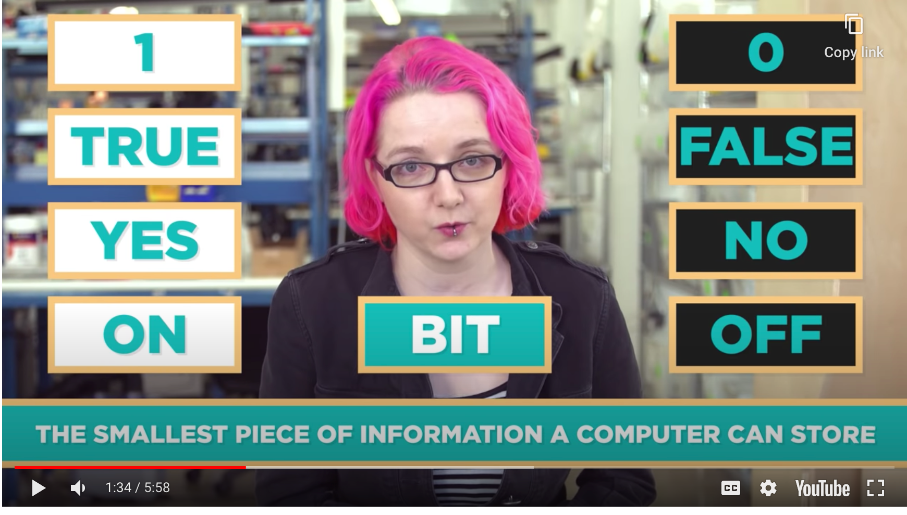
Why study binary?
How computers work: Bits and data
  Code.org videos: https://www.youtube.com/watch?v=ewokFOSxabs 6 minutes

Slide 16
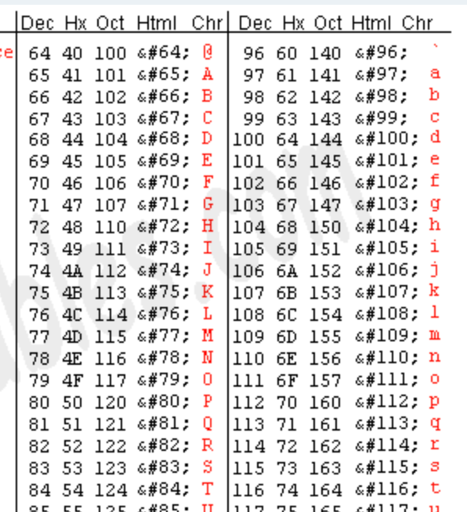
Text in binary
http://www.asciitable.com/
Notes:
http://www.asciitable.com/

Slide 17

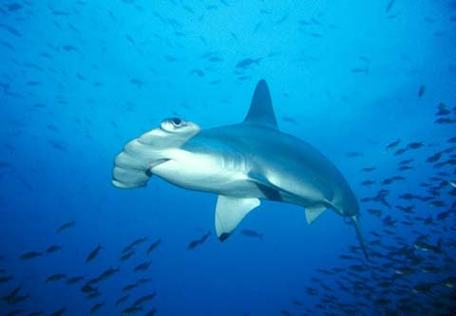
Why do photos take so much room???
Notes:
I use this example in class with participation…students realize WHY videos take up so much room.
A video can have a duration (T) of 1 hour (3600sec), a frame size of 640x480 at a color depth of 24bits and a frame rate of 25fps.
pixels per frame = 640 * 480 = 307,200
bits per frame = 307,200 * 24 = 7,372,800 = 7.37Mbits
bit rate (BR) = 7.37 * 25 = 184.25Mbits/sec
video size (VS) = 184Mbits/sec * 3600sec = 662,400Mbits = 82,800Mbytes = 82.8Gbytes

Slide 18
How many bits?
479 x 332 = 159,028 pixels
  RGB, 255 values each, 8 bits, 24 bits
  3,816,672 Bits (no alpha channel value)
How many bits in a one-hour video with each frame at 640 x 480, 24 bits/pixel, 25 fps (frames per second)
  Do the math, how many bits/bytes?
Notes:
Alpha channel represents degree of transparency.
I use this example in class with participation…students realize WHY videos take up so much room.
A video can have a duration (T) of 1 hour (3600sec), a frame size of 640x480 at a color depth of 24bits and a frame rate of 25fps.
pixels per frame = 640 * 480 = 307,200
bits per frame = 307,200 * 24 = 7,372,800 = 7.37Mbits
bit rate (BR) = 7.37 * 25 = 184.25Mbits/sec
video size (VS) = 184Mbits/sec * 3600sec = 662,400Mbits = 82,800Mbytes = 82.8Gbytes

Slide 19
Data Compression
Khan Academy: https://bit.ly/APSI-Compression
  Text Compression
  Simple Image Compression
  RLE
  Lossless File Compression
  Lossy Compression
  Lossy vs Lossless Compression
Computer Science Unplugged: https://classic.csunplugged.org/image-representation/
Notes:
Cool Activities….maybe give participants 3 minutes for each. Explain UNPLUGGED ACTIVITIES

Slide 20
Data Compression
Why do we need data compression?
What file types do you know of that are compressed?
Notes:
Talk about zip files or jpeg ormp4

Slide 21
Data Compression
Lossless compression algorithms reduce the size of files without losing any information in the file, which means that we can reconstruct the original data from the compressed file.
Lossy compression algorithms reduce the size of files by discarding the less important information in a file, which can significantly reduce file size but MAY also affect file quality.
  Khan academy
Notes:
Talk about zip files or jpeg ormp4

Slide 22

Lossless Image compression
Bitmap
0001100000110000 0011110001111000 0111111011111100 1111111111111110 1111111111111110 1111111111111110 1111111111111110 1111111111111110
RLE
3,2,5,2,4
2,4,3,4,3
1,6,1,6,2
0,17,1
…

Slide 23
Lossless Image compression-questions….
How can I represent
0011110001111000
as RLE?
Notes:
2,4,3,4,3. Start with white

Slide 24
Another version of RLE
RLE works by replacing repetitive sequences of identical data items with short tokens that represent entire sequences. Applying RLE to a string involves finding sequences in the string where the same character repeats. Replace each such sequence by a token consisting of:
  the number of characters in the sequence
  the repeating character
For example: aaaabbbbbbcddddd (16 bytes)
  4a 6b 1c 5d
  04 97 06 98 01 99 05 100 (8 bytes)
Will RLE always save space?
  What is the best case for RLE? Give an example.
  What is the worst case for RLE? Give an example.
What about a PROGRAMMING ASSIGNMENT????
Notes:
Text with few repetitions, ie more random text, will not compress well and can even result in negative compression – when the compressed version uses more storage space than the uncompressed version.
RLE-best all characters the same; aaaaaaaa (8 bytes). 8a 2 bytes
worst all characters different: abcdefgh (8 bytes). 1a 1b 1c 1d 1e 1f 1g 1h (16 bytes)
WE DON”T HAVE TO TREAT THIS AS A SEPARATE UNIT….WRITE AN RLE ALGORITHM. Give certain restrictions….a character never appears more than 9 times. (always a single digit). ENCODE and DECODE.

Slide 25
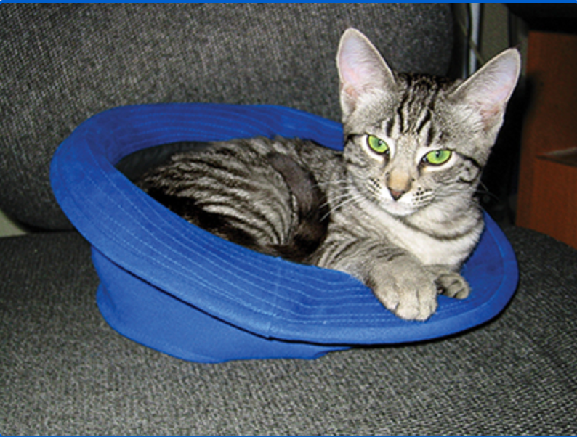

Lossy Compression
169 KB
12 KB
Notes:
When you email a photo via phone, sometimes asked about the size…When you open a photo and edit it…save as JPEG results in warnings.

Slide 26
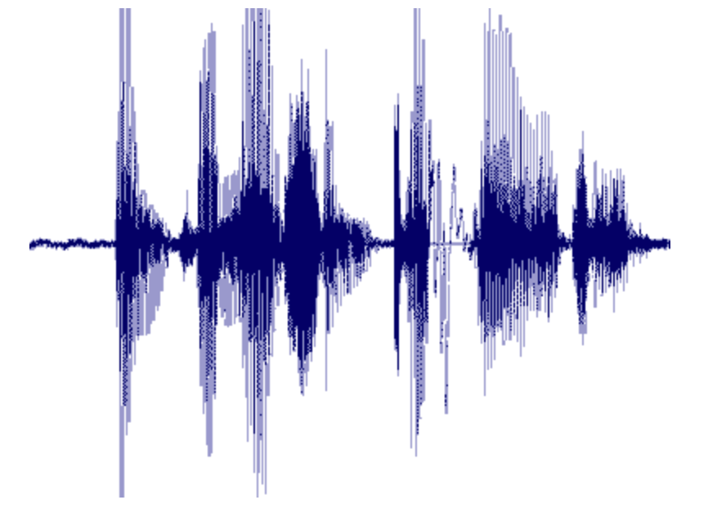
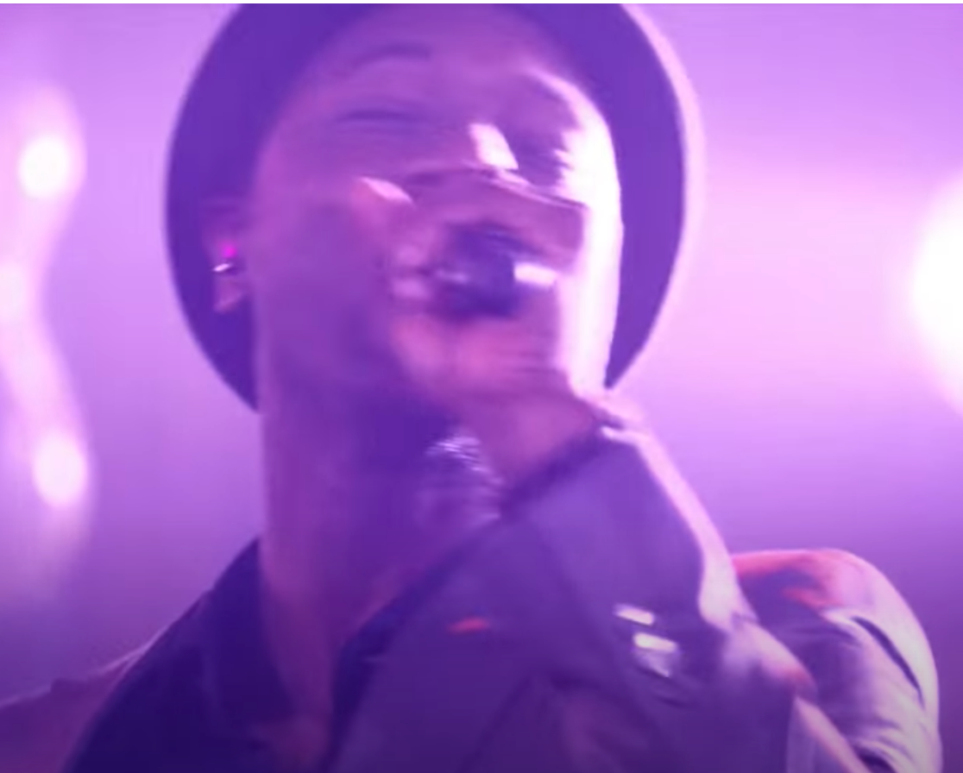
Digitizing sound
Sampling rate
Analog→digital
Can you hear the difference between an MP3 and a WAV file?
Notes:
A number represents how far the wave is above or below 0
Guidelines (Nyquist Rule)
Compression-Lossy MP3 about 1/10th the size of the original
https://www.youtube.com/watch?v=nLedFWpF9EA
Tones too high or too low for human ears to hear.

Slide 27
CHECKS: Practices and Quizzes
Quizzes: https://bit.ly/APSI-KhanCompression
  Bits and Bytes
  Binary Numbers
  Hexadecimal Numbers
  Limitations of storing numbers
  Storing text in Binary
  Converting analog data to binary
  Data Compression
    Lossless and lossy
  Digital Copyright and licenses
  UNIT TEST

Slide 28
Today’s Plan
This is Computer Science
Bits and Binary Numbers
  Number conversions (Binary and Hexadecimal)
  Bits and File sizes
Data Compression

Slide 29
Resources
  https://bit.ly/APSI-Binary
  http://www.bitsbook.com/excerpts/
  https://classic.csunplugged.org/binary-numbers/
  https://www.youtube.com/watch?v=ewokFOSxabs
  https://www.youtube.com/watch?v=By30SCp-Tsw
  http://www.asciitable.com/
  https://www.soundonsound.com/techniques/what-data-compression-does-your-music

Slide 30
THANKS MUCH!!!!

